Slide 1
Winter Planning Self-Audit Tool
Preparing Your SERVICE for the Winter

Slide 2
Contents Page
Overview
National Winter Plan
The Importance of Updating Capacity Tracker
RAG Rating of Staff and Service Users
Managing Outbreaks
  Covid-19
  Flu and Norovirus
  Infection Prevention and Control
Community Meals Provider
PPE
Travelling During the Winter
  Staff Travel
  Winter Car Essentials Checklist
  Residents Making Trips Outside The Care Home
  Gritting Routes
  Useful Resources for Travelling During the Winter
Business Continuity
  Building Maintenance
  Emergency Planning
  Food Supply
  Medicine Supply
  Staff Shortages
  Staff Health and Wellbeing
Useful Resources
  Resource Packs
  Useful Templates
  Building Maintenance Resources
  Food Supply Resources
  Pharmaceutical Supply Resources
  Workforce Resources
  Staff Mental Wellbeing Resources
  Staff Training
  Community Meals Providers
  Checklists
  Contact Information

Slide 3
Preparing for Winter: An Overview
This Self-Audit toolkit has been created to help providers in Bradford assess their current practices and also provide useful information to fill any gaps you may identify.
It will help you know how well you are doing, identify areas in which you need to improve and bring lots of guidance together into one place. The Covid-19 pandemic has highlighted the importance of robust infection control and hygiene management. Effective IPC is integral to the control of any Covid-19 outbreak, or to prevent it from having a direct impact on your service. It is understood that these times are unprecedented and that you may be overwhelmed by the amount of guidance, advice and legislation that seem to be rapidly developing as situations change. We hope that this tool will help to provide some clarity and will be easily accessible when you are searching for various items.
Completing the items in this presentation should help to satisfy the CQC that you are doing everything you need to do to manage IPC. It will also ensure that your service is prepared and in a strong position to manage any further waves of COVID-19, or indeed, other yet unknown pressures.

Slide 4
National Winter Plan
National Winter Plan: https://www.gov.uk/government/publications/covid-19-winter-plan
Bradford Winter Plan: https://www.bradford.gov.uk/health/health-advice-and-support/winter-plan-2021-how-to-keep-yourself-safe-during-the-covid-19-pandemic/

Slide 5
The Importance of Updating Capacity Tracker
CQC and other health colleagues are paying more attention to how often providers update the Capacity Tracker. If you receive the Infection Control Fund you are contractually obliged to update the Capacity Tracker at least once a week, but ideally it would be more often.
To access the Capacity Tracker use this link: https://capacitytracker.com/home
For guidance on the purpose of each question on the Capacity Tracker please view this document: https://bradford.connecttosupport.org/media/nd2jrgop/capacity-tracker-from-providers-pov.docx
CHECKLIST
Our service has a system in place to update the Capacity Tracker at least once a week, even when someone is on leave.

Slide 6
Adult Social Care Risk Reduction Framework
https://www.gov.uk/government/publications/coronavirus-covid-19-reducing-risk-in-adult-social-care/covid-19-adult-social-care-risk-reduction-framework
The ASC risk reduction framework has been developed in response to requests from employers and concerns that workers who are potentially more vulnerable to infection or adverse outcomes from COVID-19, may not be adequately supported. However, we know some employers will already have a robust process in place.
Certain factors have been associated with individuals being more vulnerable to severe disease or dying from COVID-19. Employers should carry out individual conversations with all of their workers who have identified as being at increased risk. Those at high clinical risk should be supported to continue to follow current advice for the clinically extremely vulnerable.
All Wales Risk Assessment: https://www.local.gov.uk/sites/default/files/documents/All%20Wales%20Covid-19%20Workforce%20Risk%20Assessment%20Tool.pdf
CHECKLIST
Read the Adult Social Care Risk Reduction Framework and discuss needs with individual staff, create a dynamic risk assessment and implement policy that makes them feel safe

Slide 7
RAG Rating
Guidance on the factors that will determine your service’s RAG rating are available to download with this link: https://bradford.connecttosupport.org/media/hcwjglk0/sus-rag-guidance.docx
You can then add to the document as you feel is appropriate.
If you are struggling for staff it may be necessary to consider initiating a task & finish system for your service. However this should be a last resort and you must have carefully considered which of your services users this would be appropriate for. It may be beneficial to complete a dynamic risk assessment.

Slide 8
Managing outbreaks: Flu and Norovirus
Guidance for managing a Norovirus outbreak: https://assets.publishing.service.gov.uk/government/uploads/system/uploads/attachment_data/file/322943/Guidance_for_managing_norovirus_outbreaks_in_healthcare_settings.pdf
Guidance for managing Influenza-like illness: https://www.gov.uk/government/publications/acute-respiratory-disease-managing-outbreaks-in-care-homes
Government to make flu vaccine free & promote to:
  Health and social care staff in direct contact with people who receive care or support and who are employed by a residential care or nursing home, registered homecare organisation, or hospice
  All PA’s who provide care and support via a direct payment, personal budget or personal health budget
  People with certain medical conditions, those with learning disabilities, those aged 65 years or over, and people who are pregnant
  People who are living in a long-stay residential care home or another long-stay care facility
  People on the ‘shielded’ list, their household and carers
  Carers, defined as people who receive a Carer’s Allowance or are the main carer for an older or disabled person

Slide 9
CHECKLIST FOR FLU AND NOROVIRUS
Make all staff aware that they are eligible for a free flu vaccine and encourage them to book an appointment
Ensure all staff are familiar with the symptoms of Norovirus and Flu
If you notice someone has symptoms, organise for them to have a test
Ensure you have a plan in place for segregation and separation of residents in the event of an outbreak and that everyone is familiar with the plan
Establish a clear policy for the management of staff affected in an outbreak and when they can return to work
Consider how to maintain business continuity if there are staffing shortages e.g. bank staff, movement of staff between settings
Have informative materials such as laminated signs ready to be put up in the event of an outbreak to remind everyone of procedures.
Ensure Telemeds system is up to date, switched on and checked weekly. All staff are trained on Telemeds. Ensure monitoring equipment is available, in working order and staff are trained to use it.
Ensure staff are familiar with the Gold Line service and when to use it.

Slide 10
Managing Outbreaks – Covid-19
Outbreak Checklists have been uploaded to the Provider Zone for accommodation and community based services. Please use the links below:
Accommodation Based Services: https://bradford.connecttosupport.org/media/ma2d1gk5/outbreak-checklist-accomodation-based-services.docx
Community Based Services: https://bradford.connecttosupport.org/media/zwefm2na/outbreak-checklist-community-based-services.docx
CHECKLIST
Our service has completed the Covid-19 Outbreak checklist

Slide 11
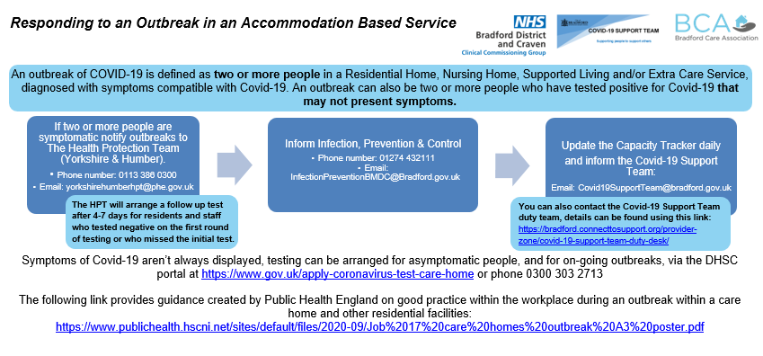
CHECKLIST
All staff have familiarised themselves with the Responding to an Outbreak flowchart

Slide 12
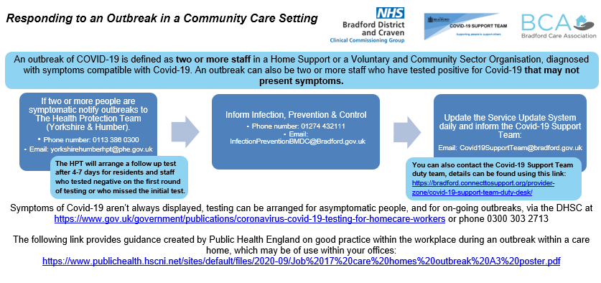
CHECKLIST
All staff have familiarised themselves with the Responding to an Outbreak flowchart

Slide 13
Infection Prevention and Control
The National Care Forum have created a fantastic IPC checklist that would be really beneficial for evidencing the hard work you are doing when CQC come to visit. It is accessible using this link: https://www.nationalcareforum.org.uk/wp-content/uploads/2020/08/NCF-Infection-Prevention-Control-FINAL-AUG-2020.pdf
This document was created in August 2020 so it predates the introduction of vaccines but it is still a really useful resource for evidencing your policies to CQC
CHECKLIST
Our service has completed the NCF IPC checklist

Slide 14
PPE
Government will provide free PPE to care homes and homecare, via the PPE portal, until end of March 2021 to supplement BAU supplies.
Guidance on how to use the PPE Portal is accessible with this link: https://www.gov.uk/guidance/ppe-portal-how-to-order-covid-19-personal-protective-equipment
Government will provide free PPE to LRFs who wish to continue distribution, and to LA’s in other areas, to distribute to social care providers ineligible for the supply via the PPE portal, until March 2021. This includes to personal assistants.
Government will provide free PPE to LRFs to have an emergency stockpile in case of local spikes.
All eligible care providers can register for and use the new PPE portal. Shortages to be reported through the Capacity Tracker, LRFs where applicable, or any other relevant escalation or data collection route.
To access a guide that illustrates the latest PPE guidance for Adult Social Care please use this link: https://www.gov.uk/government/publications/personal-protective-equipment-ppe-illustrated-guide-for-community-and-social-care-settings
For information about external PPE suppliers you can visit the Provider Zone with this link: https://bradford.connecttosupport.org/provider-zone/external-ppe-suppliers/

Slide 15
PPE CHECKLIST
Our service has enough PPE to last at least 3 weeks
All staff are aware of what PPE they must where in different care situations
All staff have received up-to-date training on donning and doffing PPE

Slide 16
Staff Travel
Disruptive weather can impact staff travel arrangements and therefore workforce capacity. We encourage care providers to ensure that their Business Continuity Plans include arrangements for staff travel.
  If you are unsure on what your Business Continuity Plan should include, please read The Care Provider Alliance guidance on business continuity planning here. You may wish to use our Winter Planning and Business Continuity Plan which provides information on what you should consider in your business continuity plan.
To prepare for travelling during the winter, staff should consider travelling with as many items from the Winter Car Essentials Checklist as they can. We encourage services to print off the Winter Car Essentials Checklist and display it in the staff room.
Staff should inform management if they are having problems with their car. In this instance, the manager should consider asking other staff members if they could offer car share. Management should also consider arranging to pay for a taxi.
Staff should inform management in the event that their car breaks down on the way to work as soon as possible.
You can find more resources on how to prepare for travelling during the winter here.

Slide 17
Residents Making Trips Outside The Care Home
Residents who wish to make out-of-home visits should wear clothing appropriate for the winter season. During the winter months, the risk of falling increases. We advice that trips outside the home are avoided where possible to reduce the risk of falling as well as the risk of common winter illnesses.
You must ensure that minibuses are well maintained for winter travel. Please refer here for more information on how to prepare for travelling during the winter.
You should carry the items on the Winter Car Essentials checklist that can be found here.

Slide 18
Gritting Routes
If you want to know which roads are on the priority network you can view gritting routes via our gritting routes map.
You can make a gritting request using our gritting request form or by calling 01274 431000 and using the gritting request option.
You can clear snow yourself but you should be careful not to make conditions worse by using liquids that may later freeze. Read more information about clearing paths on the GOV.UK website.
For more information on gritting, visit the Bradford Council Website.
What if there is an emergency or a service user needs medical help or treatment?
In emergency situations the Police, Ambulance or Fire services can contact us directly to request assistance.
If a service user has a urgent medical treatment scheduled and you are concerned that they may be unable to attend due to weather conditions you should contact Telemeds.

Slide 19

Winter Car Essentials Checklist
CHECKLIST FOR WINTER CAR ESSENTIALS
Road map
Ice scraper or de-icer
Torch and batteries
In-car phone charger or portable charger
Warm clothes and blankets
Umbrella or waterproof clothing
Spare pair of shoes or boots
Food and drink
High-visibility clothing
Hazard Triangle
First aid kit
Jump Leads
Empty fuel can
Winter Tyres
Breakdown service and insurance company contact details
Up-to-date MOT status on your vehicle
Please read the Met Office’s 6 simple checks to prepare your vehicle for winter!
Scan the QR code below
NOTICE FOR STAFF: Please inform your manager if you are having problems with your car and can no longer drive to work. Your manager may find another member of staff that you can car share with. Alternatively, a taxi can be arranged. In the event that your car breaks down on the way to work, please contact your manager as soon as you can.

Slide 20
Useful Resources for Travelling During the Winter
  Prepare a winter kit for your car
  What to pack in your emergency breakdown kit
  6 simple checks to prepare your vehicle for winter
  Winter car maintenance: 10 tips to prepare for the cold weather
  Cold weather and driving
  Travelling in heavy snow and ice

Slide 21
Business Continuity
  If you are unsure on what your Business Continuity Plan should include, please read The Care Provider Alliance guidance on business continuity planning here.
  You may wish to use our Winter Planning and Business Continuity Plan which provides information on what you should consider in your business continuity plan.

Slide 22
Building Maintenance
Your Business Continuity Plan should include building maintenance procedures to ensure the following have been checked or serviced.
If you experience problems with any items on this checklist, please inform The Commissioning Team and CQC.
Print out contact numbers so staff know who to call in the event of a failure.
CHECKLIST FOR BUILDING MAINTENANCE
Boilers and Heating systems
Equipment and Machinery
ICT services
Power supply

Slide 23
Building Maintenance
CHECKLIST FOR BUILDING MAINTENANCE
Boilers and Heating Systems
Does your business continuity plan include procedures and policies for the maintenance of boilers?
Does your business continuity plan include a protocol for reporting and managing defects in your boiler?
Do you know who to contact in the case of an emergency regarding your boiler?
Equipment and Machinery
Does your business continuity plan include routine maintenance of equipment and machinery such as computers, washing machines, hoists, stair lifts, elevators, nursing care beds and assisted baths.
Have you checked whether your supplier includes contingency plans for when parts unexpectedly malfunction, in your contracts.
Do you know who to contact in the case of an emergency regarding equipment and machinery?
ICT Systems
Does your business continuity plan consider the risk of ICT server failure, ICT telephone failure and digital care system failure?
Do you have maintenance contracts to provide a prompt response to any ICT server failure, ICT telephone failure and digital care system failure?
Have you collated the contact details for all the ICT systems your facility uses, for easy access when you require technical support?
Do you have a list of actions that would be taken to manage day-to-day operational requirements, in the instance of ICT server failure, ICT telephone failure and digital care system failure? E.g., In the event of ICT telephone failure, could calls be transferred to alternative numbers or a (personal) mobile number?
Power Supply
Does your business continuity plans consider what provisions are in place to maintain power supply in your building and carry out day-to-day operational requirements, in the event of a power outage?
Do you know who to contact in the case of an emergency regarding power supply?

Slide 24
Emergency Planning
You may want to consider dispersing several Emergency (SOS) Bags throughout your facility, in the case of an emergency evacuation. All staff members should be aware of the location of the Emergency Bags.
Below is a list of items you should include in your Emergency Bags. You can add more items to the list to suit the needs of your service.
Checklist for SOS bag
Insulated Foil Blankets
Disposable Rain Ponchos
High-Visibility Vest (for staff leading evacuation)
Torch with Batteries
Marker Pen
Travel First Aid Kit
Emergency Whistles
Staff Rota (list of all staff)
List of Residents
Contingency Plans
Emergency Contact Information for Staff and Service Users

Slide 25
Food Supply
CHECKLIST FOR FOOD SUPPLY CONTINUITY
Does your business continuity plan consider the potential risks of disrupted transport links and delays in food supplies?
Do you know who to contact in the case of an emergency regarding food supply?
Does your business continuity plan include a plan of action in the event that you experience delays in specialist foods?
Do you know who to consult with, if you need to change diets for people with requirements (i.e. GP, dietician)?
If you experience problems with food supply, please inform The Commissioning Team and CQC.

Slide 26
Pharmaceutical Supply
CHECKLIST FOR PHARMACEUTICAL SUPPLY CONTINUITY
Are supplies of required medications and medical equipment readily available and accessible?
Does your business continuity plan consider the potential risks of disrupted transport links and delays in pharmaceutical supplies?
Do you know who to contact in the case of an emergency regarding pharmaceutical supplies?
If you experience problems with pharmaceutical supplies, please inform The Commissioning Team and CQC.

Slide 27
Staffing Shortages
CHECKLIST FOR STAFFING CONTINUTIY
Does your business continuity plan include considerations for service capacity in the event staff are unable to get to work due to extreme winter conditions?
Does your business continuity plan include considerations for service capacity in the event of an outbreak amongst staff?
Do you have a contingency plan to maintain safe staffing levels? Are your staff aware of the contingency plan?
Do you know who to contact in the case of an emergency regarding staffing levels?
Do you know who to contact to escalate a serious issue both in office hours and out of hours? *We are currently speaking to colleagues in the in-house residential homes to support us with this. Once confirmed, we will add this escalation process to the winter planning tool.
Have you considered partnering with other organisations to support workforce capacity?
Do you have enough bank staff who are able to cover staff shortages at short notice?
Have you considered overstaffing to cope with staff shortages?
Do you know of care agencies that will be able to support you with staff shortages?
Are you aware of the Care Agency Register on Connect to Support?
Have you considered whether you are able to accommodate staff on site (or nearby) overnight, if extreme weather is predicted?
Have you implemented a recruitment and retention programme?
Have you reviewed your reviewed your recruitment and retention programme?
Have you sent your current vacancies to the Covid19SupportTeam? For more information, click here.
Have you read Skills for Care’s guide to safe staffing?
You can find Workforce Resources here.

Slide 28
Staff Mental Wellbeing
CHECKLIST FOR STAFF WELLBEING
Are your staff aware of where they can find mental wellbeing resources? Click here for staff mental wellbeing resources.
Does your management team have up-to-date training on Mental Health Awareness?
Are staff aware of where they can find Mental Health Awareness training?

Slide 29
Resource Packs
Coronavirus (COVID-19): care home support package
Care Home Resource Pack
Home Support Resource Pack
Business Support Information For Social Care
National Care Forum Infection, Prevention and Control (IPC) Compliance Assessment Tool
The resource packs are a fantastic source for guidance and other material. Please ensure that all staff read these packs and not just managers.

Slide 30
Useful Templates
The Care Provider Alliance Business Continuity Template
The Covid-19 Support Team Business Continuity Plan Template
Care Provider Alliance Contingency Plan Template
Actions Required Template
Dynamic Risk Assessment
Winter Planning Toolkit Checklist
Winter Planning and Business Continuity Plan

Slide 31
Actions Required
 | Low Risk |  | Medium Risk |  | High Risk
Actions required to fill the gaps | Current Status | Requirement fully met (Y/N) | By When?
e.g. Book in extra clinical waste collections |  | N | Nov 19th

Slide 32
Building Maintenance Resources
Boilers and Heating Systems
  Guidance for Essential Service Operators: Making Your Service More Resilient to Power Outages – 29 October 2020 – Energy Emergencies Executive Committee
Equipment and Machinery
  Care Services, Equipment and Care Homes
  HSE: A brief guige on providing and using work equipment safely
  HSE: A short guide to the law and your responsibilities when buying new machinery for use at work
ICT Systems
  Digital Social Care Resources and Support
  Immedicare Support
  Capacity Tracker Support
Power Supply
  Guidance for Essential Service Operators: Making Your Service More Resilient to Power Outages – 29 October 2020 – Energy Emergencies Executive Committee
  https://careprovideralliance.org.uk/business-continuity-power-disruption

Slide 33
Food Supply Resources
National Association of Care Catering
Wholesale food distributors available to care sector – 16 April 2020 – CPA
Community Meals Provider

Slide 34
Pharmaceutical Supply Resources
Access updated information on escalation processes
Guide to managing medicines supply and shortages – DHSC and NHS England
Ordering, transporting, storing and disposing of medicines for people receiving social care in the community – NICE guidance
Managing medicines for adults receiving social care in the community – NICE guidance
Serious Shortage Protocol (SSP) – NHS Business Services Authority
Business continuity guidance and template – Care Provider Alliance

Slide 35
Workforce Resources
  Skills for Care’s guide to safe staffing
  Care Agency Directory
SkillsHouse
SkillsHouse: Contingency Planning: COVID-19 Maintaining safe staffing levels webinar
SkillsHouse: Maintaining safe staffing levels – challenges, impacts and mitigations resource
SkillsHouse: Maintaining safe staffing levels – Top Ten tips
Jobs in Social Care
One Workforce Hub
Social Care Directory

Slide 36
Staff Mental Wellbeing Resources
Covid-19: BDCFT Psychological Staff Support
Recovering From Covid-19 Support for Staff
MyWellbeing College
Staff Mental Health and Wellbeing Hub
Health and Care Employee Wellbeing Support Poster
Skills for Care Workforce Wellbeing
SCIE Care Staff Wellbeing
Workplace Health: Applying All Our Health
ACAS Coronavirus (COVID-19) and mental health at work
Mental Health at Work – Our Frontline
Bereavement support during COVID-19
Self Care Resources

Slide 38
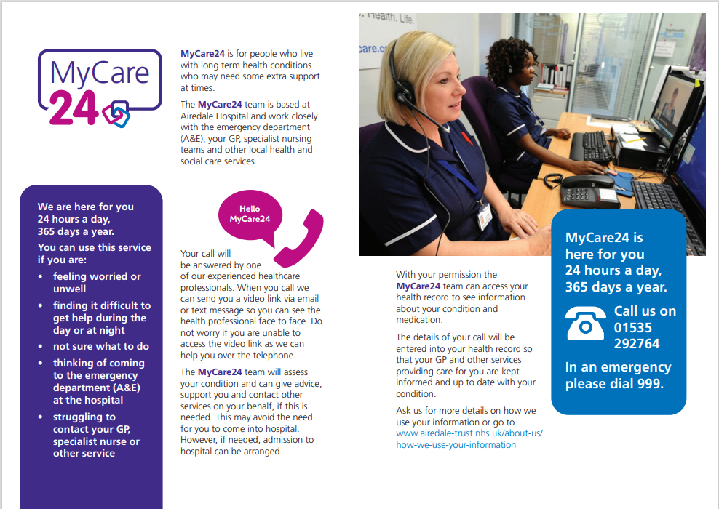

Slide 39
Staff Training
Bradford Training Hub
Restore2 Training
Day Activities Training
DSPT Awareness Webinar - 20 May 2021
Home Support IPC Training 24 September 2020
BCA Quality Workshops
Living Well Event Resource Pack
Staff Training Slides – Recognising Dehydration And Promoting Hydration – Can Be Used In Staff Meetings To Raise Awareness

Slide 40
Community Meals Provider
Park Care Meals is a family run Yorkshire based “Meals on Wheels” service that has been established since 1995. Their mission is to provide a daily visit whilst delivering delicious, wholesome meals to your door at great value for money.
Each hot meal and dessert costs £6.50 including delivery
They offer a flexible meal service. It operates every day of the year and you can choose how many days a week you would like a meal. They aim to deliver all meals between 11.30am and 1.30pm each day, arriving at approximately the same time once they have made the first delivery.
For more information please download their flyer with this link: https://bradford.connecttosupport.org/media/mqbfh1im/park-care-meals-leaflet.doc
Or visit their website: http://www.parkcaremeals.co.uk/

Slide 41
Checklists
Winter Planning Toolkit Checklist
Winter Planning and Business Continuity Plan

Slide 42
Contact Information
Covid-19 Support Team – Bradford Council
  Email: Covid19SupportTeam@bradford.gov.uk | Telephone: 01274 431999
Local public health authority (IPC) – Bradford Council
  Telephone: 01274 432111
Yorkshire and the Humber HPT
  Telephone: 0113 386 0300
  Out of hours advice: 0151 9091219
  Please encrypt any personal identifiable information (PII) you send to yorkshirehumberhpt@phe.gov.uk
  If you are sharing PII from another NHS.net email account, send this to phe.yorkshirehumber@nhs.net
Emergency Duty Team
  Email: xemergency.duty.team@bradford.gov.uk | Telephone: 01274 431010
Safe & Sound
  Email: Safe&Sound@bradford.gov.uk
National Supply Disruption Response Team (NSDRT) 24/7 Hotline
  Telephone: 0800 915 9964
Telemedicine Portal

