Slide 1
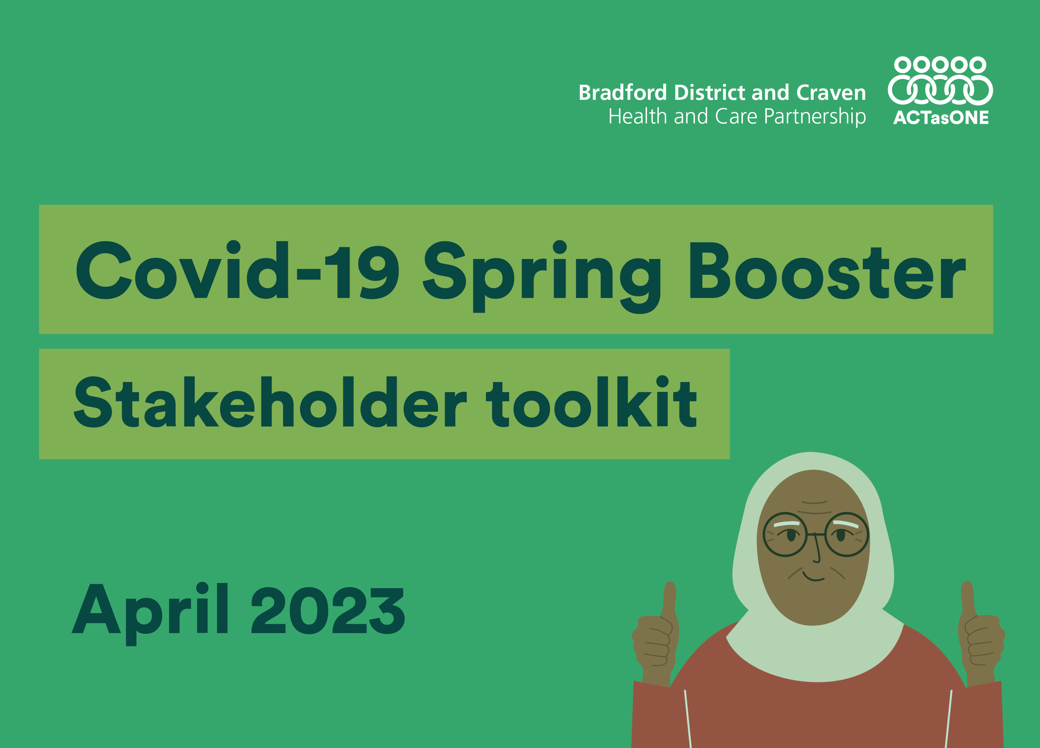

Slide 2
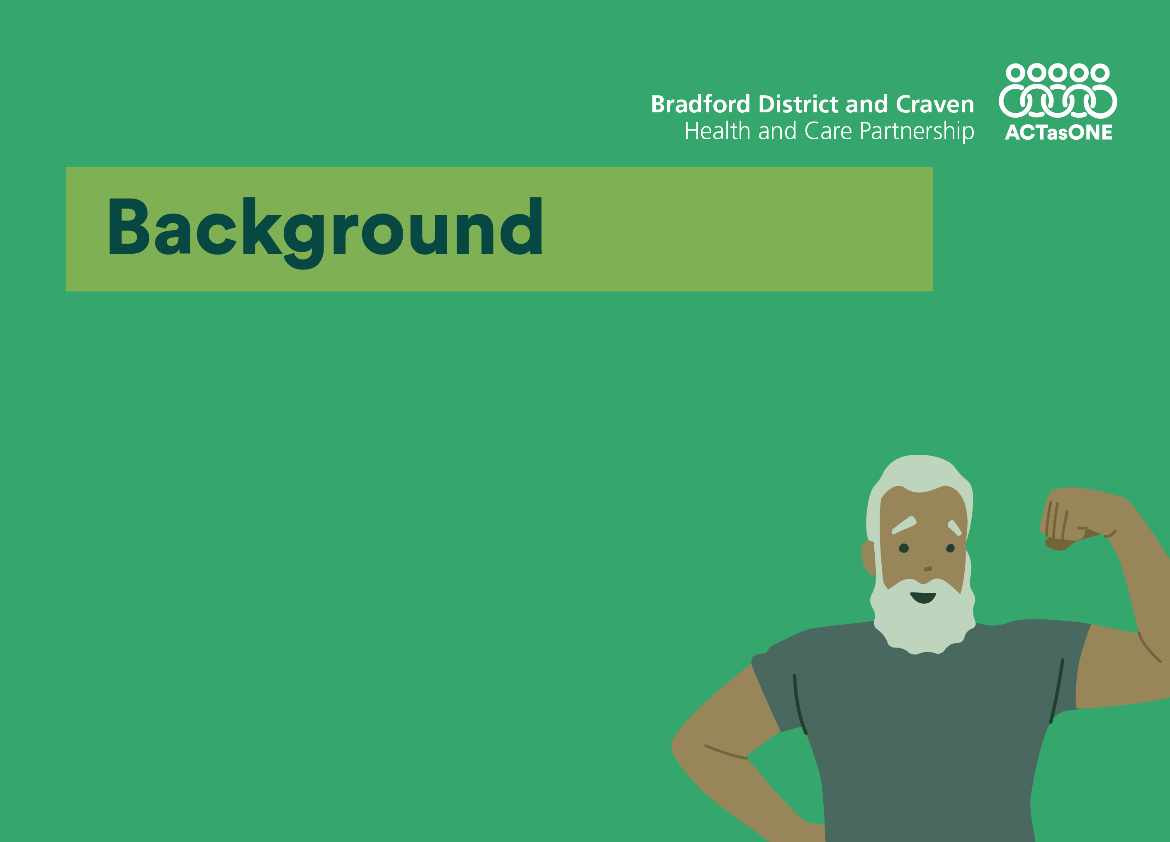
As we continue to face the ongoing challenges of COVID-19, it's important to recognise that the protection provided by COVID-19 vaccines may decrease over time, particularly for vulnerable populations. Therefore, a COVID-19 spring booster is now available for the following groups:​
Residents in care homes for older adults
Adults aged 75 years and over
People aged 5 years and over with weakened immune systems

Slide 3

Spring booster vaccinations will be administered from the end of April until the end of June.
We need your help in encouraging eligible individuals to receive the booster this spring.
This toolkit contains key information and materials for you to share with your audiences.
One way to support us is by sharing our content on your social media channels, and by following our channels on Facebook, Twitter, and Instagram listed below.
Additionally, you can post your own content on your social media channels using the assets and social media copy provided.

Slide 4

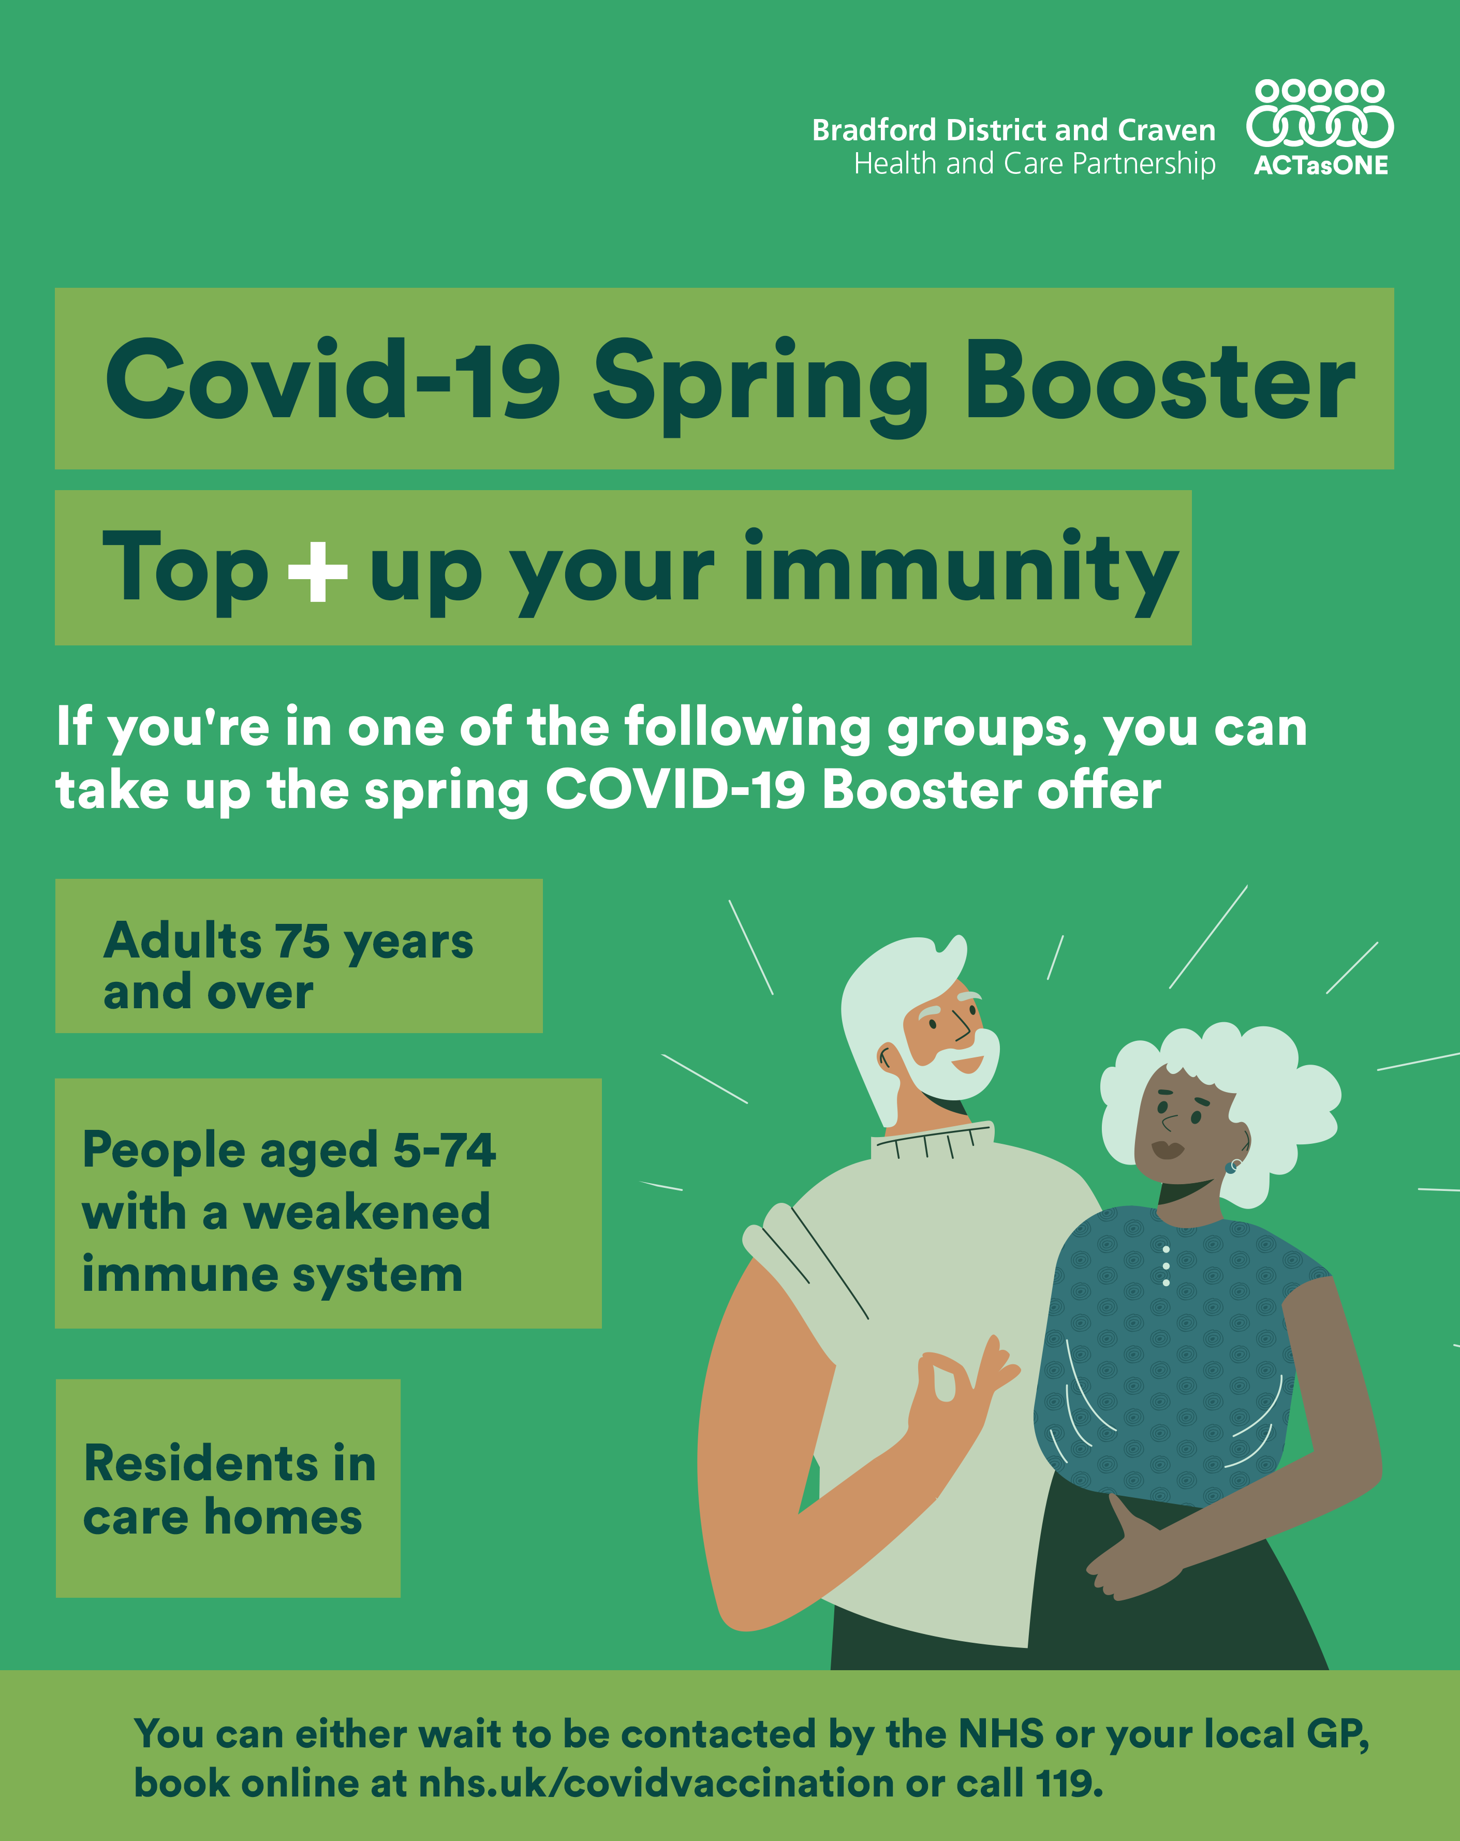
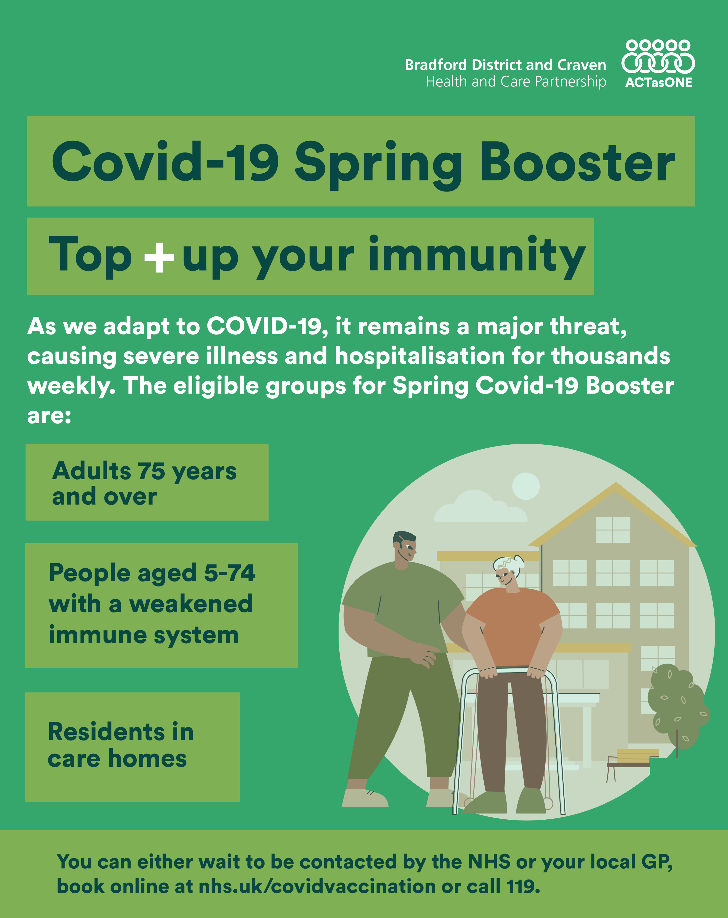
Download the assets here
All assets have been created to fit all social media platforms, including Facebook, Twitter, and Instagram. The assets include graphics in both English and Urdu, separated into three categories: General, 75+, and Immunocompromised
Alt text
General
 | 📢 💪 Those aged 75+, 5+ with weakened immune systems, and residents of care homes are eligible for the vaccine. You can either wait to be contacted by the NHS or your local GP, book online at nhs.uk/covidvaccination or call 119. #springbooster | Title: Covid-19 Spring Booster Top+ up your immunity Message: If you're in one of the following groups, you can take up the spring COVID-19 Booster offer Adults 75 years and over People aged 5-74 with a weakened immune system Residents in care homes You can either wait to be contacted by the NHS or your local GP, book online at nhs.uk/covidvaccination or call 119. Graphic of a man and women with their arm visible
 | 📢 💪 Those aged 75+, 5+ with weakened immune systems, and residents of care homes are eligible for the vaccine. You can either wait to be contacted by the NHS or your local GP, book online at nhs.uk/covidvaccination or call 119. #springbooster | Title: Covid-19 Spring Booster Top+ up your immunity Message: As we adapt to COVID-19, it remains a major threat, causing severe illness and hospitalisation for thousands weekly. The eligible groups for Spring Covid-19 Booster are: Adults 75 years and over People aged 5-74 with a weakened immune system Residents in care homes You can either wait to be contacted by the NHS or your local GP, book online at nhs.uk/covidvaccination or call 119. Graphic of a women with her caretaker outside a care home

Slide 5
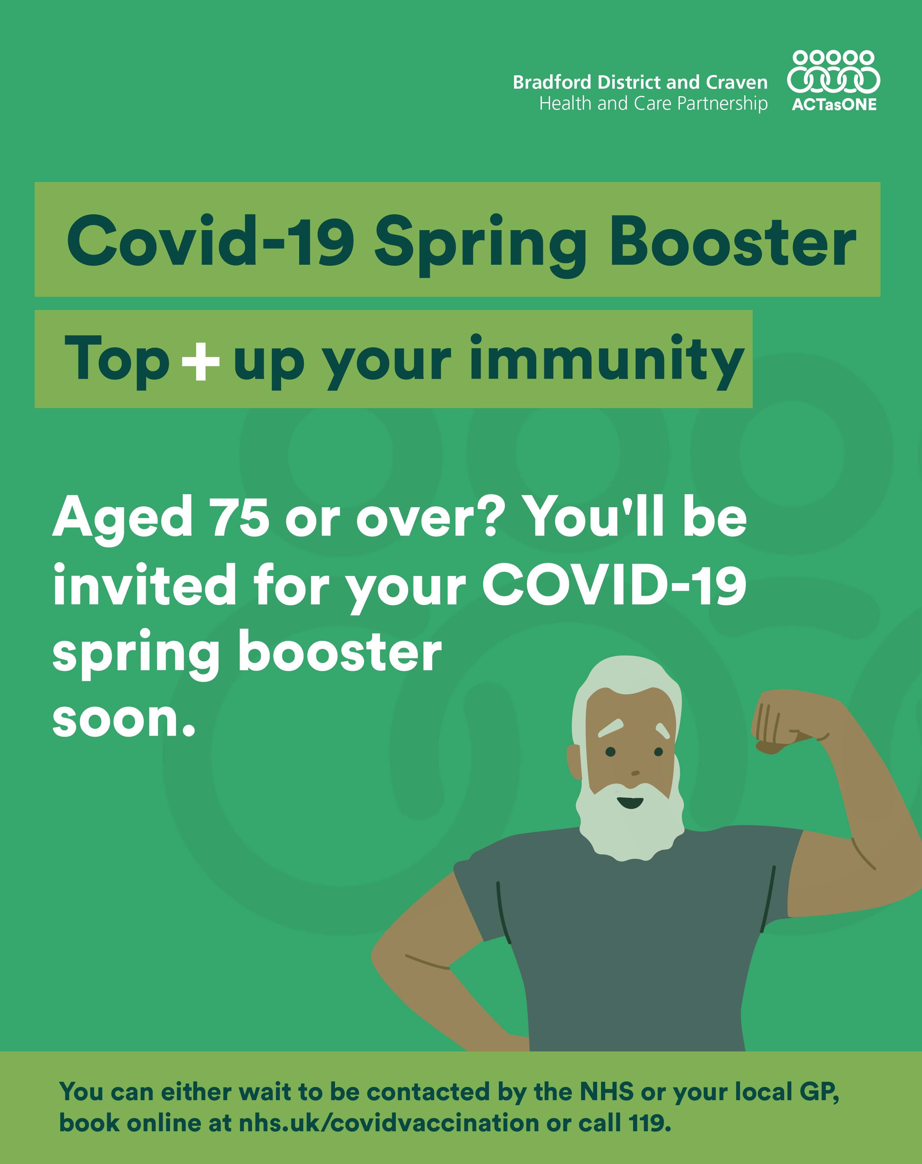
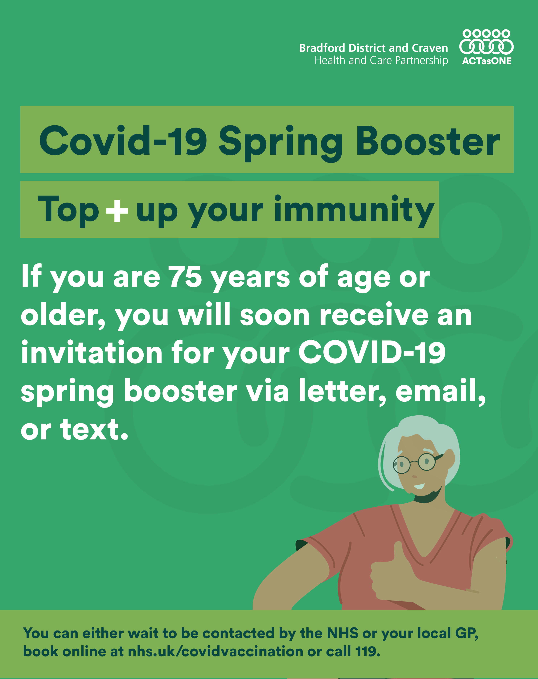
Download the assets here
75+
Alt text
 | 📢 💪 If you are 75 years of age or older, you will soon receive an invitation for your COVID-19 spring booster via letter, email, or text. You can either wait to be contacted by the NHS or your local GP, book online at nhs.uk/covidvaccination or call 119. #springbooster | Title: Covid-19 Spring Booster Top+ up your immunity Message: Aged 75 or over? You'll be invited for your COVID-19 spring booster soon. You can either wait to be contacted by the NHS or your local GP, book online at nhs.uk/covidvaccination or call 119. Graphic of a old man flexing his arms
 | 📢 💪 If you are 75 years of age or older, you will soon receive an invitation for your COVID-19 spring booster via letter, email, or text. You can either wait to be contacted by the NHS or your local GP, book online at nhs.uk/covidvaccination or call 119. #springbooster | Title: Covid-19 Spring Booster Top+ up your immunity Message: If you are 75 years of age or older, you will soon receive an invitation for your COVID-19 spring booster via letter, email, or text. You can either wait to be contacted by the NHS or your local GP, book online at nhs.uk/covidvaccination or call 119. Graphic of a old women showing her arm

Slide 6
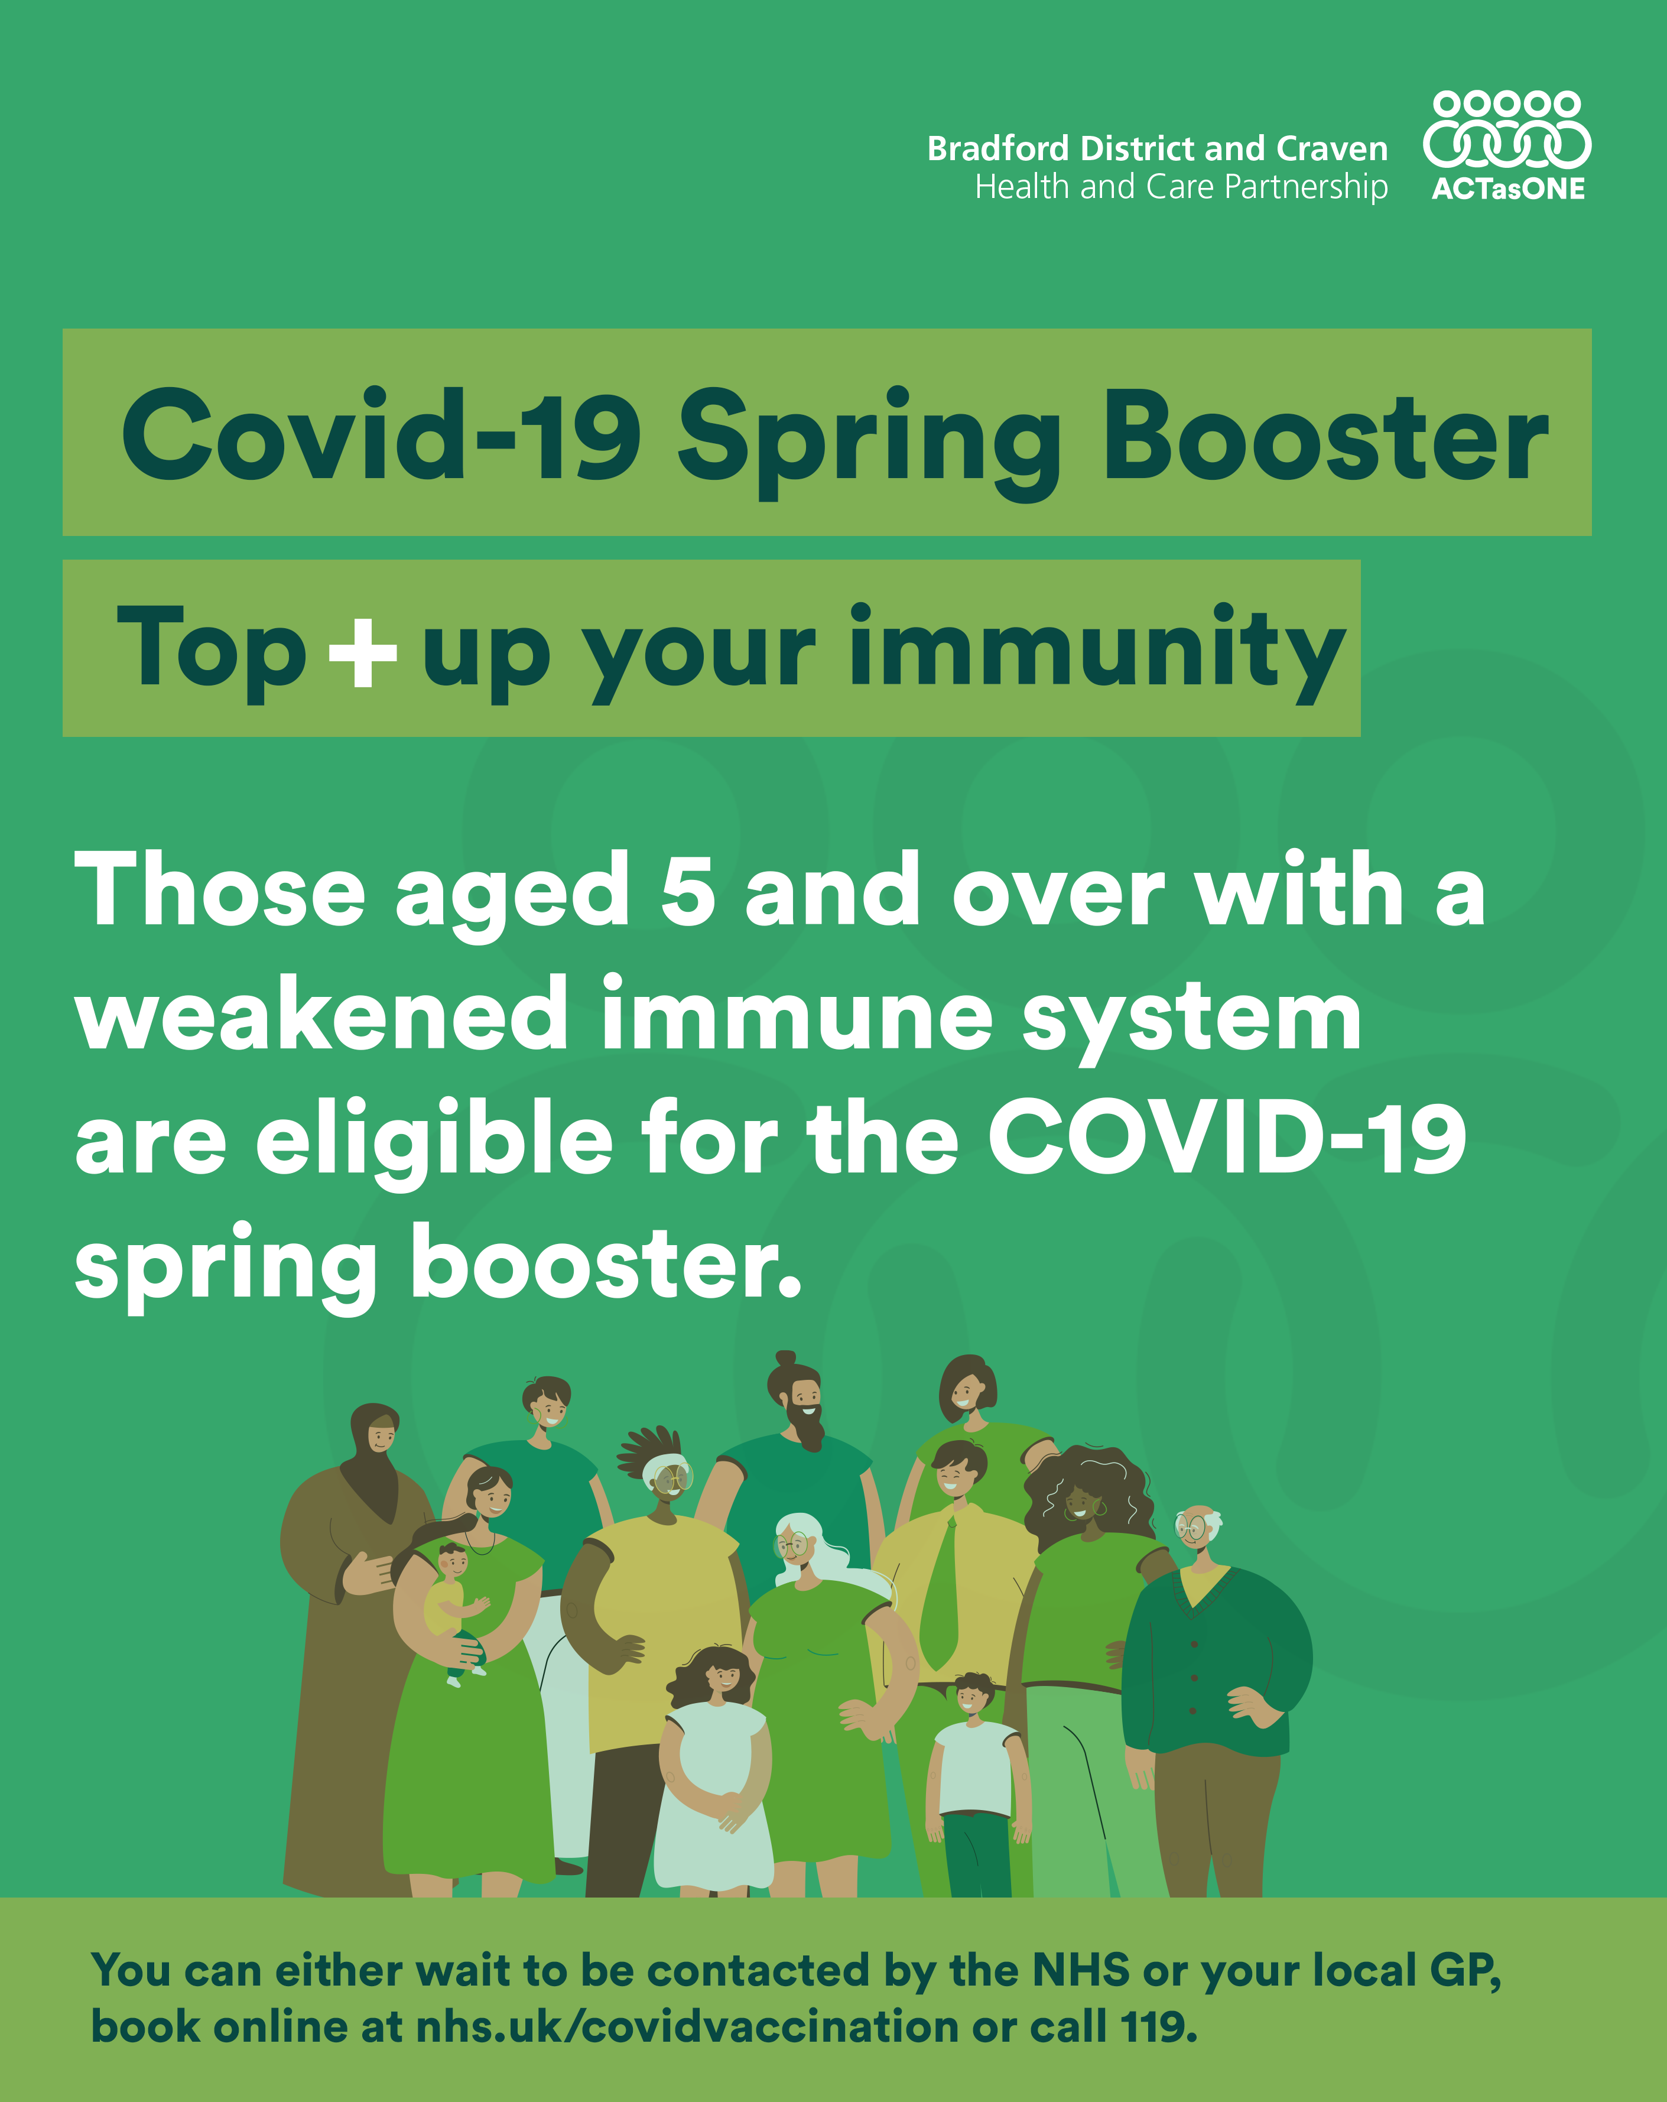
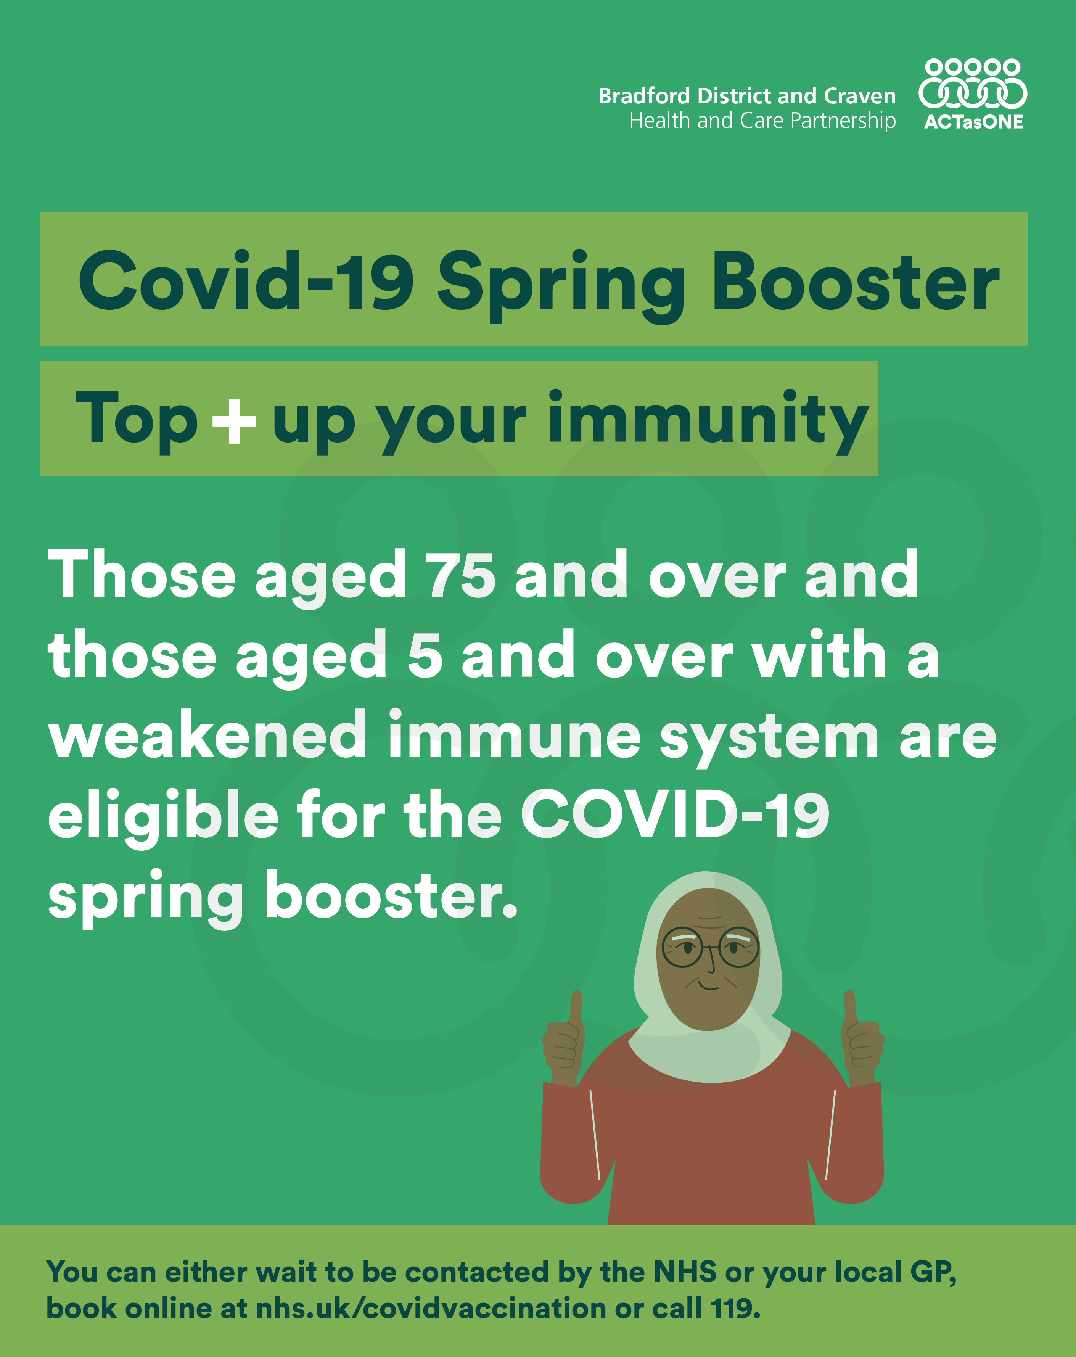
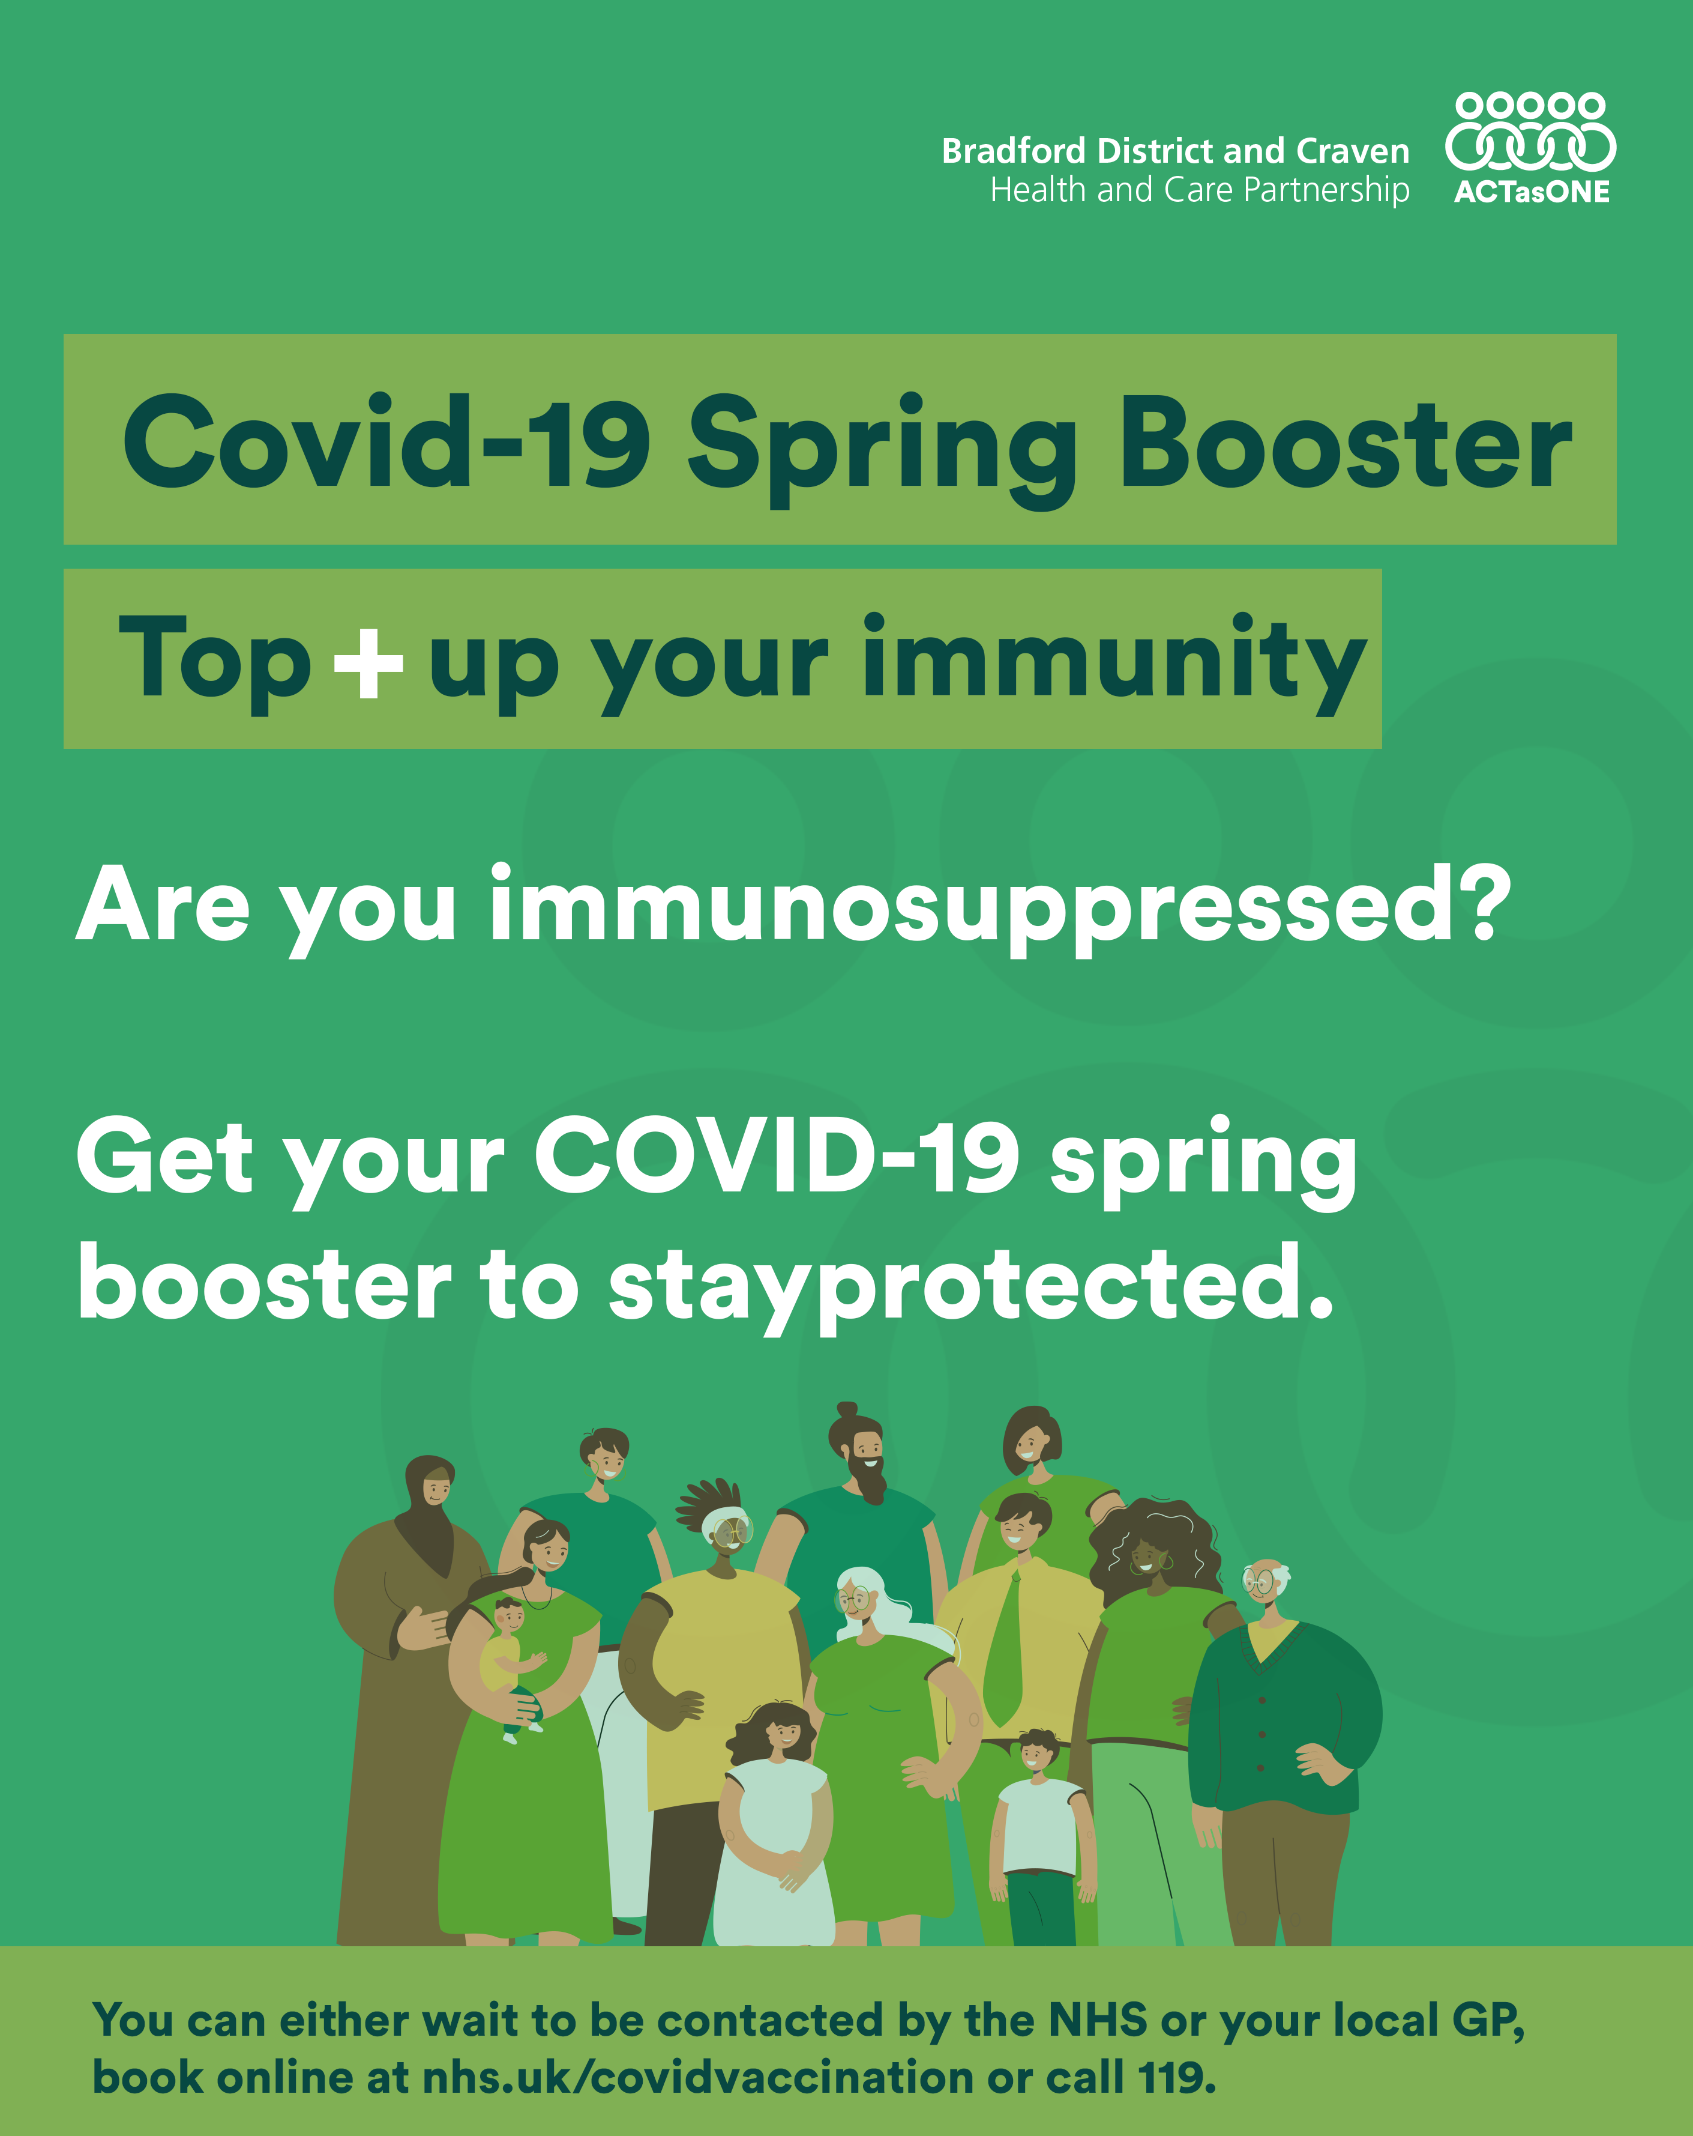
Download the assets here
Immunosuppressed
 | 📢 💪 Those aged 5 and over with a weakened immune system are eligible for the COVID-19 spring booster. If you or your child are in this group, information about getting the booster will be sent soon via letter, email or text. You can either wait to be contacted by the NHS or your local GP, book online at nhs.uk/covidvaccination or call 119. #springbooster | Title: Covid-19 Spring Booster Top+ up your immunity Message: Those aged 5 and over with a weakened immune system are eligible for the COVID-19 spring booster. If you or your child are in this group, information about getting the booster will be sent soon via letter, email or text. You can either wait to be contacted by the NHS or your local GP, book online at nhs.uk/covidvaccination or call 119. Graphic of group of people from different backgrounds and age
 | 📢 💪 Those aged 75 and over and those aged 5 and over with a weakened immune system are eligible for the COVID-19 spring booster. You can either wait to be contacted by the NHS or your local GP, book online at nhs.uk/covidvaccination or call 119. #springbooster | Title: Covid-19 Spring Booster Top+ up your immunity Message: Those aged 75 and over and those aged 5 and over with a weakened immune system are eligible for the COVID-19 spring booster. You can either wait to be contacted by the NHS or your local GP, book online at nhs.uk/covidvaccination or call 119. Graphic of group of a old Muslim women giving a thumbs up with both hands
 | 📢 💪 Those aged 5 and over with a weakened immune system are eligible for the COVID-19 spring booster You can either wait to be contacted by the NHS or your local GP, book online at nhs.uk/covidvaccination or call 119. #springbooster | Title: Covid-19 Spring Booster Top+ up your immunity Message: Are you immunosuppressed? Get your COVID-19 spring booster to stayprotected. You can either wait to be contacted by the NHS or your local GP, book online at nhs.uk/covidvaccination or call 119. Graphic of group of people from different backgrounds and age

Slide 7
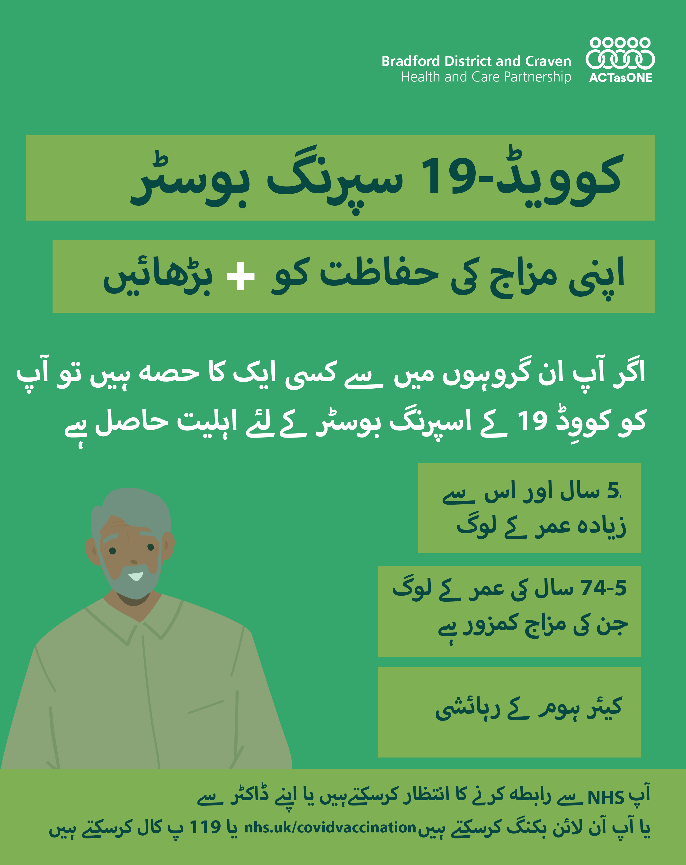
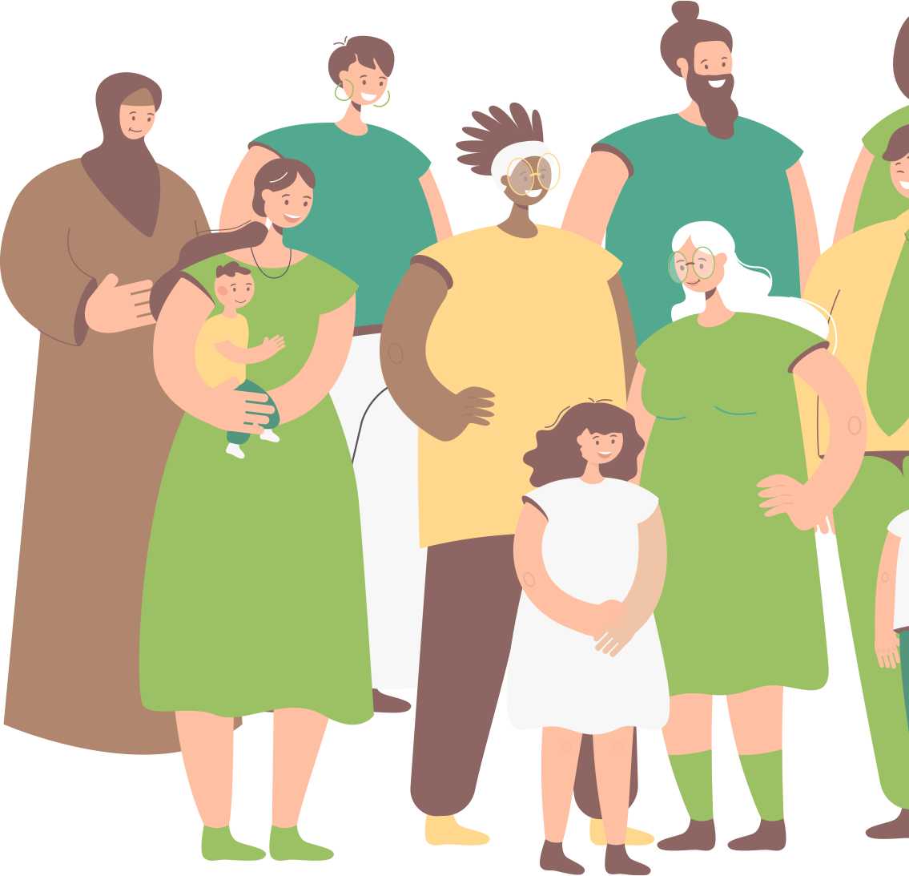
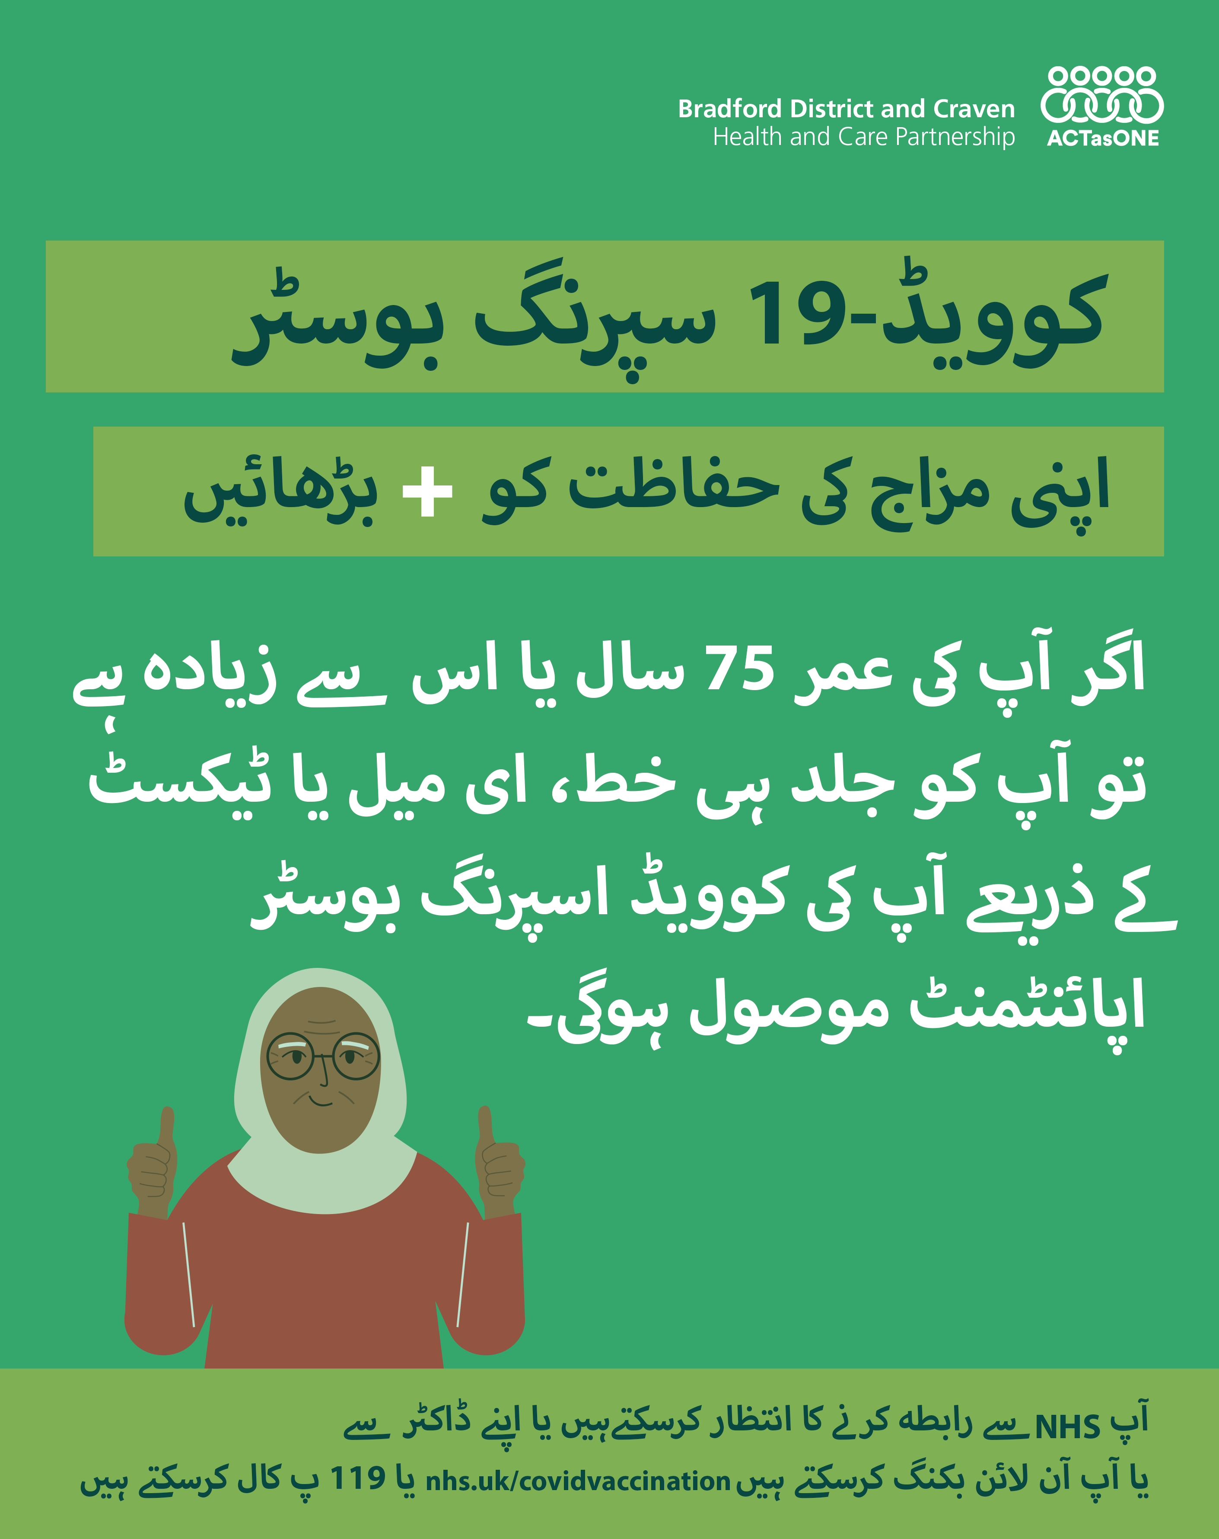
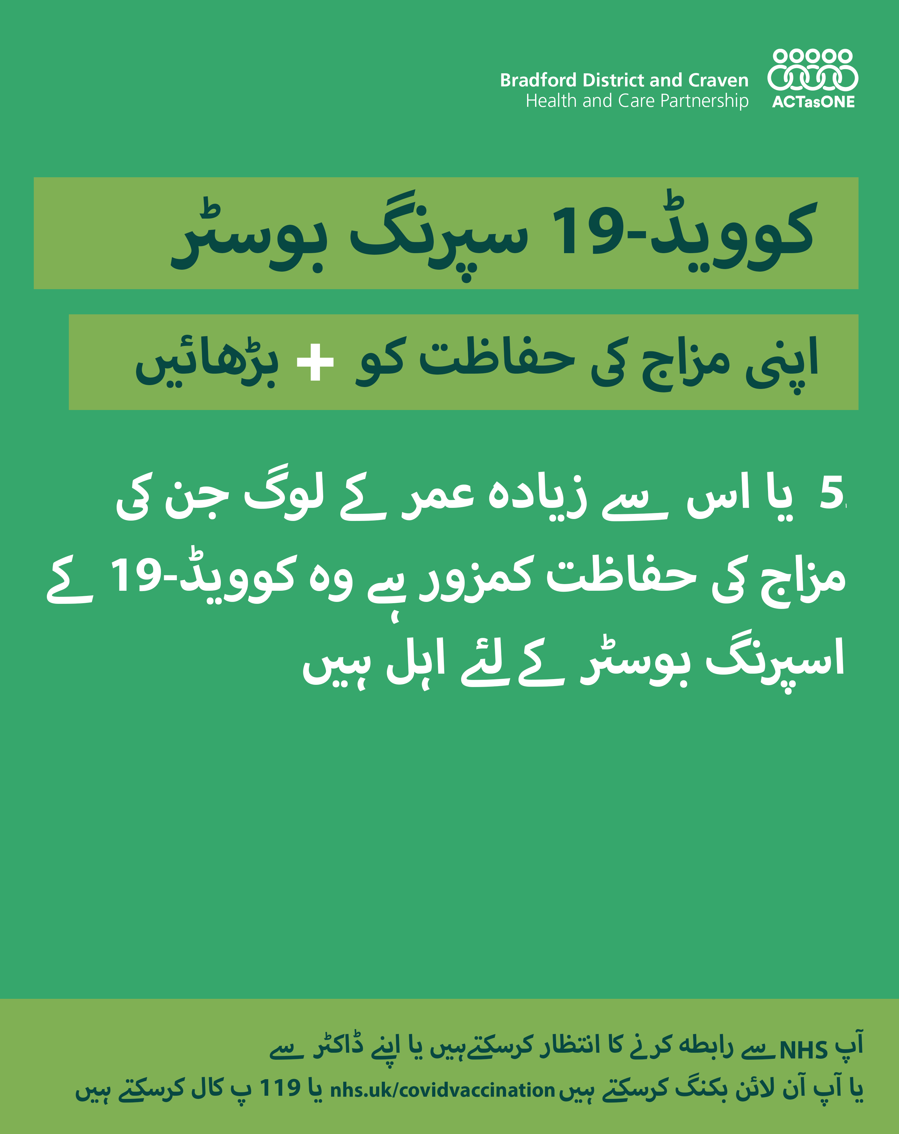
Download the assets here
Urdu (For alt text please use the caption as it summarises the text in the graphic)
 | جبکہ ہم کووڈ-19 کے مطابقت کرتے ہیں، یہ ایک بڑی خطرہ کے طور پر باقاعدگی سے رہتا ہے، ہفتہ وار ہزاروں لوگوں کو بیماری کا شدید مرض اور داخلے کے ذریعہ بھرتی کرتا ہے آپ آن لائن بکنگ کرسکتے ہیں یا119 پ کال کرسکتے ہیں بکنگ ویب سائٹ nhs.uk/covidvaccination
 | اگر آپ کی عمر 75 سال یا اس سے زیادہ ہے تو آپ کو جلد ہی خط، ای میل یا ٹیکسٹ کے ذریعے آپ کی کوویڈ اسپرنگ بوسٹر اپائنٹمنٹ موصول ہوگی۔ آپ آن لائن بکنگ کرسکتے ہیں یا 119 پ کال کرسکتے ہیں بکنگ ویب سائٹ nhs.uk/covidvaccination
 | 5 یا اس سے زیادہ عمر کے لوگ جن کی مزاج کی حفاظت کمزور ہے وہ کوویڈ-19 کے اسپرنگ بوسٹر کے لئے اہل ہیں آپ آن لائن بکنگ کرسکتے ہیں یا119 پ کال کرسکتے ہیں بکنگ ویب سائٹ nhs.uk/covidvaccination
General
75+
Immunosuppressed

Slide 8

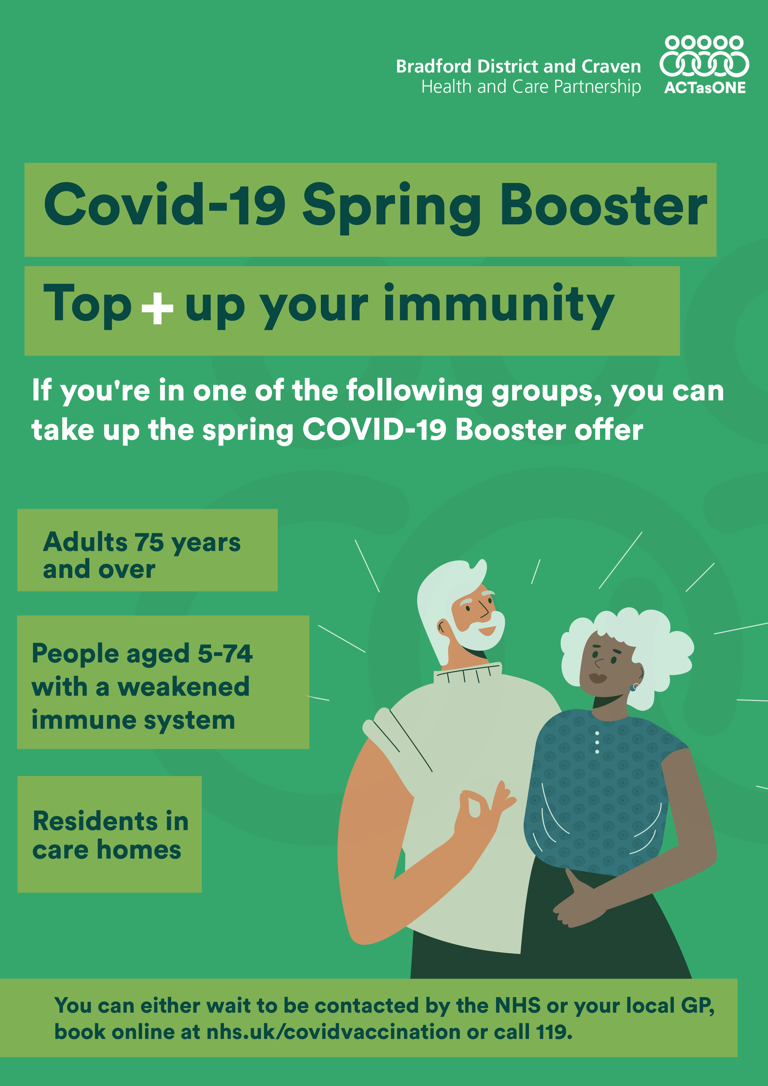
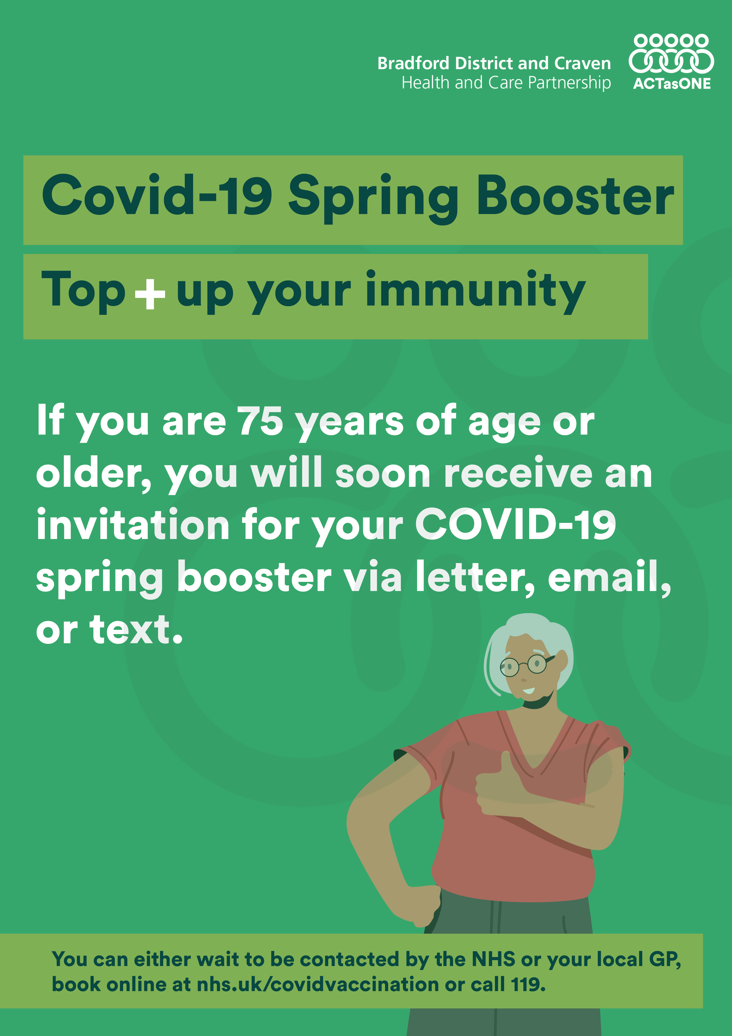
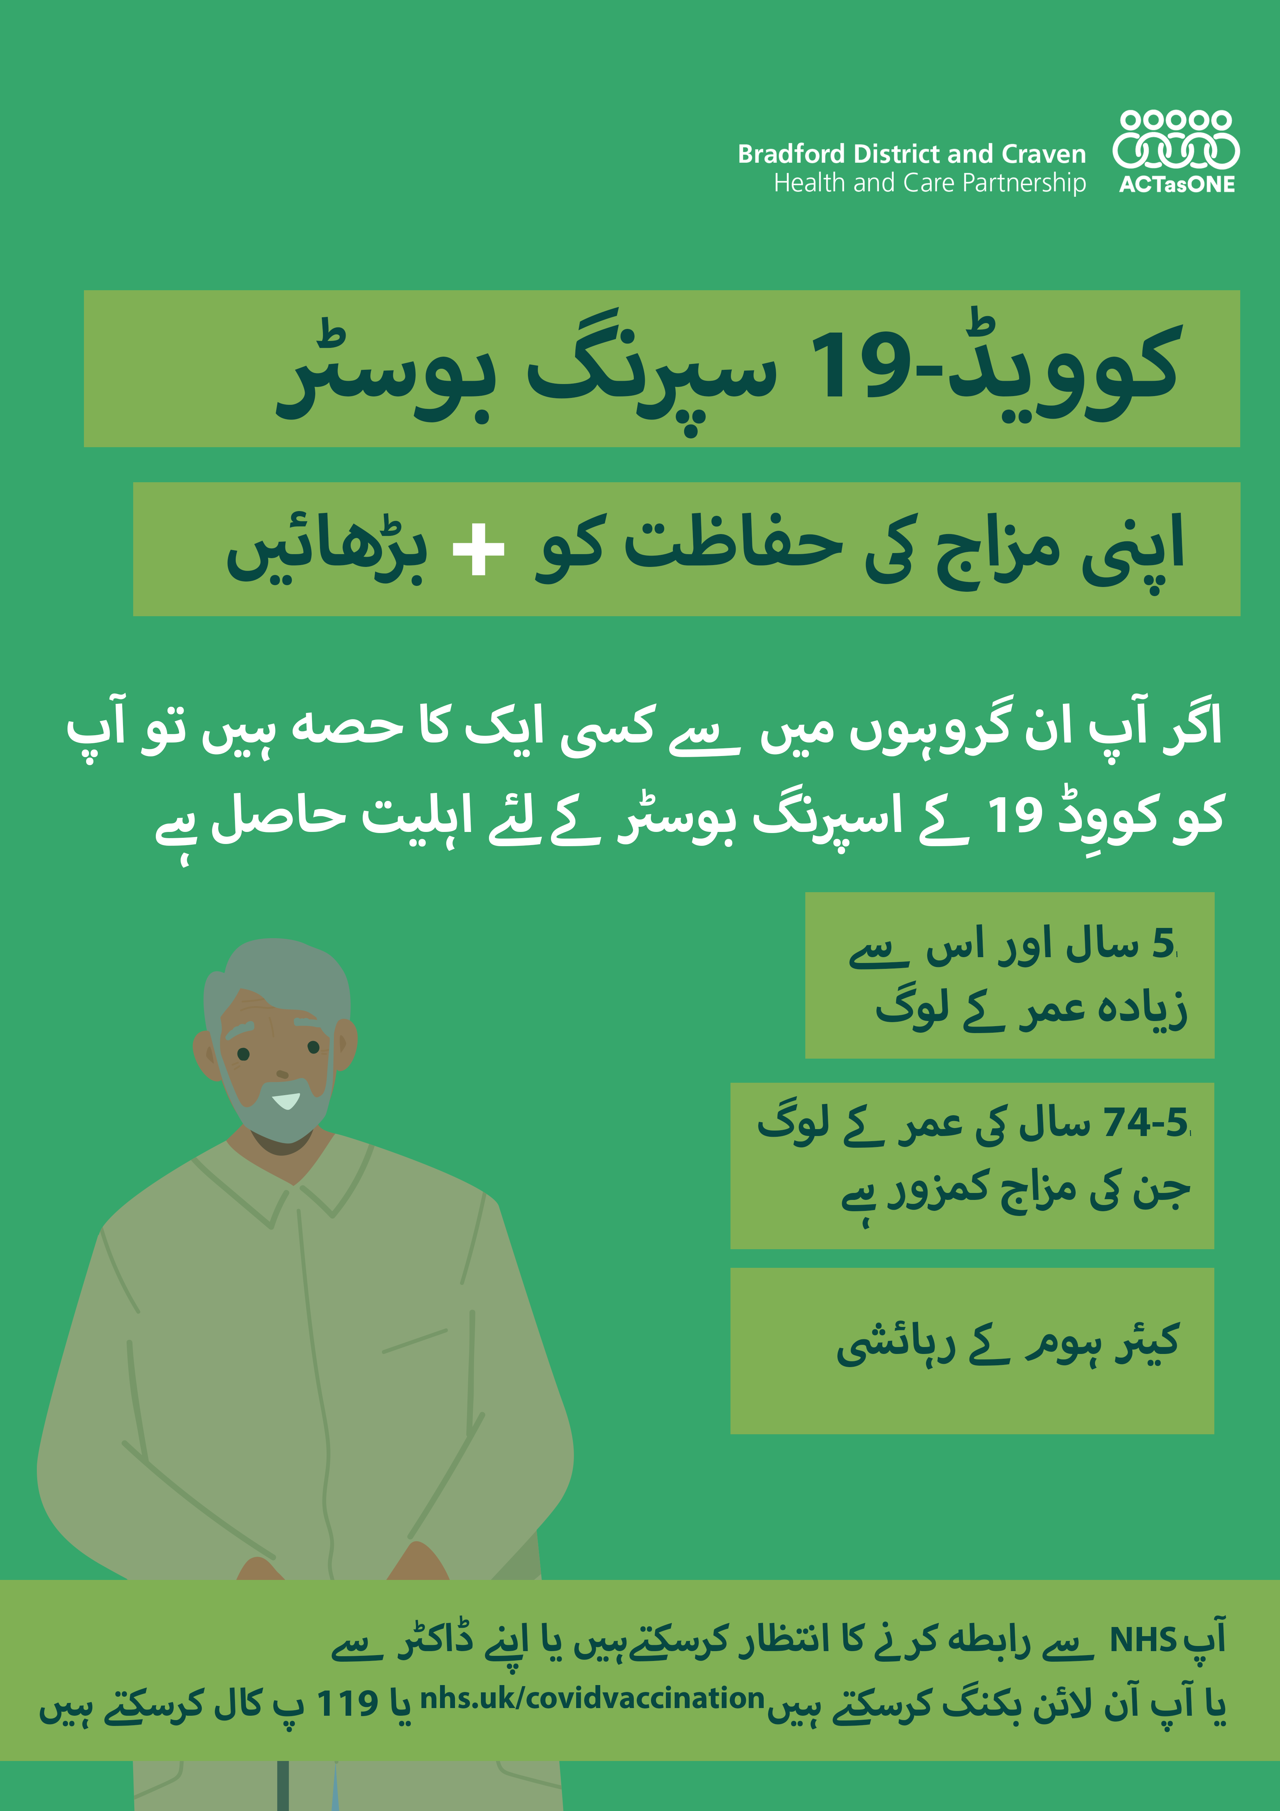
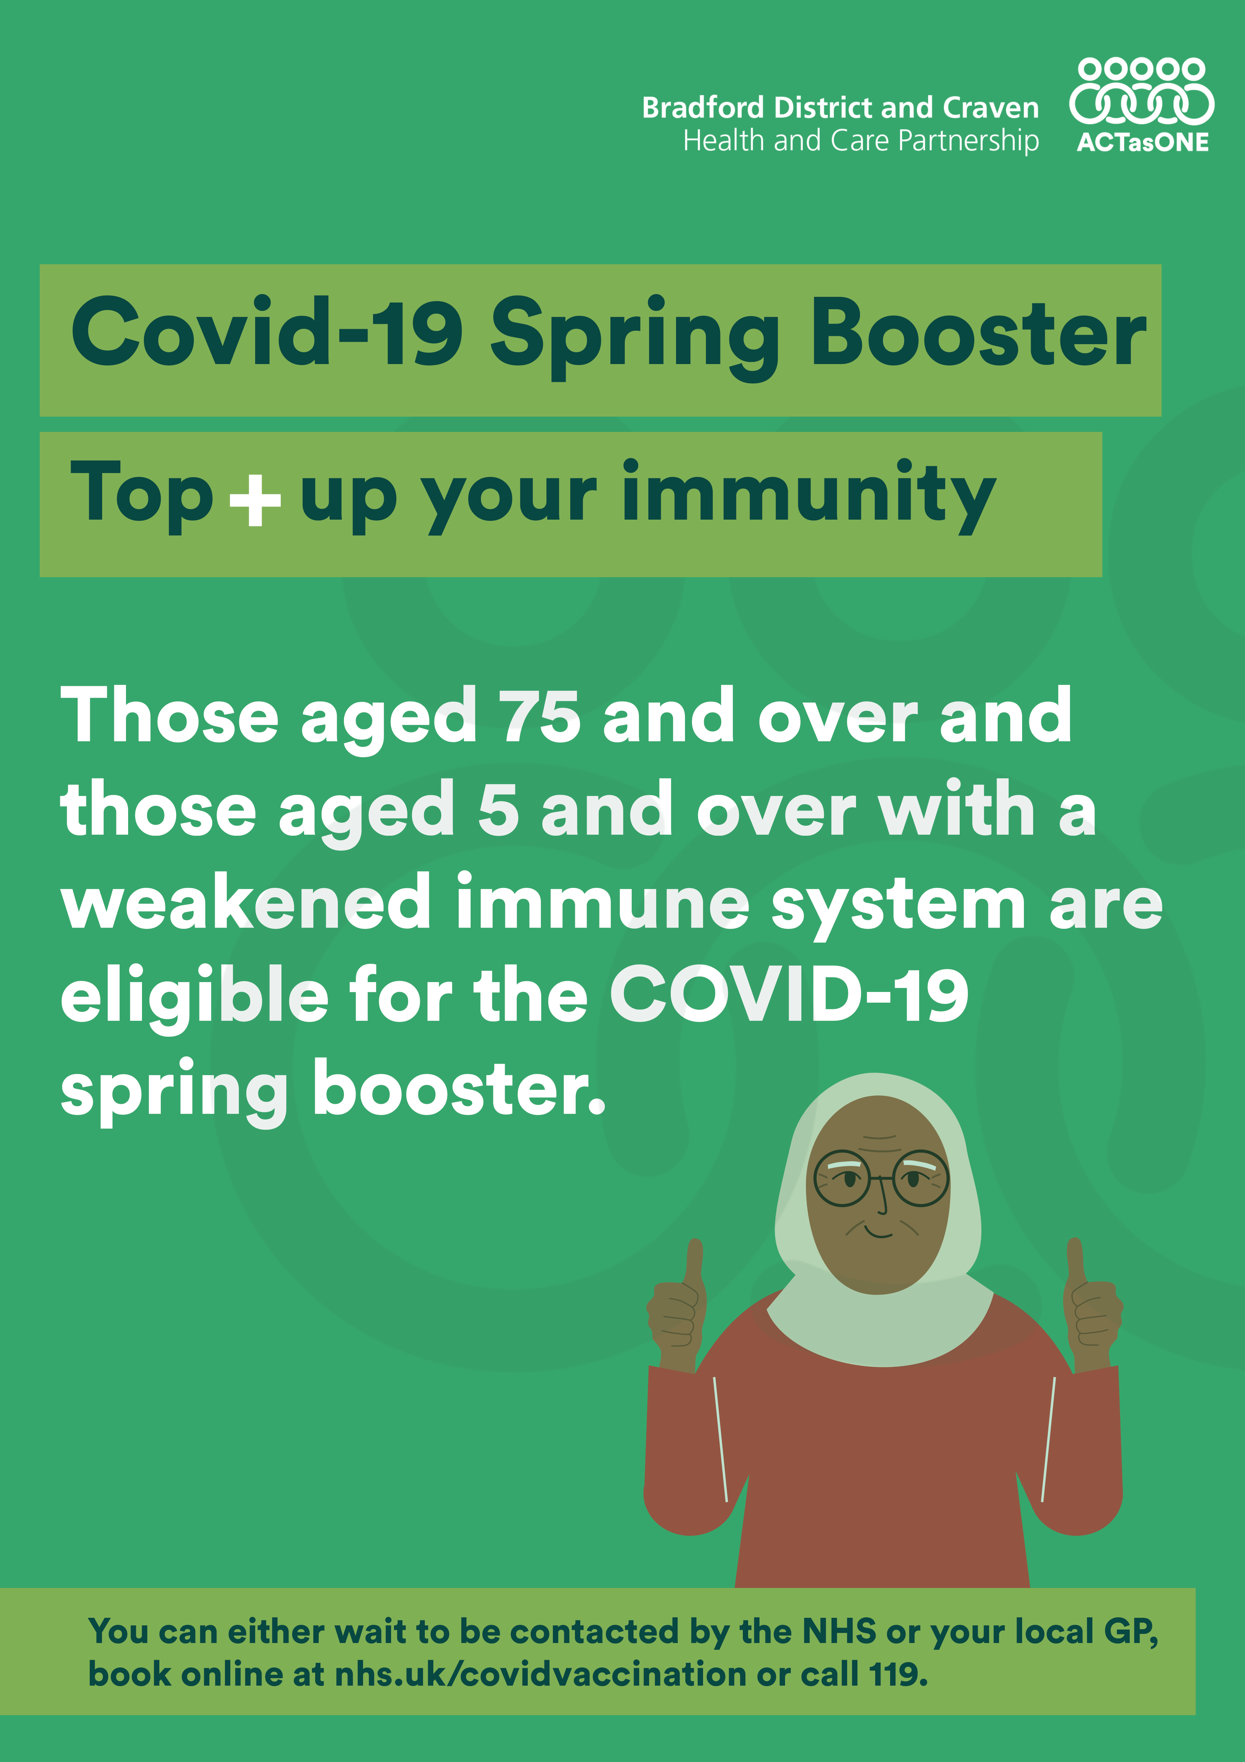
Posters
Click here to download the posters

Slide 9
Press release
Talk to vulnerable loved ones and help them get protected against COVID-19​
​
Everyone aged 75 and over and people aged 5 and over who have a weakened immune system due to a particular health condition or treatment can book their COVID-19 Spring booster at various locations across Bradford District and Craven from tomorrow (5 April).​
​
We’re asking families, friends and carers to talk to loved ones who are at risk and help them get protected as appointments open for the COVID-19 Spring booster.​
​
People eligible for the booster are at risk of serious health complications if they catch COVID-19, something that is entirely preventable with a quick vaccination.​……
Full press release available here
​​
Click here to view the full Press release

Slide 10
Website copy
(For your website)
NHS and partners
People aged 75 and over, residents in care homes for older adults and people aged 5 and over with weakened immune systems are being offered an additional COVID vaccination this spring.
Protection from the vaccines decreases over time, particularly in older people or those with weakened immune systems. The extra vaccination is to help make sure those at greatest risk continue to have high levels of protection against the virus and help prevent them from becoming seriously ill or needing hospital care.
Eligible people will be invited to book an appointment by the NHS or can use the National Booking Service to book an appointment from 5 April. Appointments start from 17 April and will be available until the end of June.
Anyone aged 5 and over who has not yet had their first or second COVID vaccination can also get them during this time. After 30 June, first and second vaccinations will only be offered to those at higher risk of severe COVID and only available during the seasonal campaigns. Please visit www.nhs.uk/covidvaccination to book an appointment or call 119.
For further information on spring vaccinations and the COVID vaccination programme, please visit www.westyorkshire.icb.nhs.uk/covidvaccination
Download Website Copy Here

Slide 11
Gff efoefjf gmldfmw s.mgewo;gew
Upcoming
This is the first set of assets to support COVID-19 vaccination efforts, with more resources on the way soon.
In the coming weeks, you can expect to receive additional resources, including:
  Graphics, website copy, and message scripts tailored for specific populations and target groups.
  Further kits for local health providers, including printed materials to be placed in relevant practices and ready letter/text message to be sent out in both Urdu and English for practices to use.
  Additional kit to promote the evergreen offer for the 1st and 2nd vaccinations
  Kits designed to help facilitate conversations with individuals who are eligible for vaccination.
Other promotional efforts may include:
  Potential Urdu TV, radio, and online advertisements.
  Advertisements in local newspapers targeting specific groups.
  Working with various community groups to help promote the message.

