Slide 1
THE IMPACT OF COVID ON CARE HOMES IN THE BRADFORD DISTRICT

Slide 2
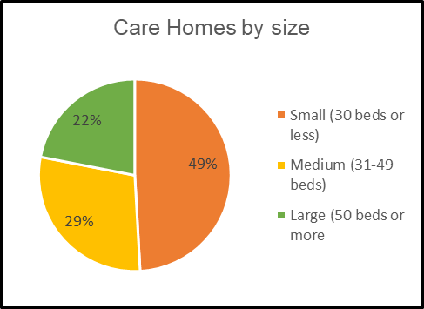
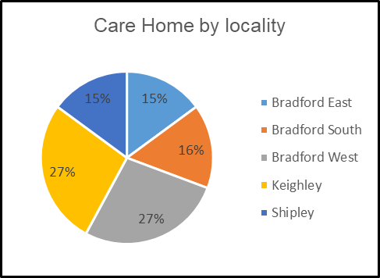
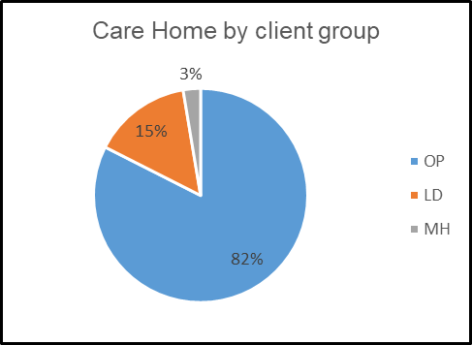
1. The Care Home Sector
There are 114 Care Homes in the Bradford Council District
There are 4148 CQC registered beds, but current capacity in the District, as reported on Capacity Tracker on 26/04/2021 is 3802.
Notes:
71 independent sector residential homes
37 independent sector nursing homes
6 Council-run residential homes

Slide 3
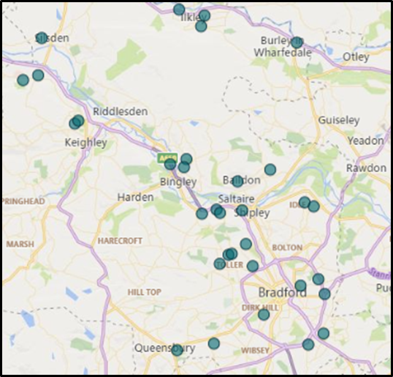
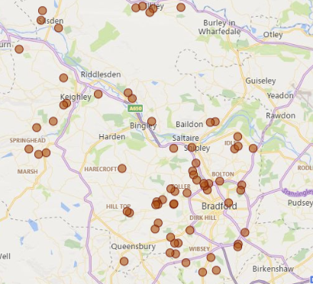
The Care Home Sector (cont.)
Nursing Homes in the District
Residential Homes in the District

Slide 4
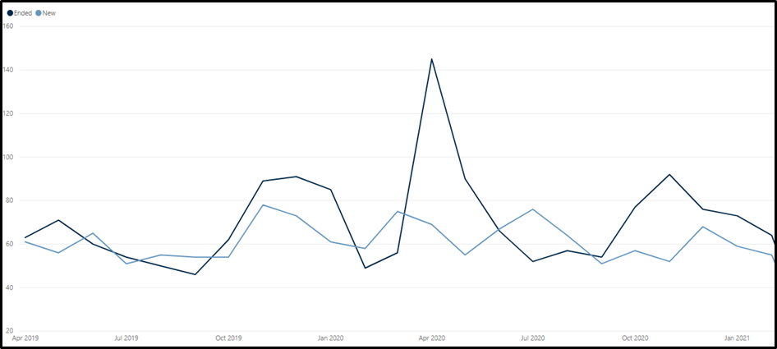
2. New and ended placements
Number of new and ended funded placements by month – All Care Homes for Older People:
Notes:
Overall, the number of placements ending has been reflective of previous years, apart from in April and May 2020 when, at the height of the pandemic, there was a significant increase in placements ending. There was a second spike in placements ending, but to a lesser degree, in October and November 2020.
There has been no significant change in the number of new funded placements being made month on month during the pandemic compared to 2019, except for a slight increase in July 2020 as restrictions from the first lockdown eased.
We can see this in more detail on the next slide

Slide 5
New and ended placements (cont.)
 | Ended | New | Net |  |  | Ended | New | Net
Apr-19 | 63 | 61 | -2 |  | Apr-20 | 145 | 69 | -76
May-19 | 71 | 56 | -15 |  | May-20 | 90 | 55 | -35
Jun-19 | 60 | 65 | 5 |  | Jun-20 | 66 | 67 | 1
Jul-19 | 54 | 51 | -3 |  | Jul-20 | 52 | 76 | 24
Aug-19 | 50 | 55 | 5 |  | Aug-20 | 57 | 64 | 7
Sep-19 | 46 | 54 | 8 |  | Sep-20 | 54 | 51 | -3
Oct-19 | 62 | 54 | -8 |  | Oct-20 | 77 | 57 | -20
Nov-19 | 89 | 78 | -11 |  | Nov-20 | 92 | 52 | -40
Dec-19 | 91 | 73 | -18 |  | Dec-20 | 76 | 68 | -8
Jan-20 | 85 | 61 | -24 |  | Jan-21 | 73 | 59 | -14
Feb-20 | 49 | 58 | 9 |  | Feb-21 | 64 | 55 | -9
Mar-20 | 56 | 75 | 19 |  | Mar-21 | Data incomplete
Notes:
This data indicates that the low occupancy levels being seen in the sector now (see section 3), are not due to a reduction in new placements, but because of the high number of placements ending in April 2020 caused by the excess number of deaths relating to COVID-19.

Slide 6
3. Occupancy levels
Notes:
Pre-pandemic, average occupancy rates within the District were estimated to be approx. 85%. In 2021 average occupancy has remained around 74%.

Slide 7
Occupancy levels (cont.)
Notes:
The percentage of homes with occupancy below 70% has been increasing over the last 6 months.

Slide 8
Notes:
Within the red category, we can see there is also an increasing number of homes with what the BCA consider to be unsustainable low occupancy of less than 60%

Slide 9
Occupancy levels (cont.)
Notes:
When looking at the number of residents (funded by the Council or CHC), you can again see the impact the pandemic had in April, with total number of residents falling after this point. At the start of April there were 807 funded residents, after this point the highest number of funded residents in any month was 726 (September 2020).

Slide 10
Notes:
Breaking the data down by residential and nursing homes, we can see that while the number of people in residential homes have stabilised over the last few months, the number of people in nursing homes continues to decline.

Slide 11
4. Funding sources
Notes:
This data is only available from June 2020 onwards.
As seen in the previous section the number of Council, CCG and joint funded packages has remained relatively stable during this period. We have seen a greater change in placements funded through other sources, with a decline taking place since November 2020.
Other funding sources includes self-funders and out of area placements. This decline may be a result of fewer self-funders choosing to go into care homes, and funding alternative support instead, and also restrictions meaning fewer people moving out of their current home area when going into care.

Slide 12
5. Quality in care homes
Notes:
Due to restrictions on attending Care Homes, fewer number of CQC inspections have taken place. However, where inspections have happened there appears to be a trend for reducing quality, with a 3% increase in the number of inadequate homes between March 2020 and March 2021.

Slide 13
6. What this tells us about the future
Notes:
The current trend in placements is that there will be a slight decline in the number of used beds each month, meaning that percentage occupancy levels will continue in the low 70s without a change in the market.
The first change in the market model reflects a similar increase in placements seen after the end of the first lockdown and a slight increase month on month after that to show potential recovery as confidence in the sector improves. It this scenario, occupancy in the sector would raise to 75% in six months from its current position, and to 76% in a year.
The second model reflects a 4% reduction in the number of beds available (the equivalent of the max capacity of the 3 homes with lowest occupancy) with the same increases in used beds as in model 1. In this scenario, occupancy in the sector would rise to 78% in six months from its current position (79% in a year).
In the third model, we have calculated for a greater reduction in the number of beds available – 15% – while retaining the increases in used beds as in the previous models. In this scenario, occupancy in the sector would rise to 88% in six months from its current position (89%in a year).

Slide 14
What this tells us about the future (cont.)
The low occupancy we are seeing now in the sector is the lasting impact of the high number of deaths (and placements ending for other reasons) in care homes at the height of the pandemic in April and May 2020 last year.
Fewer placements from other funding sources (such as self-funders and out of area) may also be having an impact.
There may be a slight increase in new placements when the latest restrictions ease, as happened in July 2020, but this is unlikely to be significant enough to improve occupancy across the sector.
Higher occupancy rates across the sector are most likely to come from the market shrinking (homes closing) rather than an increase in new placements.
There will need to be renewed focus on quality to ensure the improvements seen in Bradford over recent years aren’t lost.

Slide 15
What's happening now
We are reviewing the Occupancy Support Scheme
The new Residential and Nursing Framework will be launched in June – please look out for this
We are looking at cost of care
We are establishing a strategic group to look at future needs and how the market may need to shift into more specialist areas like complex dementia

