Slide 1

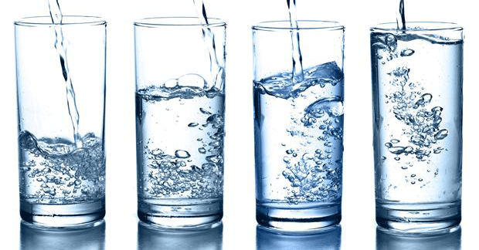

Dehydration and Benefits of Hydration

Slide 2
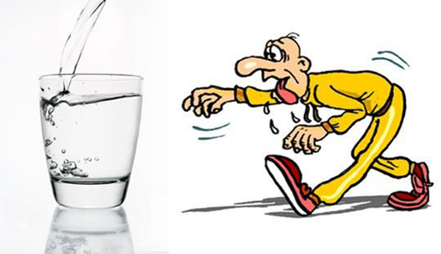
What is Dehydration?
‘the loss of water or body fluids from an
individual’ (World Health Organisation 2002)
Dehydration can affect both our physical and
mental health
It can affect your mood and
feelings as well as your body

Slide 3
CQC: Regulation 14:
Meeting nutritional and hydration needs
• People who use services have adequate nutrition and hydration to sustain life and good health and reduce the risks of malnutrition and dehydration while they receive care and treatment.
• Providers must make sure that people have enough to eat and drink to meet their nutrition and hydration needs and receive the support they need to do so.

Slide 4
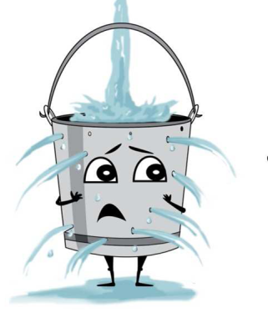
What are the Common Causes of Dehydration?

Slide 5
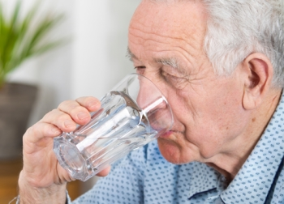
Common causes of dehydration
The elderly have a reduced thirst so may not know when they are thirsty
Unable to communicate (cannot say when they are thirsty)
Pre-existing medical conditions e.g. diabetes, stroke.
Dementia
Cognitive impairment
Medications e.g. diuretics
Dysphagia/swallowing difficulties
Fear of incontinence due to drinking
Mobility and dexterity issues

Slide 6
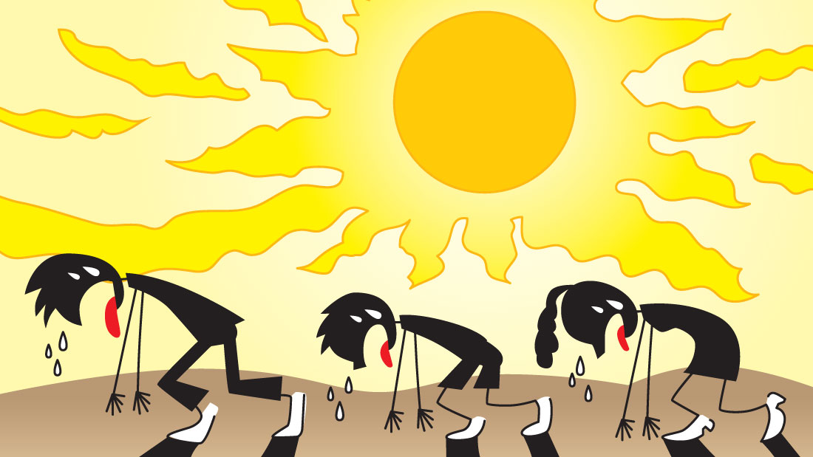
What are some of the signs that can indicate a person may be dehydrated?

Slide 7
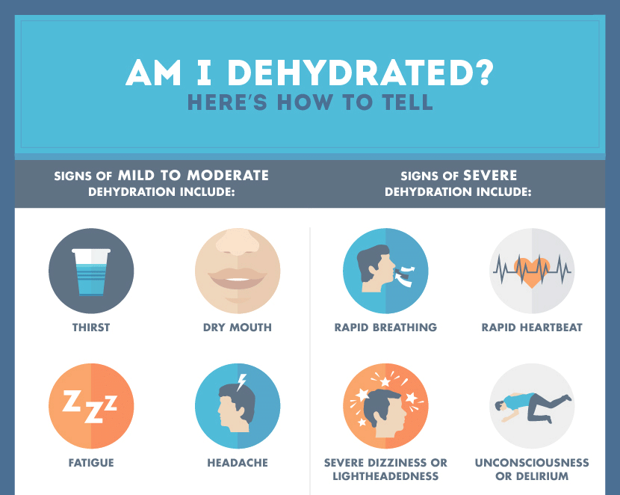
Signs and symptoms that can indicate a person may be dehydrated

Slide 8
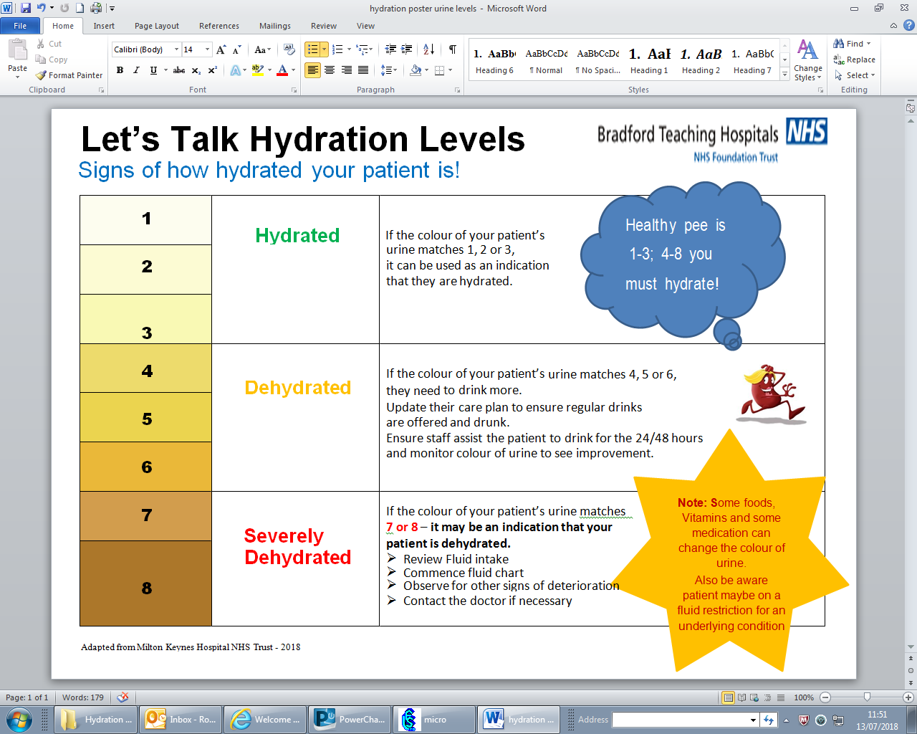
Header here
Text here
Text here

Slide 9
What are the benefits of good hydration?
Good hydration improves cognitive function
Reduced risk of constipation
Promotes skin health and reduces risk of pressure ulcers and aids wound healing
Reduces risk of UTI’s - Good hydration maintains healthy urinary tract and prevents infections

Slide 10
What are the benefits of good hydration?
Avoids postural hypotension (low blood pressure)
Kidney stones- reduces risk of stones forming
Reduces risk of falls- (dehydration identified as a risk to falling)
Reduces risk of hospital admission and improves clinical outcomes
Diabetes- blood sugar levels (high sugar level control leads to increased urine output)

Slide 11

Can you think of ways to improve hydration?

Slide 12

Give people lots of choices
By offering multiple choices, the patient can choose what they want each time

Slide 13
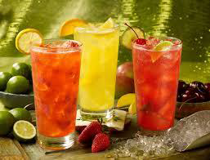
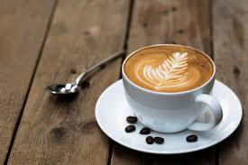
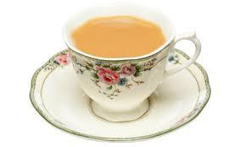
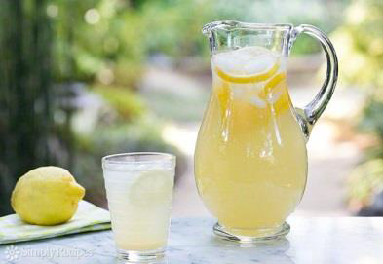
Think about choices – what would people like to drink?
Hot and cold
Different flavours
Colourful options
Fruit infused water
Ice
Squash
Fruit Juice
Nourishing milk drinks
Different types of cups – find out what residents like
Try something new ‘flavour of the week/month’

Slide 14
Tools for assessing and recognising dehydration
GULP dehydration screening tool
https://eput.nhs.uk/wp-content/uploads/2014/07/GULP-Dehydration-risk-screening-tool.pdf
Recognising dehydration
https://www.infectionpreventioncontrol.co.uk/content/uploads/2016/10/Advice-Bulletin-Care-Homes-02-2016.10.pdf

Slide 15
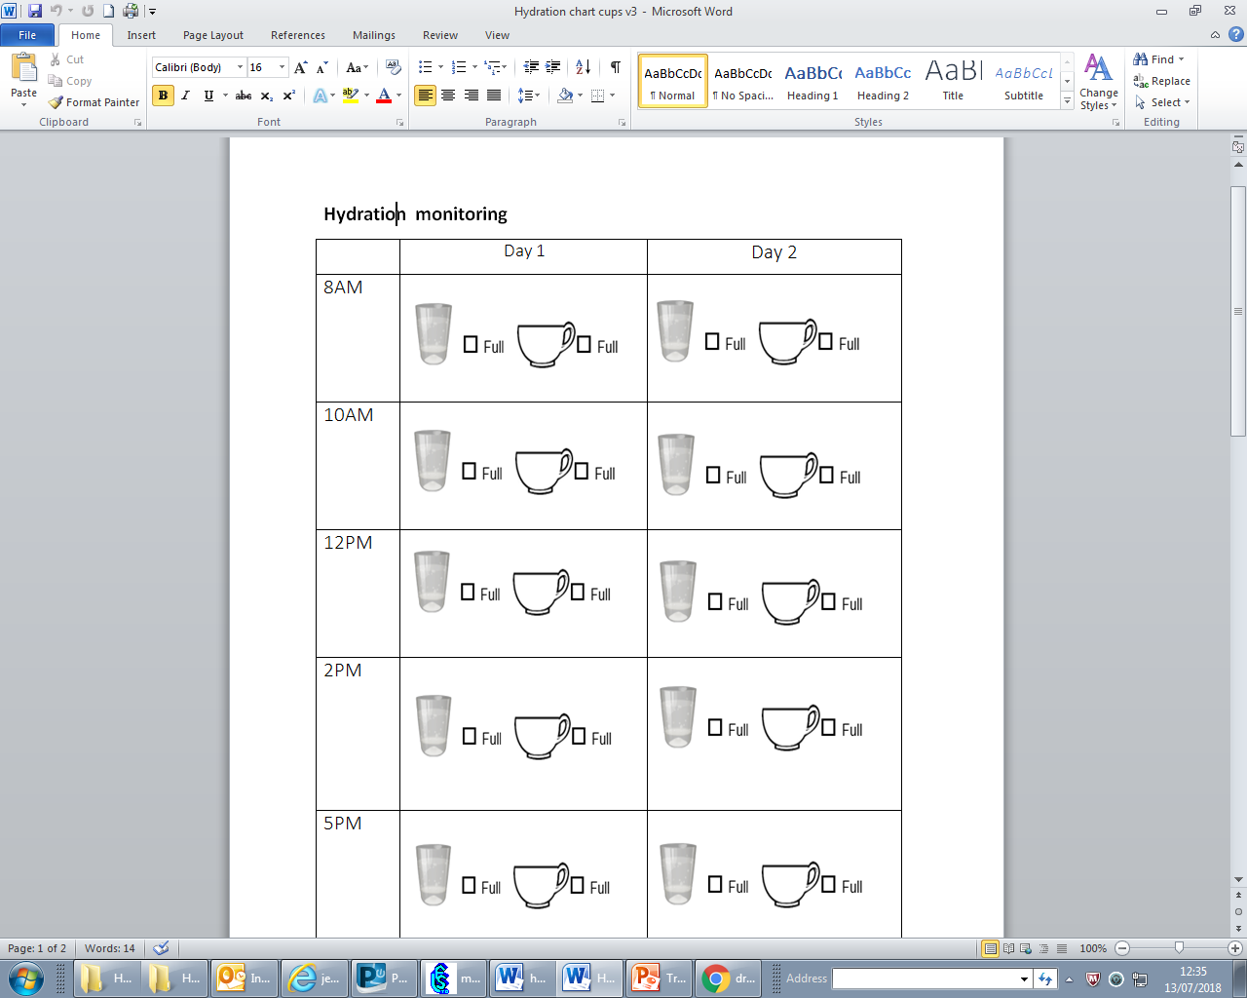
Drinks Record Chart
(if you are concerned about a persons fluid intake)

Slide 16

Do you have any further Questions, Comments, Concerns?
Please email:
CareHomes@bradford.nhs.uk

