Slide 1


The Case for Review - Nutrition and Hydration Standards for Community
Professor Jane Murphy RNutr RD
Bournemouth University

Slide 2
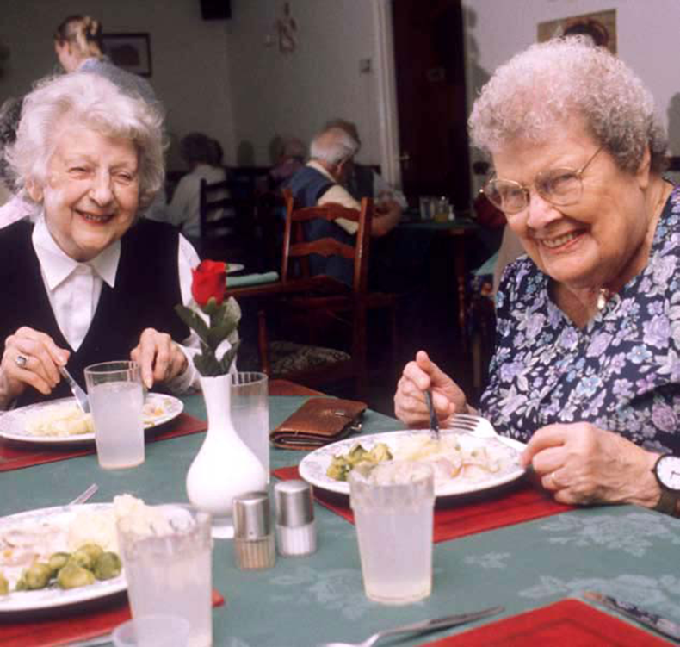
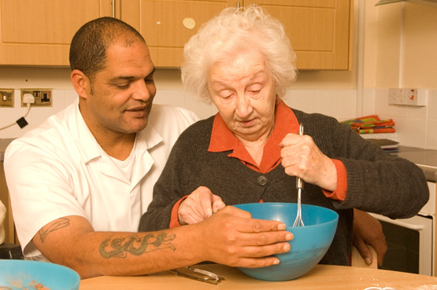

What do we know?
Why is it important to achieve good nutrition and hydration?
How can we deliver good nutrition and hydration?
Notes:
Plan and set the scene

Slide 3
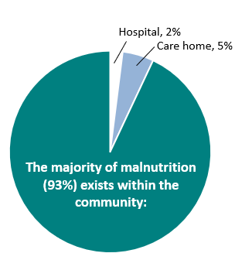
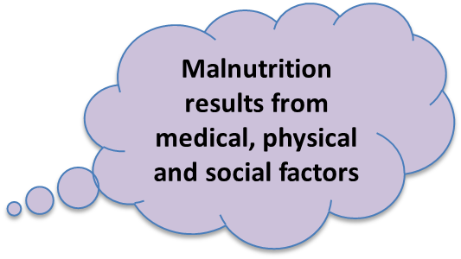
1 in 10 people
>1.3 million people >65 years in UK
30 – 42% of residents are at risk of malnutrition or malnourished on admission to UK care homes (Russell & Elia, 2015)
Notes:
30 – 42% of residents are at risk of malnutrition or malnourished on admission to UK care homes (Russell & Elia, 2015)

Slide 4

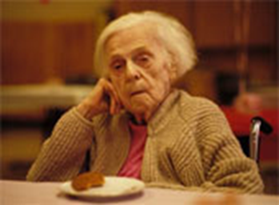
Unplanned weight loss (e.g. dementia and frailty)
Being (or becoming) underweight
Other ‘warning signs’ include:
  Poor appetite
  Loss of interest in food
  Loss of interest in activities / routines
  Absence at clubs / activities
  Withdrawal
  Irritability
  Pressure sores / poorly healing wounds
  Urinary infections
  Poor concentration
  Unwell more or for longer than usual
Notes:
BUST the MYtHS! Losing weight is NOT great, need to change mindset!
Frailty and vulnerability significantly increase risk of dehydration (Volkert et al 2018)
Loss of only 2 – 3% of body fluid can cause physical and cognitive impairment in some people, and older adults are particularly at risk (Picetti et al 2017)

Slide 5
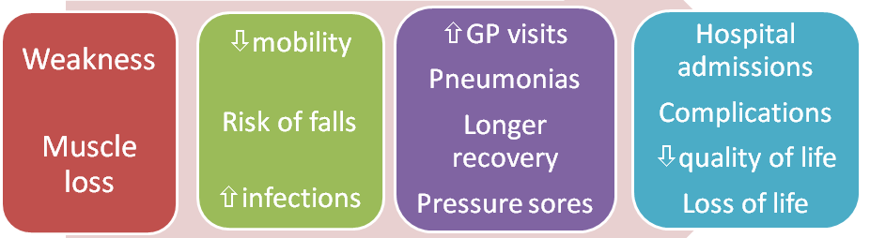
Why is poor nutrition and hydration a concern?
‘It’s a myth that it is normal to get thin & frail as you get older’
Notes:
BUST the MYtHS! Losing weight is NOT great
Frailty and vulnerability significantly increase risk of dehydration (Volkert et al 2018)
Loss of only 2 – 3% of body fluid can cause physical and cognitive impairment in some people, and older adults are particularly at risk (Picetti et al 2017)

Slide 6
What are the National Standards?
Guidelines:
NICE Clinical Guideline 32 ( 2006)
NICE Quality Standard 24 ( 2012)
Training:
Mandatory training: Care Certificate briefly covers fluid and nutrition (standard 8)
Optional training thereafter eg Nutrition and Hydration certificate Level 2
Notes:
Despite national guidelines, malnutrition is still under-detected, under-treated, under-resourced…. and often overlooked
Training is important - come back to training later

Slide 7
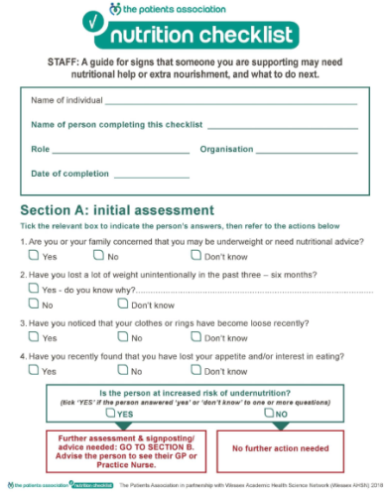
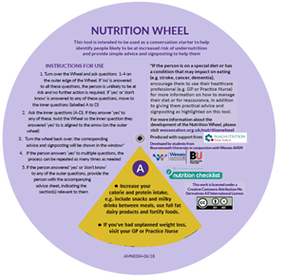
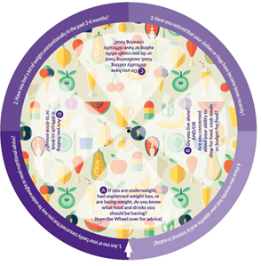
Identifying malnutrition and dehydration?
Validated tools for identifying risk, screening and monitoring in community
No validated screening tool for dehydration
Validated screening tool for malnutrition (e.g ‘MUST’)
Identify malnutrition at an early stage through a conversation, signposting to
appropriate support (Patients Association Nutrition Checklist/Nutrition Wheel)
Notes:
link up health and social care
Incorporate the Nutrition Wheel & Nutrition Checklist - which have the ability to highlight ‘clinical concern’ which could then act as a prompt to formal screening, using ‘MUST’ (NICE guidelines CG32), need to connect pathways
A number of studies have established that commonly used signs and symptoms of dehydration (including assessment of fluid intake, urine colour, urine volume, dry mouth and feeling thirsty):
lack even basic levels of diagnostic accuracy for dehydration
are not appropriate to use, and should not be relied on individually as ways of assessing either presence or absence of dehydration in older people (Hooper et al 2015, Volkert et al 2018, Bunn & Hooper 2019)

Slide 8


‘Eating and Drinking for Health’
Adulthood – stay healthy, prevent illness
Older age – prevent
Illness/malnutrition
Older age – if malnutrition
identified, treat/manage
Balanced varied diet
Low fat
Low salt
Low sugar
High fibre
At least 5 a day
Limit alcohol
Nutrient dense,
Balanced diet
Higher protein
Vitamins
Minerals
Hydration
Nutrient dense
choices
Higher protein
Nutrient
dense food fortification
Hydration
Notes:
When refer to a nutrition specialist support – dietitian?
Nutrition policies?
if resident has lost 2kg/ 2.5kg/ 3kg refer to the GP or Dietitian/request GP to prescribe supplements”
“if resident is at High risk according to MUST refer to the Dietitian”

Slide 9
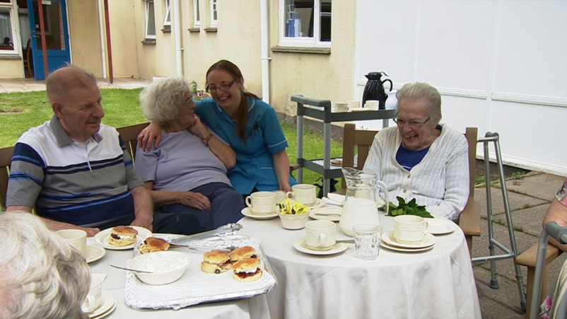
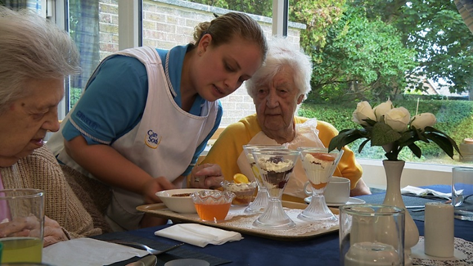
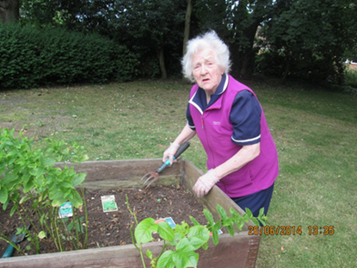
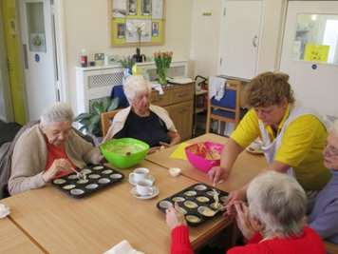
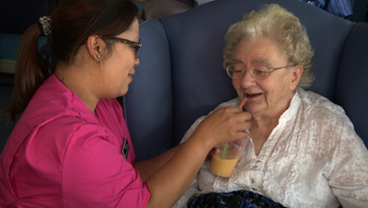
Person-centred nutritional care
Notes:
Not just about food on the plate – more complex.
Social interactions, mealtime experience, eating together/involve family etc
Know personal preferences, optimise opportunities/activities,
Small changes have a big impact e.g. Copy-cat action, change size/colour of cup, mug of tea, ‘whiskey lolly’,

Slide 10
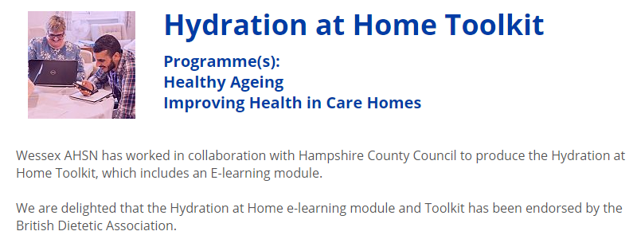
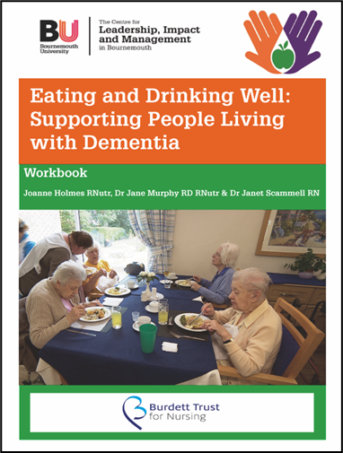
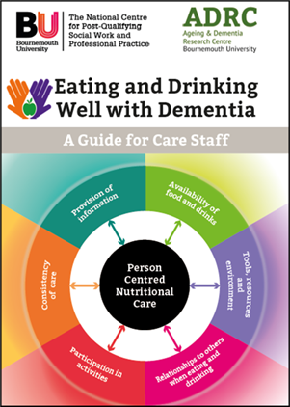
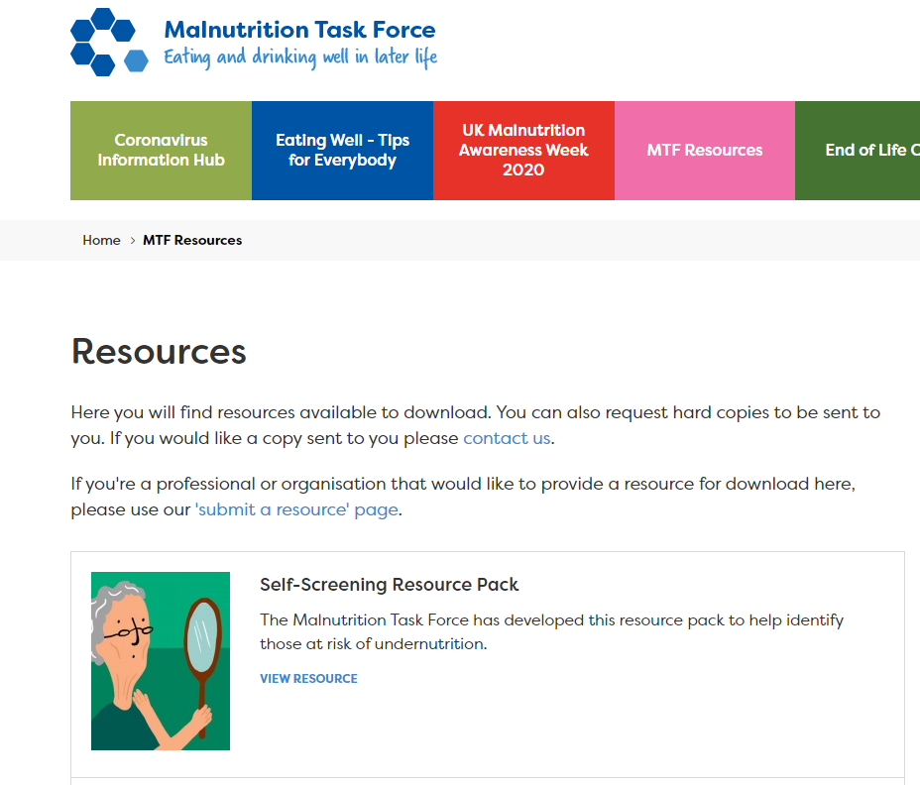


Health Education England's electronic learning for health (e-lfh) portal
Bunn D et al (2019) Nursing Times
DrinKit (supporting hydration care for older adults): https://www.uea.ac.uk/groups-and-centres/uea-hydrate-group
Notes:
Examples:
Research informed tools and resources/toolkits
Validated and tested
Do they work?
What do you use?

Slide 11


Thank you for listening
Any Questions?

