Slide 1
Bringing forward the uplift in the National Living Wage
PROVIDER Update
18/01/2022

Slide 2
Stage 2 Payment
The actual full total cost to you of bringing forward the National Living Wage uplift based on the conditions set out in this letter, minus the value of the Stage 1 payment

Slide 3
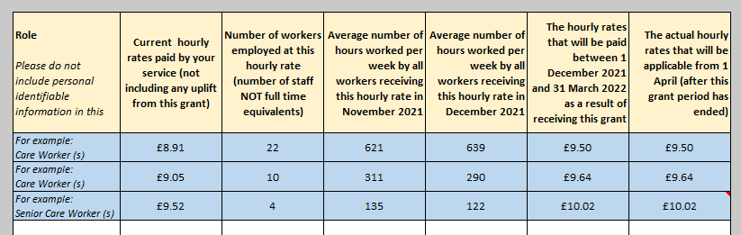
Stage 2 Payment
List all roles you have given an increase to

Slide 4
Stage 2 Payment
Please count each worker only once.
If a worker gets more than one hourly rate, only include this number of the main rate of pay.

Slide 5
Stage 2 Payment
Please give the weekly average in each month for all workers receiving this hourly rate.

Slide 6
Stage 2 Payment
This is the rate paid to staff – on-costs are automatically calculated

Slide 7
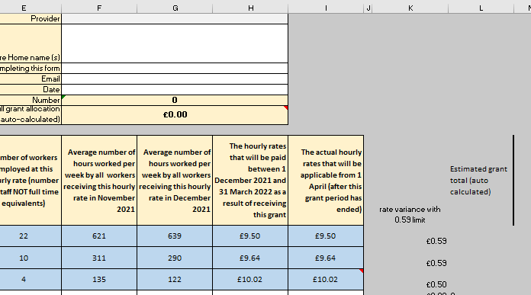
Stage 2 Payment
There are hidden rows that calculate the total the uplift amounts and number hours for the whole period (17.3 weeks)

Slide 8
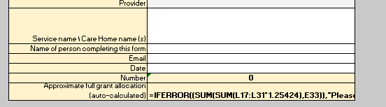
Stage 2 Payment
The on-costs and admin costs (E33) are added to the approximate full grant allocation here.
If the form is completed correctly, you will receive this amount minus your Stage 1 payment

