Slide 1
Bradford Care Home Resources

Slide 2
Suspected Cases
Consider COVID-19 infection in a person with any of the following: New continuous cough, different to usual High temperature (≥37.8°C), shivery, achy, hot to touch Loss or change to sense of smell or taste The new delta variant is presenting with headache, sore throat and runny nose etc. Care home people may also commonly present with non-respiratory tract symptoms, such as new onset/worsening confusion/sleepy or diarrhoea and other subtle signs of deterioration. Record observations where possible: Date of first symptoms, Blood Pressure, Pulse respiratory rate and Temperature (refer to Thermometer instructions) – Remember to Maintain fluid intake Reduce the risks of harm from COVID 19 ( Delirium & Kidney Failure) by ensuring residents are supported to drink regularly For more support contact Immedicare using the laptop provided
Isolation for people who walk around for wellbeing (dementia, learning disabilities, autism) Use standard operating procedures for isolating people who walk around for wellbeing (‘wandering’). Behavioural interventions may be employed but physical restraint should not be used. When caring for, or treating, a person who lacks the relevant mental capacity during the COVID-19 pandemic, please follow government guidance.
Communication with the NHS Local Restore2 Mini and SBARD materials are available at this link Restore2 (a deterioration and escalation tool). Where appropriate please ensure that people are offered advance care planning discussions and that their wishes are recorded. Do you have NHS Mail? Send emails directly to your GP, Community Team and Hospital To get an NHS.net email complete this form and email it to: England DSPT North Please register and use Capacity Tracker to support hospital discharge planning.

Slide 3
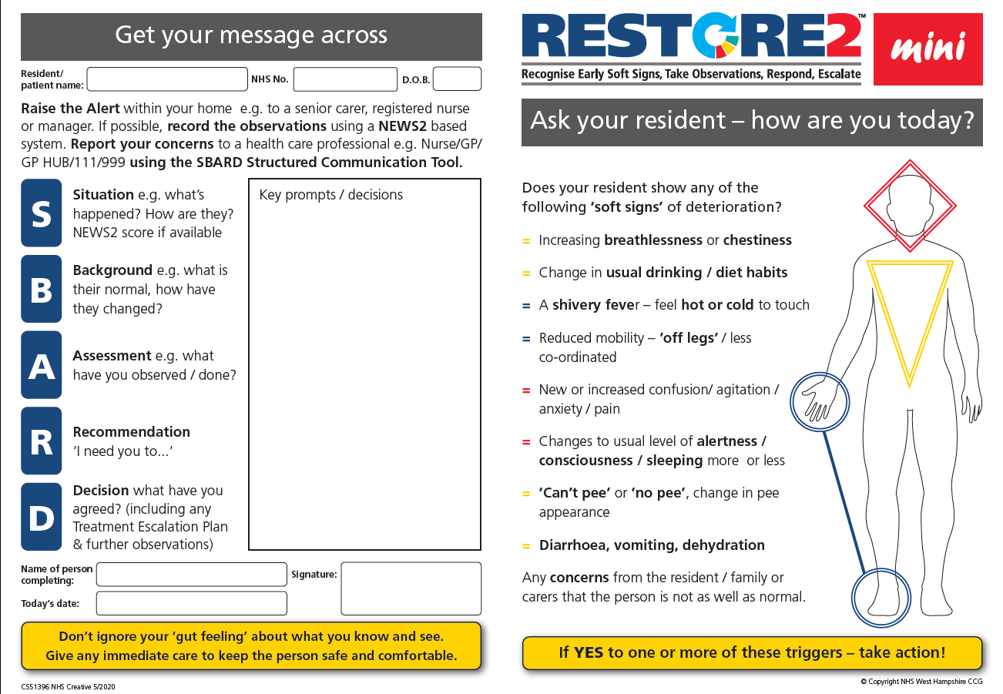
Restore Mini

Slide 4
Taking Observations
Temperature - https://www.youtube.com/watch?v=UxE6J9YBxqs&list=PLrVQaAxyJE3cJ1fB9K2poc9pXn7b9WcQg&index=10
Heart Rate - https://www.youtube.com/watch?v=gfR4N_s-8-0&list=PLrVQaAxyJE3cJ1fB9K2poc9pXn7b9WcQg&index=8
Oxygen Saturation -https://www.youtube.com/watch?v=QabKghrtXps&list=PLrVQaAxyJE3cJ1fB9K2poc9pXn7b9WcQg&index=6
Blood Pressure - https://www.youtube.com/watch?v=G8QkaAyqatE&list=PLrVQaAxyJE3cJ1fB9K2poc9pXn7b9WcQg&index=7
Respiratory Rate - https://www.youtube.com/watch?v=ccKGzZXNKYs&list=PLrVQaAxyJE3cJ1fB9K2poc9pXn7b9WcQg&index=5
Conscious Level - https://www.youtube.com/watch?v=mo1DCAJddkQ&list=PLrVQaAxyJE3cJ1fB9K2poc9pXn7b9WcQg&index=9
https://www.youtube.com/playlist?list=PLrVQaAxyJE3cJ1fB9K2poc9pXn7b9WcQg
https://www.hampshiresouthamptonandisleofwightccg.nhs.uk/your-health/restore-official

Slide 5
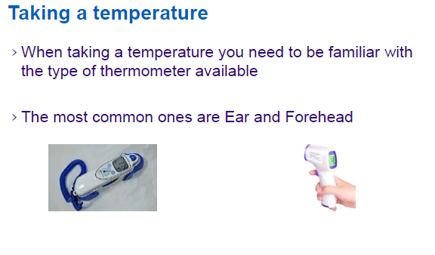
Temperature

Slide 6
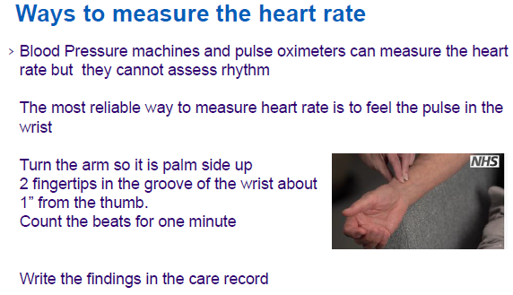
Heart Rate

Slide 7
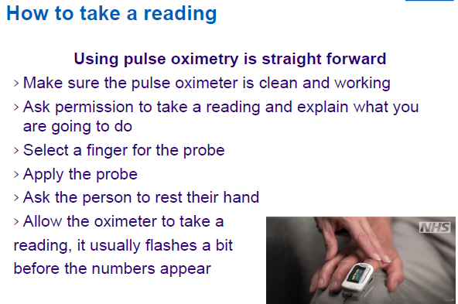
Oxygen Saturation

Slide 8
Blood Pressure
https://www.youtube.com/watch?v=G8QkaAyqatE&list=PLrVQaAxyJE3cJ1fB9K2poc9pXn7b9WcQg&index=7

Slide 9
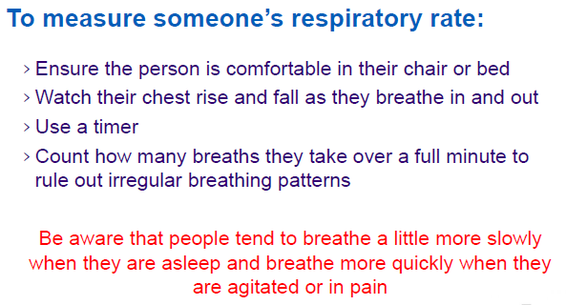
Respiratory Rate

Slide 10
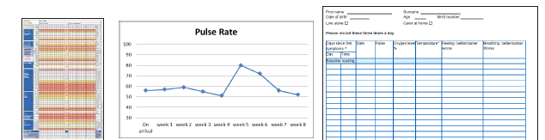
Document
Don’t forget to send your observations to the Super Rota doctor at digital.carehub@nhs.net

Slide 11
Isolate and Monitor
Person to be isolated for 14 days in a single bedroom. Use Infection Control Guidance for person using PPE (guidance and how to wear and dispose) Due to sustained transmission PPE is to be used with all people. Additional PPE is required for Aerosol Generating Procedures as recommended here Ensure the correct donning and doffing technique is used (video) Practice the 5 moments to hand hygiene here Consider bathroom facilities. If no en-suite available. Designate a single bathroom for this person only / own commode in room Record temperatures twice a day, including asymptomatic residents. Monitor oxygen saturations and observe for signs of deterioration. PLEASE USE YOUR nhs.net ACCOUNT TO EMAIL YOUR OBSERVATIONS & ISSUES IDENTIFIED ON THE RESTORE2 MINI EVERY MORNING TO IMMEDICARE Digital.carehub@nhs.net FAO of the SUPER ROTA
What to do in case of an outbreak? An outbreak is defined as two or more people in the care home diagnosed with symptoms compatible with Covid-19 If you have one or more new symptomatic people and these are the first new cases for over 28 days: Contact: The Health Protection Team (Yorkshire and Humber) Phone number: 0113 386 0300 Email: yorkshirehumberhpt@phe.gov.uk Update: Capacity tracker, your Local Authority and RIDDOR
How to access Personal Protective Equipment (PPE): Order PPE through your normal supplier. Contact your Local Authority or visit the Bradford Provider Zone for external suppliers. Guidance for Residential Care Providers
Resources and Support for Care Home Staff Guidance on how to work safely in care homes COVID-19 Care Platform Bradford Provider Zone RIDDOR reporting of COVID-19 Recognising & Responding to Deterioration – Module 1 – Softer Signs (includes RESTORE2 MINI) Document 1, Document 2, Document 3 Recognising & Responding to Deterioration – Module 2 – Measuring Vital Signs Document 1, Document 2 .Document 3, Document 4 Recognising & Responding to Deterioration – Module 3 – Keeping Residents Safe Through Good Communication & Teamwork (includes SBARD) Document 1, Document 2

Slide 12
