Slide 1



Talking about My Future Wishes during COVID Having, recording and sharing important conversations

Slide 2
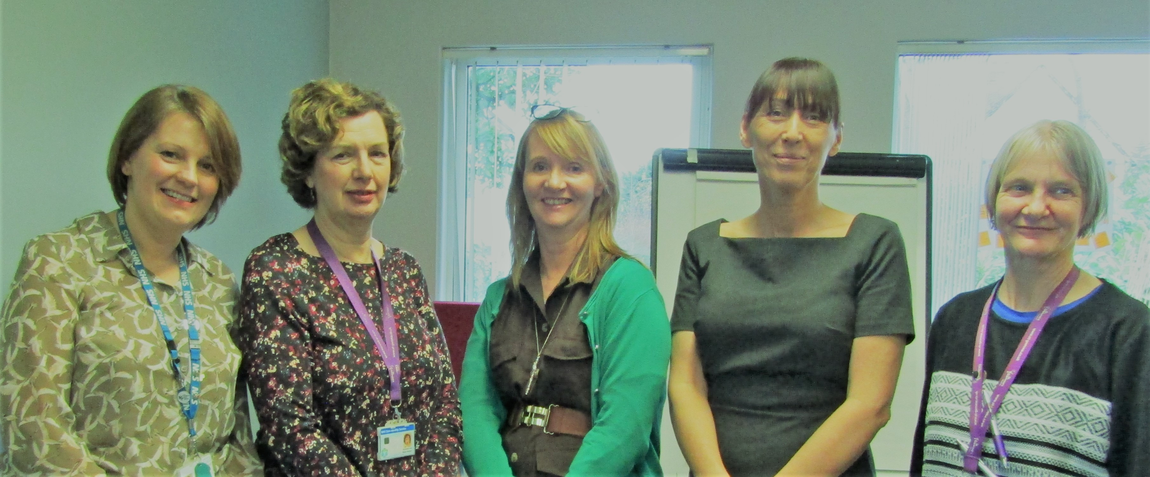
The Team
Janet Millard
Debby Veigas
Jane Chatterjee
Penny Kirk
Helan Mullan

Slide 3
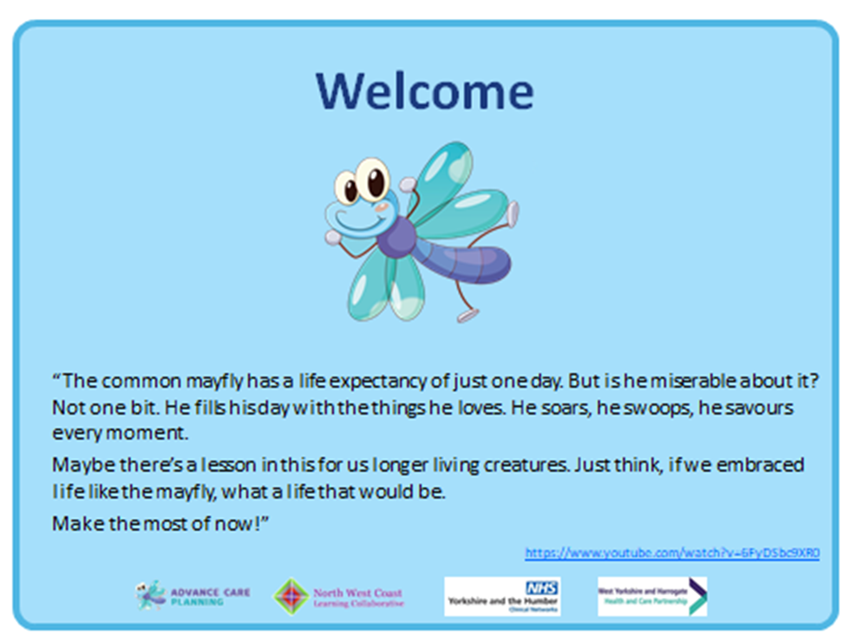
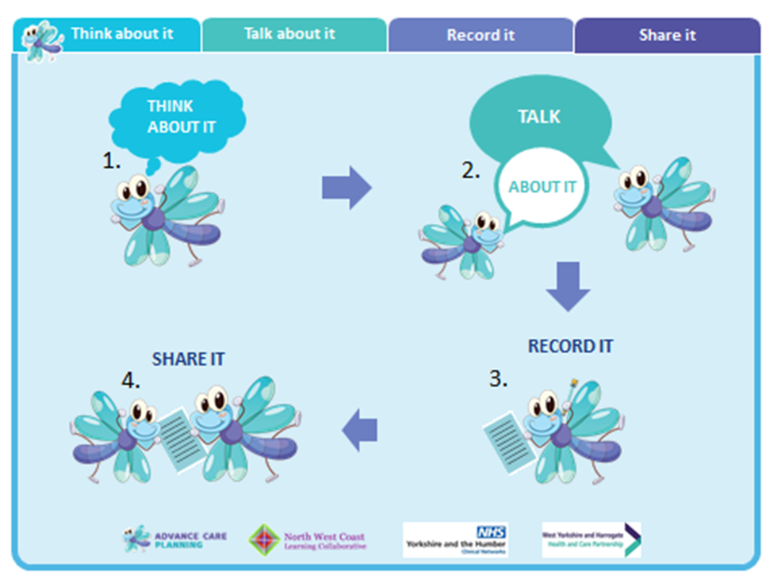
Introduction
Notes:
JC

Slide 4

Think about it
Advance Care Planning (ACP)
Is a discussion between an individual and their care provider(s) to make clear their wishes and preferences about their future care and treatment.
It takes place when a person has capacity and is to be used only when a person lacks capacity to make their wishes know

Slide 5

Think about it
A continuous process
Sensitive
Timely
Starting the conversation can pave the way for others
Notes:
JC

Slide 6
Think about it
Advance Statement
Let people know your wishes
Ask someone to speak for you
Named Spokesperson
INFORMAL
Personal
Future Plan
Advance Care Plan
Advance Decision to Refuse Treatment
Lasting Power of Attorney
Refuse treatment in advance
Appoint someone to make decisions
FORMAL
Legally binding
Notes:
JC

Slide 7
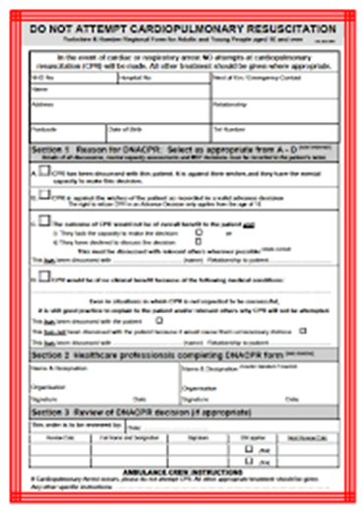
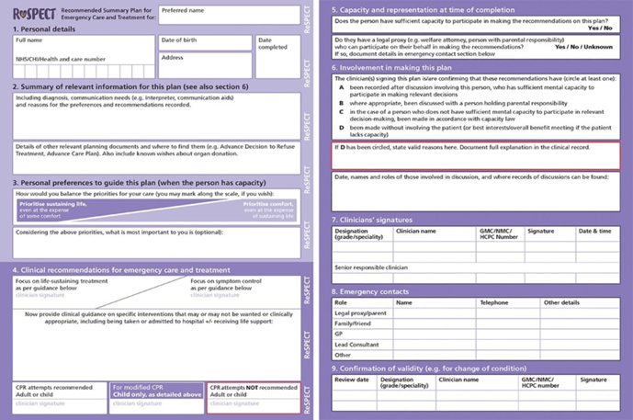
Anticipatory Clinical Management Plan
Notes:
JC

Slide 8









Think about it – COVID 19
Staying in touch
Difficult conversations by phone or video link
What care and treatment is available at the home/ going to hospital
Communication-wearing PPE
Check validity online
Alternative funeral plans
Notes:
JC

Slide 9
Talk About It
Introduction
Experiences Discussion
To recognise the need to facilitate conversations so that we may open up conversations about Advance Care Planning
To acknowledge that these conversations are often difficult
To consider the consequences of not opening up these conversation
To identify when these conversations need to be passed on to other more experienced staff
To acknowledge that we don’t have to know all the answers but gathering the information and passing it on is really important.
Notes:
JM

Slide 10





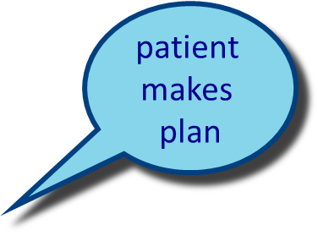
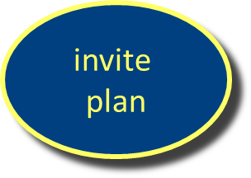
Simple Skills Secrets
patient
gives
cue
screen
summaries
Notes:
JM

Slide 11

A conversation about future care wishes may start because we ask an open Question or the person gives us a Cue.
An Open Question cannot be answered by yes or no and encourages the person to talk.
Eg.” What are your thoughts about …….”
A Cue “I’m worried about this virus”
Followed by an open question
“what is it that’s worrying you?”
Notes:
JM
Encourage the person to open up the conversation by using open questions
For example – ‘What are your thoughts about your future care wishes?’, ‘How would others know about your wishes and preferences?’
‘Do you feel your preferences have changed since the covid pandemic?’

Slide 12




Talking about it
Remember that wearing PPE significantly impacts on non verbal communication, in particular facial expressions .
You should be mindful of this when talking to service users
Consider the tone of your voice
Eye contact
You can use gestures such has head nodding and verbal encouragement like “mmm…or tell me more”.
Remember most people are more likely to listen
to the tone of your voice rather than the words that you
have said.
Notes:
JM
Non-verbal communication or body language says a lot about our interest and engagement in the communication we are having.
Even when we say the right things, the message can be lost if our body language suggests we are thinking something very different.
When you are wearing PPE, it is really important to consider the tone of our voices and the important of using empathic language.

Slide 13
Talk about it
Empathy, the ability to see a situation from another's perspective, it is a key skill in effective communication.
It is often, however, confused with sympathy.
People sometimes have concerns about how to show empathy if they are worrying that it will make things worse for the person they are talking to.
Notes:
JM
These demonstrate you are trying to understand the patient’s 'perspective and encourage further elaboration.
For example:
“It sounds like you have had a really difficult time recently since your relatives have been unable to visit you”

Slide 14
Talk about it Sympathy, Pity and Empathy
Pity
Poor you that is awful
Sympathy
I know how you feel that must be terrible
Empathy
That sounds really difficult, tell me more
Notes:
JM

Slide 15
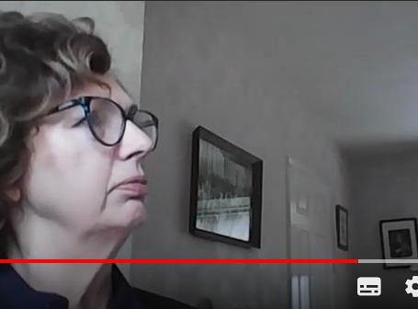
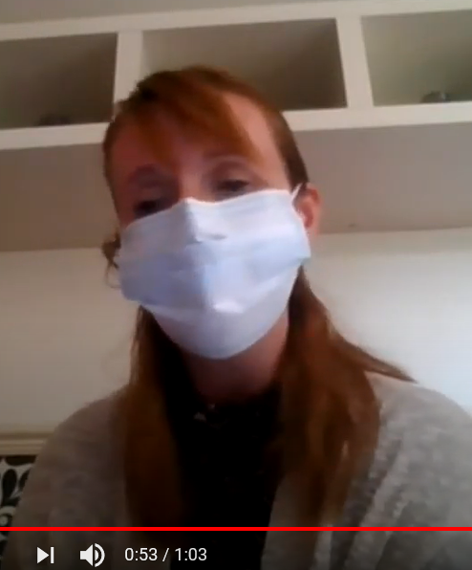
VIDEO: Blocking the Conversation
Press Ctrl and click the text above to go to the video
Notes:
JM

Slide 16
Blocking (video 1)
This clip demonstrates blocking
Alice gives 3 cues that all give an opportunity to open a conversation about future wishes:
“I wouldn’t want to go into hospital “
“I’d be frightened to death”
“I am frightened”
Janet does not pick up any of these cues in this clip.
Notes:
JM

Slide 17

Blocking behaviours Stop the person talking about their concerns, can be very obvious or more subtle by using:
Inappropriate information/Jollying along
Closed questions
Defending/justifying
Premature reassurance/advice
Normalising
Passing the buck
Notes:
JM

Slide 18

VIDEO: Enabling the Conversation
VIDEO: Enabling the Conversation
Press Ctrl and click the text above to go to the video
Click a picture to watch the video
Notes:
HM

Slide 19
Picking up the cue (video 2)
“I wouldn’t want to go back in to hospital”
This time Janet acknowledges the cue “I can imagine” and then clarifies and explores Alice’s thoughts.
Notice who does most of the talking from a few simple prompts Janet gets a good idea of Alices wishes.
Having gained the information she seeks permission to pass it on to a senior colleague.
Notes:
HM

Slide 20
Allow the person to talk
Remember not to jump in Silence/Pauses give the person time to think.
Active Listening
This lets the person know you are listening:
Maintain good eye contact
Is your body language showing that you are open and interested
Nodding your head, facial expressions
Minimal prompts “yes” “right”, “go on” “mm mm”
Notes:
HM

Slide 21
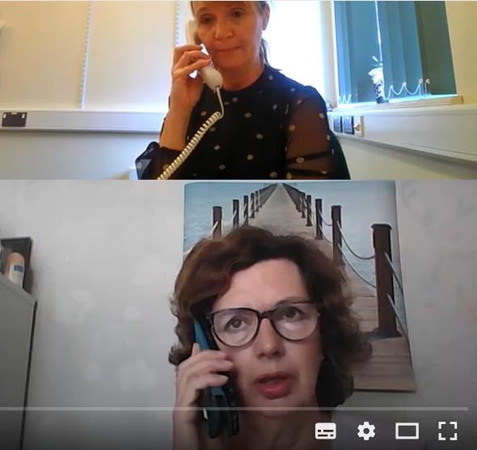
VIDEO: Discussing future wishes for care
Press Ctrl and click the text above to go to the video
Notes:
HM

Slide 22
Phone call to a patient to discuss wishes for future care.(video 4)
Notice how Janet sets the scene:
“can you remember talking to your doctor about….”
“have you reflected on”
Janet summarises and clarifies what Mary says throughout the conversation
She encourages her to continue “tell me more about…”
“Sounds as though you’ve been thinking a lot..”
She screens for more concerns “is there anything else”
Notes:
HM

Slide 23


Summarise
When the person has talked for a while and given you some information it is important to Summarise what you have heard.
This lets the person know that you are listening
Allows them to correct any misunderstanding
Gives you the opportunity to clarify the information
Eg.
“So you are frightened of being breathless and being alone at home.”
“So what you are feeling at the moment is you would want a full package of care and home oxygen....”
Notes:
HM

Slide 24

Screening
At this point it is tempting to move the conversation on to solutions but it is important to make sure there is nothing else concerning the person.
This is Screening.
Eg. “Is there anything else ?”
“Is there something else worrying you?”
Don’t forget to convey empathy throughout the conversation just little phrases make the difference
When you have gathered all the information you are ready to make a plan of how to take things forward.
Notes:
HM

Slide 25

Inviting A Plan.
Ask the person what they would like to do, how do they want to take things forward.
Do they want you to speak to someone else.
You may not be the best person to take this forward so ask permission to pass the information on to a more appropriate colleague. (see egs in videos)
Below are examples of documents that people can use to record their wishes would the person want something like that.
Notes:
HM

Slide 26
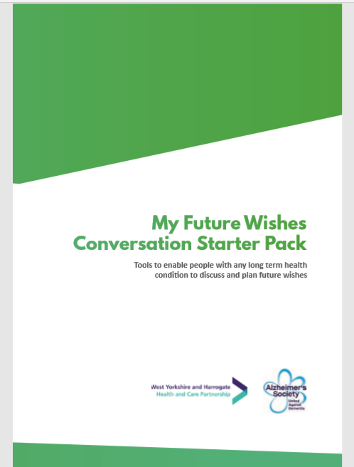
Available to download here:
http://www.yhscn.nhs.uk/media/PDFs/mhdn/Dementia/Care%20Planning/Alzheimers%20resource/My%20Future%20Wishes%20Care%20Pack%20PDF%20READ%20VIEW.pdf
Notes:
DV

Slide 27
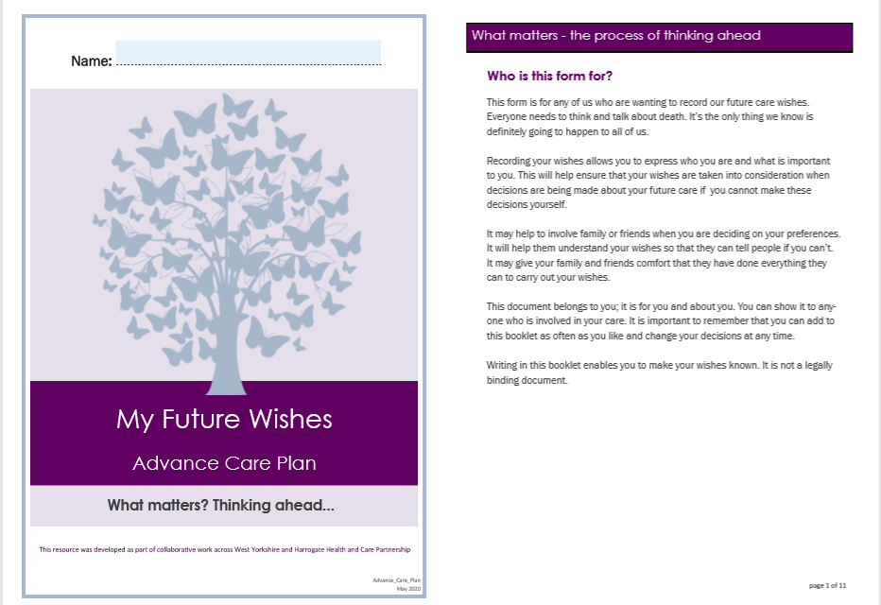
Record it and Share it
Available to download at:
http://www.yhscn.nhs.uk/media/PDFs/mhdn/Dementia/Care%20Planning/ACP%20Resources/Advance_Care_Plan_May2020_editable.pdf
Notes:
DV
It is important that information from these ACP conversations is written down and with consent shared with all who are involved with the person and their care.
There are various templates to record a person’s preferences and wishes. This is an example of one developed by the Alzheimer’s Society in consultation with people living with dementia. It is also likely that as individual care homes you have your own way of recording this information.
Electronic systems are used to share information across health and social care services. Key pieces of information will be recorded to allow professional’s quick access to the information in an emergency or if a person is moved to a different care setting such as being admitted to hospital.
The back page of this future wishes booklet can be completed and given to the GP to input the information onto the person’s electronic record.
This information includes: Key contact persons; preferred place of care and of death for the person and if there is any ACP documents and where they are kept, Documents such as:
Statement of preference and wishes; LPA; ADRT; DNCPR or emergency care plan.

Slide 28
Summary
ACP conversations allow people to say what they would or would not want to happen should they become less well and be unable to express their needs.
It supports families to know that decisions made on behalf of a person who has lost capacity are being made in their best interest. This can alleviate distress in crisis situations.
It is important that people are given the opportunity to have these conversations and this can be done sensitively by those who know them well; using open questions to ask about their worries, concerns or wishes for the future.
Having opened the conversation it is important to acknowledge what is being said but it is not necessary to have all the answers. Support can then be asked for from appropriate health or social care professionals.
Starting these conversations makes it easier for the specialists to discuss more specific issues if this is needed.
There is no blanket approach to making decisions about a person’s care and treatment. These are made on an individual basis weighing up risks, burdens and benefits to that person and valuing their wishes far as is practicable
Notes:
DV

Slide 29

Jane Chatterjee and Helan Mullan, St Gemma's Hospice, E: janec@st-gemma.co.uk Debby Veigas and Janet Millard, Wakefield Hospice E: debby.veigas@wakefieldhospice.co.uk E: janet.millard@wakefieldhospice.co.uk Penny Kirk, Quality Improvement Manager (Dementia and Older People's Mental Health) T: 07825 242493 E: penny.kirk@nhs.net Colin Sloane, Quality Improvement Lead (Dementia and Older People’s Mental Health) T: 07554 222798 E: colinsloane@nhs.net

