Slide 1
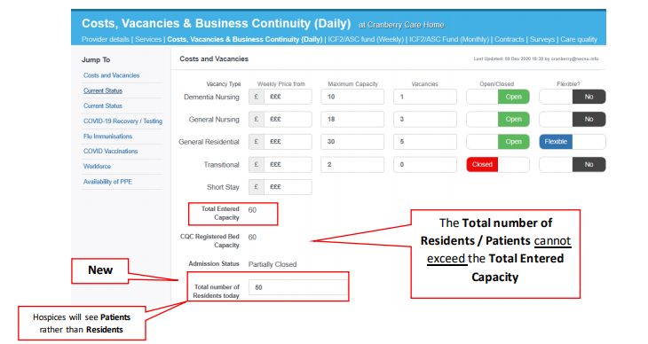
Resident/Patient Count
New field capturing resident/patient number
Cannot exceed Total Entered Capacity
The residents number must match in the COVID and flu section

Slide 2
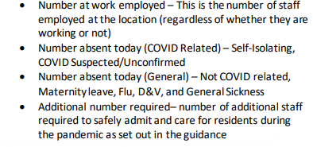
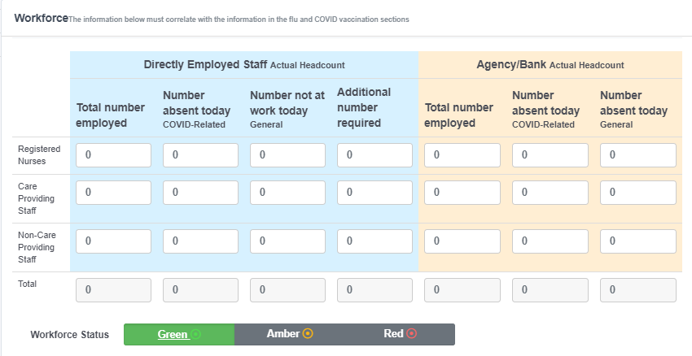
Revised Workforce cont’d …
This number must match the staffing numbers in the COVID and FLU vaccinations section

Slide 3
COVID Vaccination
Section to capture First COVID Vaccination for Residents, Directly Employed Staff and Agency/Bank workers for Care Homes & Hospices
Residents – total must equal Total No. Residents
Staff – total must equal Total No. Directly Employed Staff
Agency/Bank – total must equal Total No. Agency/Bank staff employed

Slide 4
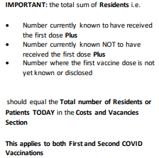
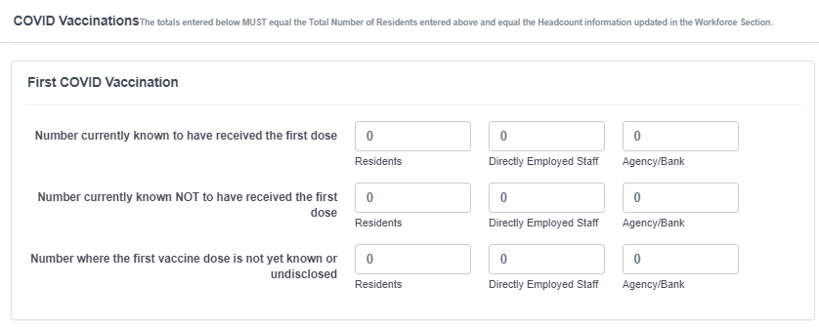
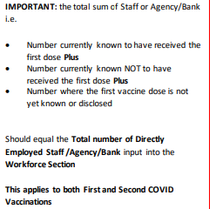
COVID Vaccination cont’d…

