Slide 1
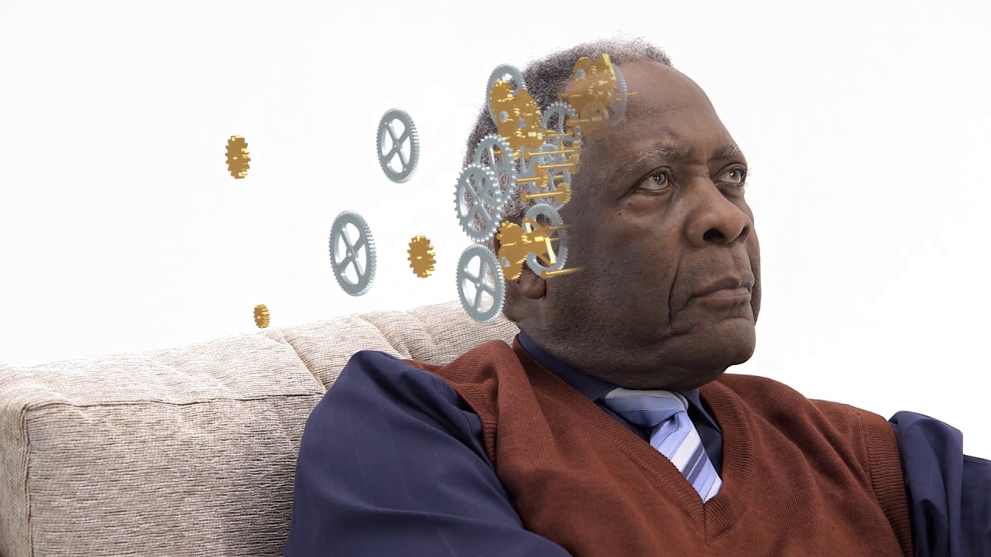
Assessing a persons capacity to understand COVID testing and best interest decision making

Slide 2

Right to private life includes the right to make autonomous decisions
Can you imagine that one day someone decides that you are not in charge of your own life and you are not able to make decisions for yourself. Others begin to make decisions for you and you are unaware of when you can make decisions and when other can make decisions for you. This includes medical testing and treatment. How scary might that feel. The Human Rights Act tells us that we must justify taking away a persons right to make decisions for themselves in the form of a capacity assessment and a best interest decision.

Slide 3
The assumption of capacity – the person is the decision maker
The law says that we must assume capacity unless there is reason to suspect otherwise. What might those reasons be?
If we say that the person (Within our service) has capacity to make a particular decision and something goes wrong (In relation to the decision made), who is responsible for the consequences of the decision?
For this reason we may choose to record a capacity assessment if we believe someone might challenge that assessment.

Slide 4
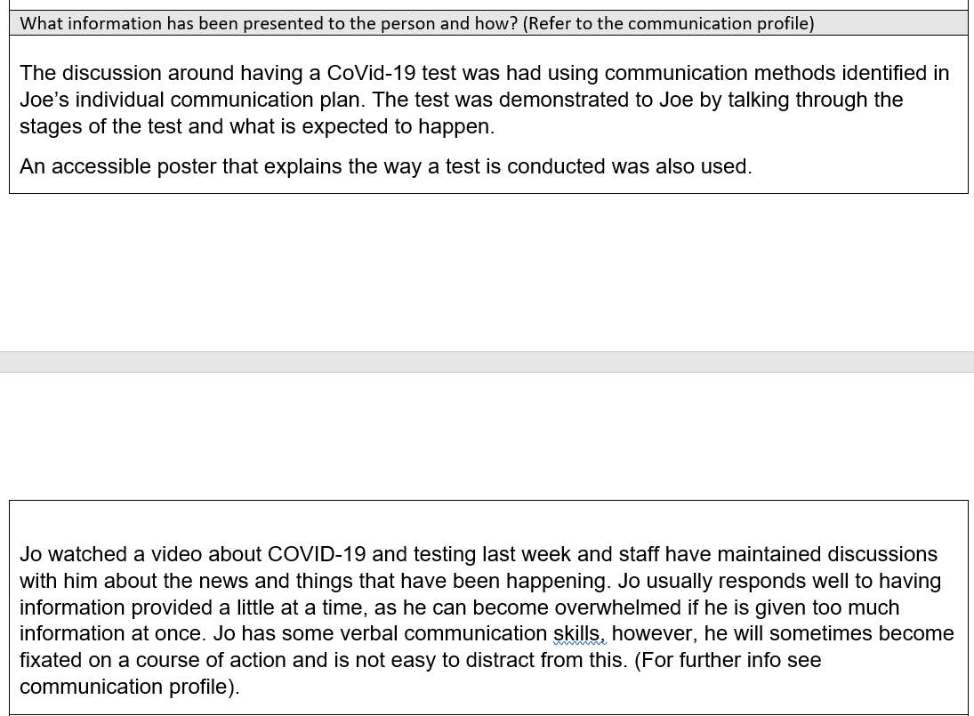
People should receive support to help them to make their own decisions
No matter how disabled a person is they deserve your best attempt to get them to understand something explained in the best way possible for them. The law requires you to demonstrate how you have attempted to help the person to understand and why that was the best method. We also need to recognise things like the best form of communication, the best place, best time of day, when the person feels the most safe and secure, who might be best to communicate with the person.

Slide 5
Consent to Treatment
To ensure that I knew I had consent for testing I would ………….I would want to hear…………… I would want to know
What the virus is
What the test is for
How the test is conducted
What happens if the test is positive
What happens if the test is negative
Having the test means
Not having the test means
If a person is considered to have capacity to make a decision they are responsible for the consequences of that decision, not service providers or others. You must make sure that the person fully understood the decision that they were making and the consequences of their chosen actions or choices.
The first thing that you need to do in any capacity assessment is work out for that individual at that time, in that situation what would they need to know to make an informed decision.

Slide 6
Have those discussions with the person and write down their responses
When watching the video about testing we tried to engage her in recognising the swab test and indicating where it would go whilst she was watching the video. When Sarah is enagaged and understands something she will give eye contact and point to the things mentioned at the time mentioned. Sarah would not give eye contact and continued to play with her blanket. Satah usually doies this when she feels uncomfortable about something
When talking to George about the virus George said that he had a been watching the television and he saw that all over the world people are dying from the virus. George was given a sample test kit and we demonstrated where the test would go. George wasn’t keen on having the swab in his throat but said that he wanted to get out to the pub each week and if he could do that he would take the test. We told George that if he didn’t have the virus at the moment he could go to the pub. We showed a video about how this might change if further restrictions were put in place. George said that he didn’t want restrictions because they hurt him. We explained that these were different restrictions. George understood about the virus, he recognised how to take the test but could not understand fully the consequences of having or not having the test. He became anxious when restrictions were mentioned as he had previously in a secure hospital experienced unnecessary restraint that staff called restrictions.

Slide 7
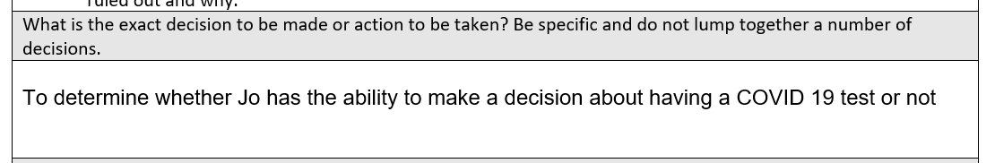
People often make mistakes in this box by pre-empting the outcome of the capacity assessment or identifying what they want to happen:
For Jo to have a COVID test
For Jo to be supported to have the nasal test because a member of staff tested positive
This does not demonstrate us respecting a persons right to make decisions for themselves because we are deciding the outcome before we have had a chance to discover and determine whether they can make the decision including the right to make unwise decisions.

Slide 8
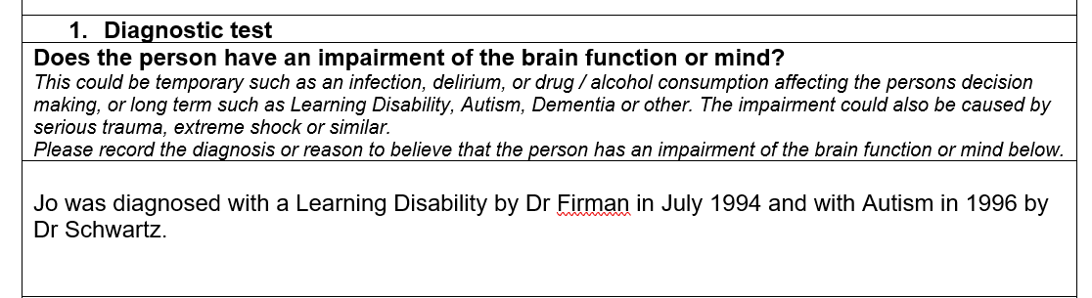
We must consider the person to be lacking capacity as a result of the impairment of the brain function or mind. Each aspect of the capacity assessment relates to the diagnosis:
Is a person unable to understand parts of the decision to be made because of this impairment of the brain function or mind?
Is the person unable to retain information as a result of this impairment of the brain function or mind? etc

Slide 9
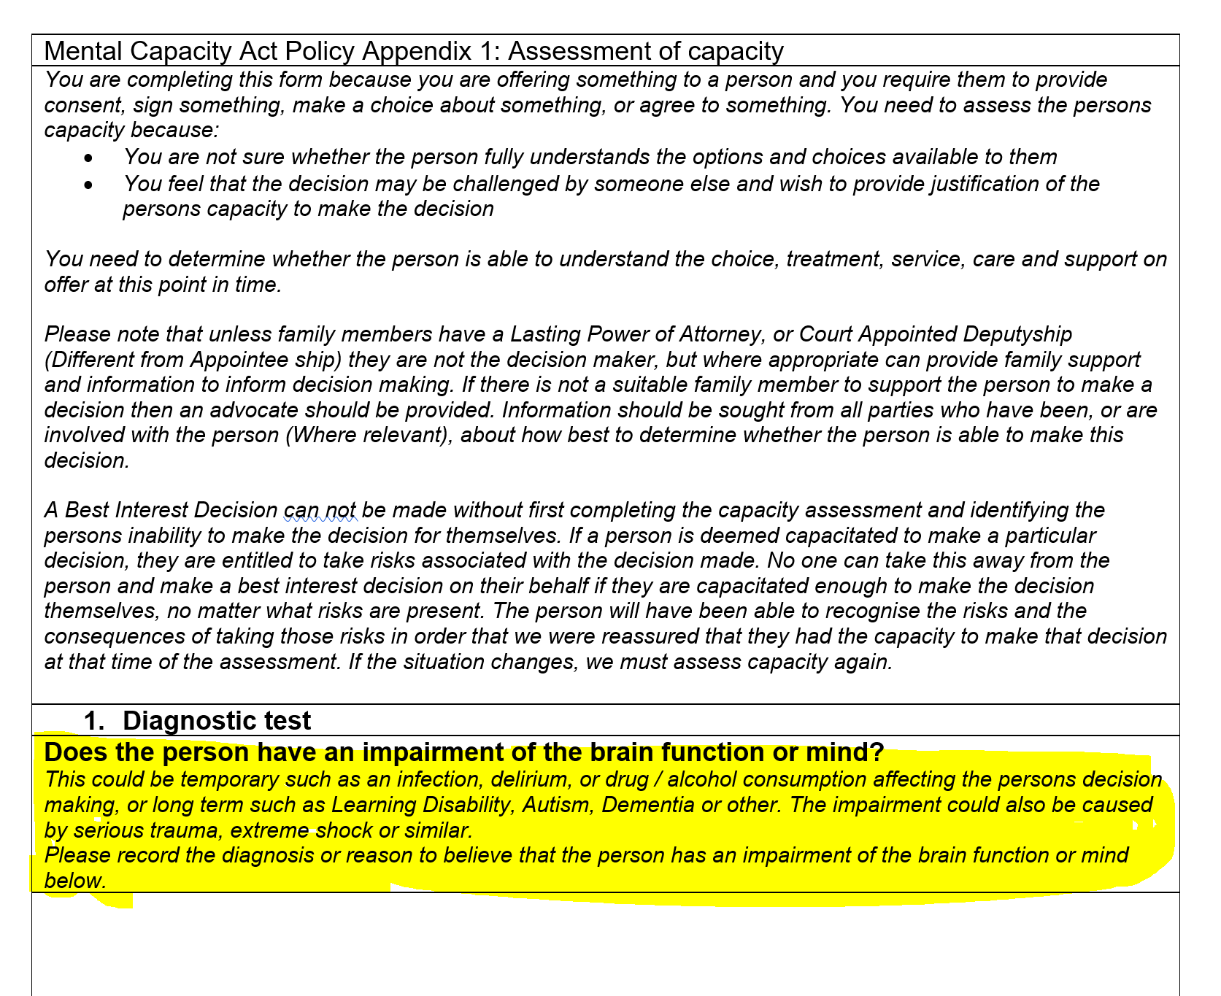
The diagnostic element of the test: How the functional element of the test relates.
Belle is quite a character and at the age of 87 nothing has changed. All her life Belle has been considered eccentric and to have a great sense of humour. Family tell us that she has always wandered off topic when talking. They laugh about how one conversation can last weeks as out of the blue she will return to the conversation days later adding to her story. Belle now has dementia and needs to make some important decisions about her place of residence. The Social Worker needs to consider whether Belle can retain the information. Each of the four boxes in the functional element of the capacity assessment must be as a result of the impairment of the brain function or mind. If the worker can not link the reason for straying from topic to Belles dementia what happens?

Slide 10
Consent to Treatment
To ensure that I knew I had consent for testing I would ………….I would want to hear…………… I would want to know
What the virus is
What the test is for
How the test is conducted
What happens if the test is positive
What happens if the test is negative
Having the test means
Not having the test means
Consider which aspects of this discussion is about understanding the virus and the testing process
Consider which aspects of this assessment is about weighing up the pro’s cons. And consequences of having or not having the test.

Slide 12
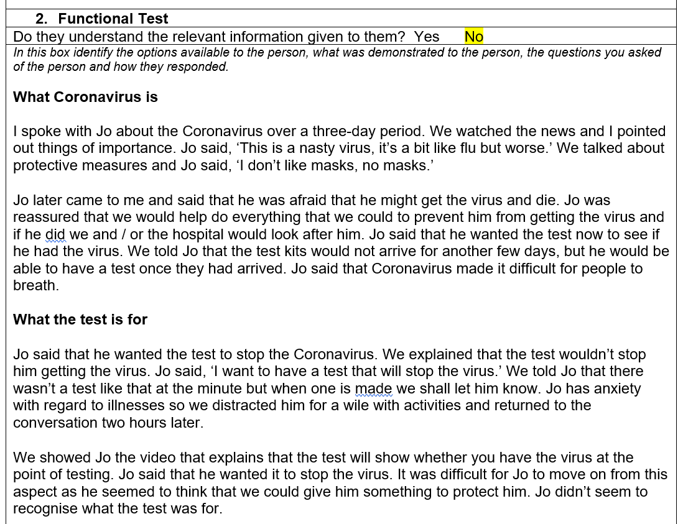
The functional part of the assessment

Slide 13
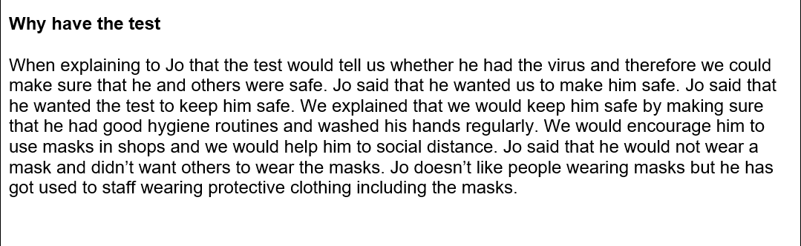
The functional part of the assessment

Slide 14
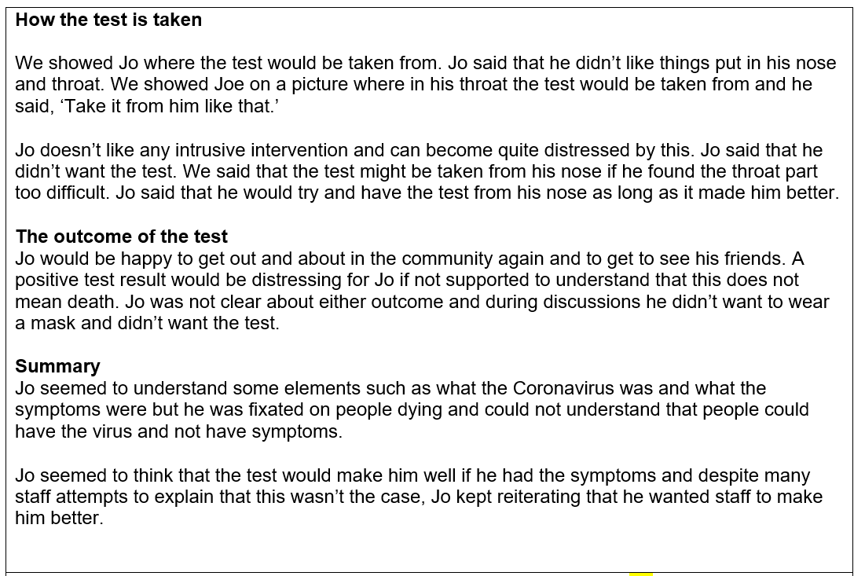

Slide 15
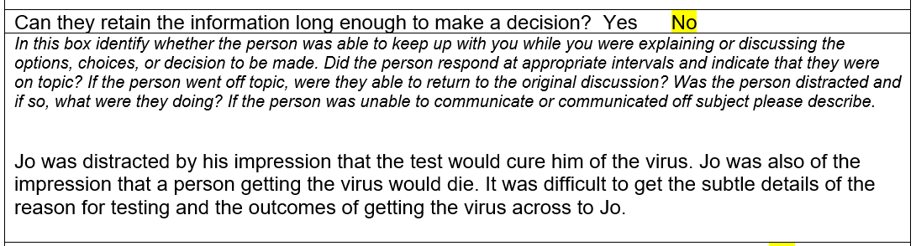
This does not mean RECALL it is retain so you do not have to test whether the person can hang on to the information for a certain length of time. They just need to demonstrate that they can keep up with you during the conversation, that they would not get distracted by other things, or go off on a tangent about something else.

Slide 16
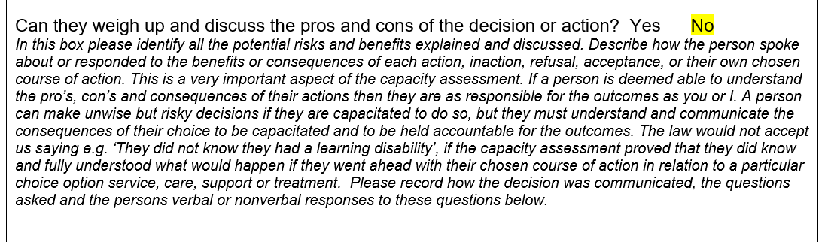
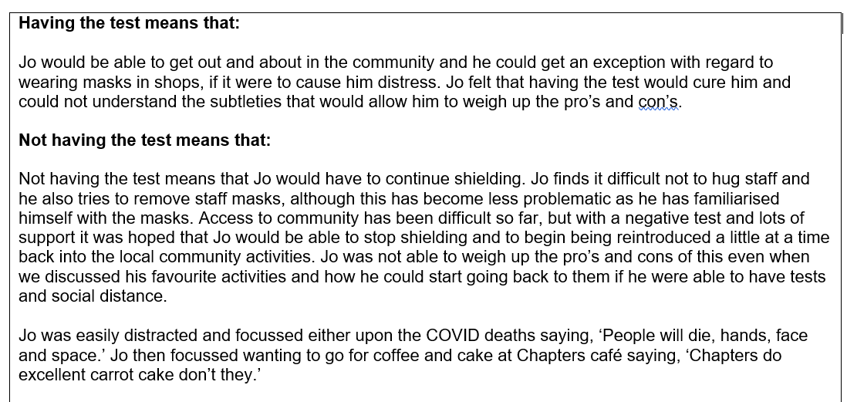

Slide 17
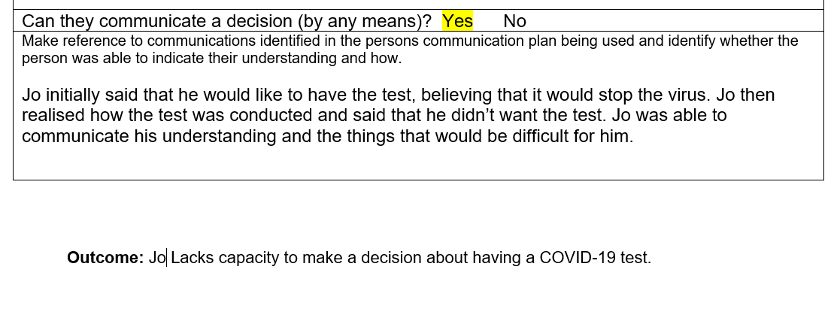
This box means can they tell you by any means about COVID, why the test is important how the test is taken, demonstrate that they recognise the pro’s and con’s of having or not having the test.

Slide 18
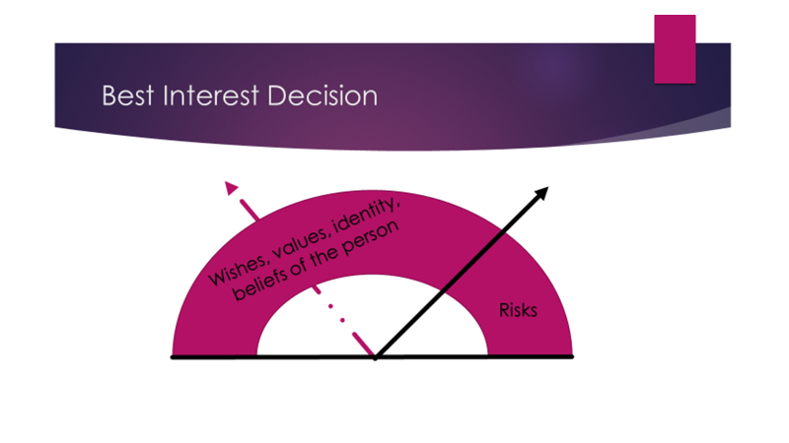
Planning your best interest decision if the person is assessed as lacking capacity to make the decision about having a test
How is this affecting the person, their mental and physical wellbeing (Restrictions), and how would the person respond to the test?
Past knowledge
What are the risks for this person in this area? What are the Government rules?
How would we keep others safe and what does that mean for the person?
What are the least restrictive interventions considering the risks

Slide 19
It is a good idea to demonstrate our consideration of a persons wellbeing in our best interest decision. So in relation to the question in hand how did we consider and demonstrate the following:
The Care Act 2014: Care and support statutory guidance
1.5 ‘Wellbeing’ is a broad concept, and it is described as relating to the following areas in particular:
personal dignity (including treatment of the individual with respect)
physical and mental health and emotional wellbeing
protection from abuse and neglect
control by the individual over day-to-day life (including over care and support provided and the way it is provided)
participation in work, education, training or recreation
social and economic wellbeing
domestic, family and personal
suitability of living accommodation
the individual’s contribution to society

Slide 20
Lets explore the best interest decision and then consider key points
Each outcome will be different
We can not have the same recording in capacity assessments and best interest decisions they MUST be specific to the individual. If not this will be heavily criticised by CQC – no cutting and pasting
You will need to ensure that you are clear about the local restrictions and guidance in place and what this means for the people that you support before you begin the capacity assessment and best interest decision.
You will need to ensure that you have demonstrated that you have tried to communicate this to the person in the best way possible
The assessment is only valid at that point in time. If something changes for example the lockdown situation you may need to revisit the assessment and best interest process.

Slide 21

Human Rights is foundation legislation
We must always balance decision making with Human Rights. We can not violate a persons Human Rights who does not understand enough to make an informed choice.

