Slide 1

National & Local update on Adult Social Care
Jane Wood, Assistant Director – Commissioning & Integration

Slide 2
Outline
Pandemic & recovery
Health & Social Care Bill
Future funding of ASC – Queens Speech ….
Bradford Council Department of Health and Wellbeing plans

Slide 3

Pandemic & Recovery
Where have we been and where are we now?
Covid support team switching to recovery focus
Care Home sector sustainability challenges
CQC changes & contract and quality team planning to resume site visits
Consultation on vaccinations for care staff
Consultation on ongoing financial pressures of the IPC measures
Commissioning intentions – work resuming

Slide 4

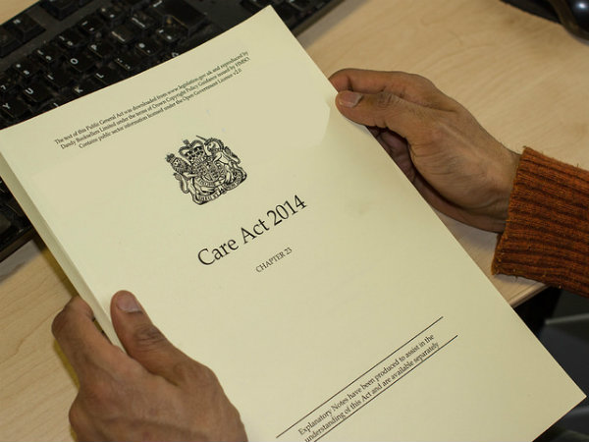

Health & Social Care White Paper
Themes: working together and supporting integration; stripping out needless bureaucracy; enhancing public confidence and accountability; and additional proposals to support public health, social care, and quality and safety.
Integrated Care System & abolition of CCGs
Adult Social Care inspection – CQC & focus on commissioning and data collection

Slide 5
Bradford District & Craven Integrated Care Partnership (ICP)
May 2021

Slide 6
WY&H ICS Operating Model
We have developed a partnership model of working based on subsidiarity, distributed leadership and mutual accountability rather than hierarchy.
We are a partnership of places, provider collaboratives and system. The ICS is the larger circle within the diagram: ‘the ICS is the system’.
We will work in a networked model as a ‘team of teams’ across place and WY&H.
The NHS ICS body will employ staff working for the ICS core team plus staff working at place level under ‘Integrated Care Partnership’ (ICP) arrangements
NHS E – NHS I
ICP
provider
collaboratives
ICP
ICP
ICS core team
ICP
ICP

Slide 7

Our proposed ICP operating model
BTHFT
CBMDC
NYCC/CDC
BDCFT
Population Health Delivery Unit
ICS NHS Body
Enabling strategies
Inequalities Academy
BCA
(care providers)
ICP Board
(joint committee)
PCNs
Quality& Performance
Collaborative Commissioning
ANHSFT
Governance and Assurance
Insight and Intelligence
Data &
Communities
VCS (Assembly)
Strategy and planning
Happy, healthy at home in Bradford district and Craven

Slide 8
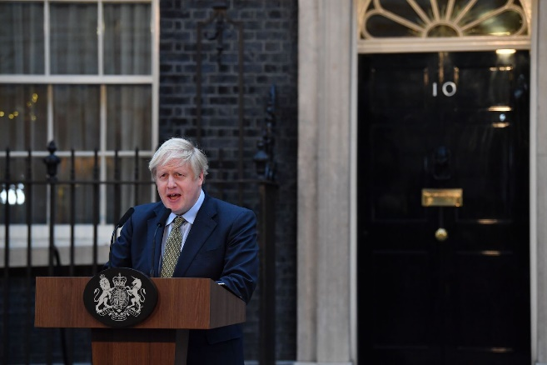
Future funding of ASC – Queens Speech ….
The government is expected to reiterate its longstanding pledge to reform how adult social care in England is funded.
But…Boris Johnson has not said whether a commitment to a new bill on funding will be included in this year's speech.
Reports suggest that discussions are ongoing within government about the potential cost of changes, which could run into the billions.

Slide 9
Bradford Council Department of Health and Wellbeing plans
Expansion of commissioning & contracts and quality team
Sustainable funding for the BCA
Commissioning Intentions

Slide 10
Personalisation Development Manager
Service Manager - Contracts and Quality
Senior Contract and Quality Manager x2
Strategic Joint Commissioners x4
Service Manager - Commissioning
Assistant Director – Commissioning & Integration
Commissioning Managers x7
Commissioning Officers x3
Support Options Team Manager
Support Options Team Leader x2
Contract and Quality Manager x7
Contract and Quality Officers x17
SO and DP Officers
Contract Support Officer x2
Support & Integration Manager
Senior Knowledge Manager
Engagement and Co-production Manager
Admin Coordinator
Knowledge Support Officer
CTS Development Officer
Project Officer x2
Engagement and Co-production Support Officer
Admin Support x4

