Slide 1

Understanding and addressing vaccine hesitancy
Nicky Knowles, Senior Public Health Specialist/Trainee Health Psychologist
Notes:
Introductions – role within PH/trainee health psych
Context of work in COVID – understanding behaviours and how they can be changed to prevent spread

Slide 2


Aims of the session
Understand factors that influence vaccine uptake
Consider skills that can support conversations about the vaccine
Notes:
Acknowledge current context – mandated vaccine for care home staff
Some people wont change their mind – those who are more ambivalent may do so
2

Slide 3
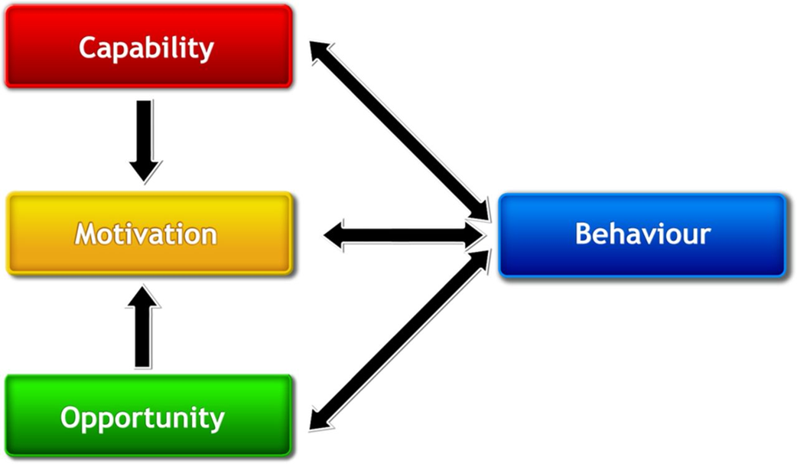
Understanding vaccine uptake from a behavioural perspective
Notes:
How can we understand vaccine uptake?
The COM B model recognises that for any behaviour to be enacted people must have the capability, the opportunity and they must be more motivated to that behaviour than anything else
Changing behaviour can therefore be thought of as a combination lock – all elements need to be in place – if just one of them isnt then the desired change wont occur.
Capability refers to psychological and physical abilities
Opportunity refers to the environment with which people interact – physical (events, time, place) or social (culture and norms)
Motivation refers to intentions and evaluations (conscious thinking) and desires, emotions and habits (automatic processes)
As the diagram shows, they all influence each other.

Slide 4
Exploring influences on behaviour
Capability
Physical capability: physical skills, strength or stamina
Psychological capability: knowledge, psychological skills
Opportunity
Physical opportunity: Time, resources afforded by the environment
Social opportunity time: Social norms, social cues
Motivation
Reflective motivation: reflective processes such as making plans, setting goals, weighing up the pro’s and cons
Automatic motivation: Automatic processes involving emotions, habit
Notes:
Capability: understanding how and why to make the change
Opportunity: having the financial and material resources, having sufficient time, exposure to social prompts, supportive family/social network
Motivation: truly wanting or needing to engage in the behaviour, having habits and routines, and values and identity that embrace the behaviour

Slide 5
Capability factors relating to the vaccine
Knowing about why each dose of the vaccine is needed
Knowing when where and how to access the vaccine
Knowledge of vaccine safety
Ability to plan and make an appointment
Notes:
Worksheet and hand-out with prompt questions
5

Slide 6
Opportunity factors relating to the vaccine
Having support and encouragement from others to get the vaccine
Access to local vaccination centres that are easy to get to/have flexible appointments
Social and cultural norms for vaccination
Encouragement from credible sources
Notes:
Worksheet and hand-out with prompt questions
6

Slide 7
Motivation factors relating to the vaccine
Believing that the vaccine will lead to positive outcomes
Belief that the value outweighs concerns about side effects
Overcoming negative emotions related to getting the vaccine (e.g fear)
Holding strong intentions to get the vaccine when offered
Past experience of having the vaccine
Notes:
Worksheet and hand-out with prompt questions
7

Slide 8
Concerns about vaccine uptake in care home staff
Concerns about the lack of vaccine research
Concerns that the vaccine might affect future fertility (women)
Concerns about having the vaccine when pregnant
Staff been off site during vaccination sessions
Concerns that there has not been enough testing of the vaccine to ensure its safety
Concerns about potential (unknown) long term side effects of vaccination
Concerns about rare side effects (e.g. blood clots)
Concerns about allergic reactions
Loss of free will
https://www.medrxiv.org/content/10.1101/2021.03.07.21252972v1

Slide 9
6 principles to optimise uptake
Understanding
Safety of the vaccine; benefits of the vaccine to protect personal health and that of others; side effects; need to maintain disease prevention behaviours; need for second dose.
Personalise for the Population
Messages that meet the needs of individuals/target populations: appropriate media, tailored messages, appropriate language and literacy level, personal relevance, co-designed with target populations.
Trust
Messages should state facts and dispel misinformation. Trusted messengers and channels should be used for the relevant communities.
Addressing barriers to Access
Address identified barriers i.e. make vaccinations easy to access for all.
Keep it brief
Use short clear messages that avoid scientific and vaccine-related jargon so that messages can be remembered and understood.
Evidence for Effectiveness
Provide evidence for effectiveness of the vaccine for individuals, loved ones and society as a whole.
Notes:
Need to help people understand
Personalise the message for the target audience

Slide 10
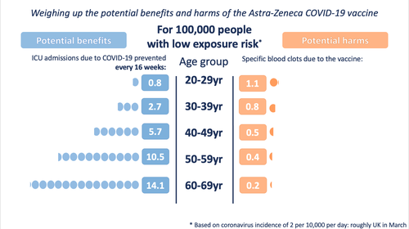
Weighing up benefits versus harm
Notes:
https://wintoncentre.maths.cam.ac.uk/news/communicating-potential-benefits-and-harms-astra-zeneca-covid-19-vaccine/

Slide 11
Having conversations with staff about the vaccine

Slide 12
Making Every Contact Count (MECC)
MECC is about prevention
MECC is about brief conversations
MECC uses existing interactions
MECC is for everyone
MECC is for you – you can make a huge difference
https://www.meccgateway.co.uk/nenc/services/COVID-19

Slide 13
“Motivational interviewing is a collaborative conversation style for strengthening a person’s own motivation and commitment to change”

Slide 14
Key principles of Motivational Interviewing
Partnership
Acceptance
Compassion
Evocation
Notes:
Partnership: Not done ‘to’, but ‘with’ and ‘for’ a person. An active collaboration between experts -honours and activates the client’s expertise and resources. You are there to hear and understand their story. You are not there to give the answers.
Acceptance: Honour the person’s absolute worth and potential as a human being, recognise and support the person’s irrevocable autonomy to choose his own way, seek though accurate empathy to understand the other’s perspective and affirm the person’s strengths and efforts
Compassion: Deliberate commitment to pursue the welfare and best interests of the other
Evocation: “You have what you need and together we will find it”. Therefore important to probe for their wisdom, internal arguments, strengths and resources

Slide 15
Core Skills (OARS)
Open questions
Affirmation
Reflections
Summaries
Providing information and advice with permission

Slide 16
Open questions What do you already know about the vaccine?
An open question is like an open door; you cant answer with yes or no
Open questions invite reflection and elaboration
Use open questions to explore what they already know about the vaccine and how they feel about it

Slide 17
Affirmations I really appreciate you been honest about your feelings…
To affirm is to recognise, support, and encourage the clients’ strengths and efforts
Be authentic – it isn’t praise (telling someone they’ve done well)
Use affirmations to demonstrate you have heard the person, to build respect empathy. Validate their views and support self-efficacy. Spotlight positive feelings towards vaccination.

Slide 18
Reflection It sounds like you have some concerns about the safety of the vaccine…
Reflections involve repeating back what the person has said or slightly adding to/amending what they have said
It’s not a question, but allows you to check with the person what you’re hearing
Use reflections to show you are listening and to check your understanding of what they are saying about the vaccine

Slide 19
Summaries Thank you that’s been really helpful….
Summarising what's been said and the outcome of the conversation
It supports reflection and enables agreement on what happens next
Summary needs to be tailored to the persons current intentions about the vaccine i.e.
Notes:
Person is ready to make an appointment
Still unsure: Time to think, offer info, arrange to speak again
Person refuses: Reinforce autonomy and offer information. Encourage them to reconsider and book a call with their GP / signpost to educational resource

Slide 20
The righting reflex
The temptation with someone who is ambivalent is to persuade, encourage and advise
Good intentions
Desire to stop someone going down wrong path
BUT it has a paradoxical effect
Something in human nature resists being told what to do (Reactance theory)
A person arguing for change forces the client to voice the other side: “why I shouldn’t change”
The Righting Reflex is even stronger when in a professional role
https://www.stephenrollnick.com/about-motivational-interviewing/

Slide 21
Conversations can be tricky…
Resist
Resist the righting reflex
Elicit
Elicit their understanding of/views towards the vaccine and their intention
Listen
Listen with empathy
Ask
Ask for permission to provide further information about the vaccine

Slide 23
Tips on countering conspiracy theories and misinformation
Assess how willing they are to listen
Go private
Don’t attack
Ask questions
Ask for their sources of information
State what is true, don’t just reject their belief
Don’t overwhelm them with information

Slide 24
Summary
Its important to try and understand the reasons why people are unsure/don’t want to have the vaccine
Motivational interviewing skills can support helpful conversations about the vaccine - use open questions, listen, and use reflection to check understanding
Seek permission to provide further information on the vaccine
Work together rather than against
Provide opportunities for people to ask questions/seek further information
Make it as easy as possible for people to have the vaccine
Notes:
Examples for NYCC:
FAQs
Myth busting
Signposting to evidence/research/data
Panels with experts to address concerns about vaccine
Vaccination clinics in care homes

Slide 25
Resources
https://wintoncentre.maths.cam.ac.uk/news/communicating-potential-benefits-and-harms-astra-zeneca-covid-19-vaccine/
https://www.bps.org.uk/sites/www.bps.org.uk/files/Policy/Policy%20-%20Files/Optimising%20vaccine%20uptake.pdf
https://www.meccgateway.co.uk/nenc/services/COVID-19
https://www.yhphnetwork.co.uk/links-and-resources/
https://hackmd.io/@scibehC19vax/misinfo_myths
https://hackmd.io/@scibehC19vax/home
https://www.bmj.com/content/372/bmj.n509
https://www.rcog.org.uk/en/guidelines-research-services/coronavirus-covid-19-pregnancy-and-womens-health/covid-19-vaccines-and-pregnancy/covid-19-vaccines-pregnancy-and-breastfeeding/
Notes:
25

