Slide 1
Learning from Events
October 2020
Notes:
Skills for Care was commissioned to develop a new, digital module, called ‘Learning from Events. It supports managers in social care carry out ‘learning reviews’.
We have worked in partnership with:
Digital learning developers
The Behavioural Insights Team
A care provider – WCS
And, of course, the QNI.
As well as having discussions and seeking guidance from The Chartered Institute of Human and Ergonomic Factors and the Health Safety Inspection Board.

Slide 2
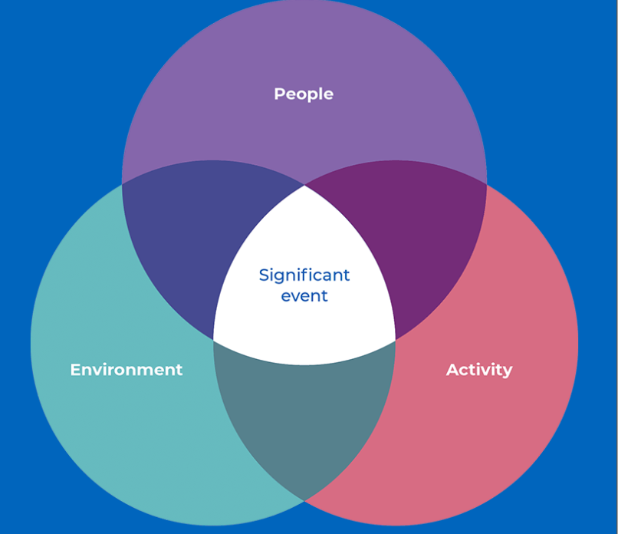
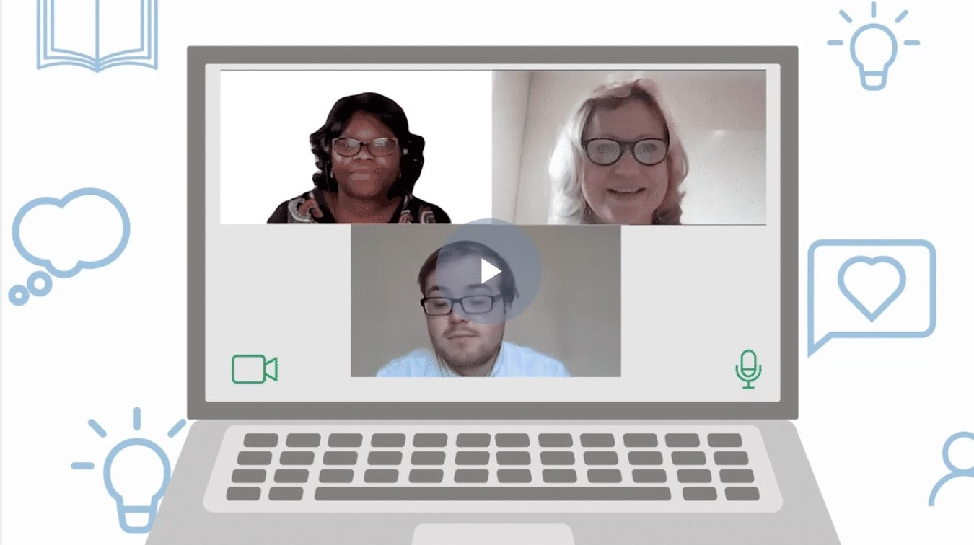
Learning from Events
What is it?
Who is it for?
A short digital module to support you to run learning reviews.
Managers and leaders in all adult care settings.
What does it cover?
How do I sign up?
This 35 minute module will address:
What learning reviews are and why they’re needed
How managers can move from completing reviews at an individual level to involving the wider team
Supporting managers and leaders develop the skills and confidence to carry reviews out effectively within care settings
Practical tips for embedding learning reviews into the working environment
Spread the word and sign up from 26th October 2020 at this link www.skillsforcare.org.uk/LearningFromEvents
Access £100 Workforce Development Funding.
Notes:
So… what is a ‘learning review’?
Learning reviews are an opportunity to bring together representatives of a full team to explore an adverse event or near miss.
The approach has already been in use for a long time in healthcare settings and a number of different frameworks exist.
Learning reviews take a holistic view of events, from everyone's perspective.
The outcome is an action plan identifying improvements which can be made at a systemic and organisation-wide level.
Crucially: Outcomes should be positive, with individuals and teams feeling supported and enabled by the proposed changes which improve quality and safety of care.
Specifically the module will address:
What learning reviews are and why they’re needed
How managers can move from completing reviews at an individual level to involving the wider team
Support managers and leaders develop the skills and confidence to carry reviews out effectively within care settings
Practical tips for embedding learning reviews into the working environment
The module will be available from 26th October and accessed through Skills for Care’s new virtual learning environment.
Skills for Care are also pleased to confirm that Workforce Development Funding has been attached to the digital module. Organisations will be able to claim £100 upon completion of the module.
Who is the module for?
The module was originally commissioned for care home managers to support them if they had any COVID-19 outbreaks or incidents.
However, the content has been developed to support managers apply their learning to any sort of incident or near miss that needs exploration, learning from, and action to mitigate in the future. And can be easily applied to any social care setting.
It is very suitable for nurses working within social care to support them to lead these discussions, even if you are not in a management position.
Winter Plan
If you’ve had the opportunity to review the governments Winter Plan, you might have spotted that learning reviews are referred to a couple of times within it.
It talks about undertaking learning reviews after any covid outbreak, as well as enabling staff to access online learning to undertake these reviews.
It’s interactive
The module is interactive. Through it, we explore 2 case studies – one in written form, and one through videos. There are activities throughout to help you consolidate your learning.
It will take learners around 35 minutes to work through, and has further reading signposted at the end.

Slide 3
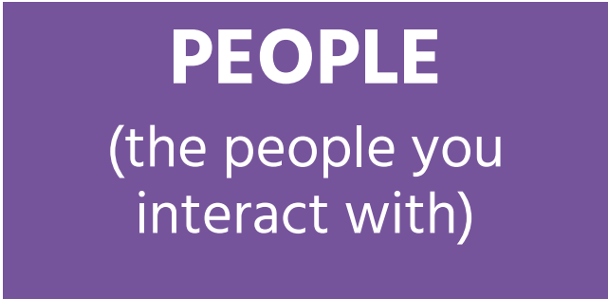
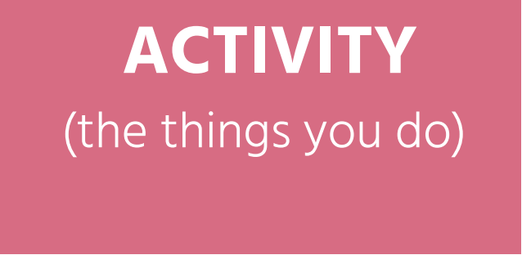
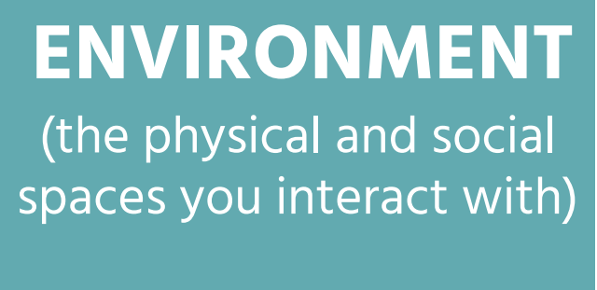
Learning from Events
Use the PAcE model to identify contributing factors and overlaps between the factors that contribute to an incident or near miss.
Notes:
What is PAcE?
‘PAcE’ is a crucial part of the module. It supports a holistic discussion, guiding participants in the learning review to consider the People, Activity and Environmental factors that contributed to the incident or near miss. Importantly, it then encourages discussion about the interactions between these factors, and leads on to discussions about the actions that are needed for the future.
Examples:
A medication error. The usual response might be that the worker made a mistake and therefore need to undertake further training. The PAcE model would dig further in to this. Considering the factors and the interactions, it might be concluded that the event was caused by the interaction:
People:
Senior care worker who is feeling tired and stressed.
Junior member of staff who interrupted the worker on their rounds.
Activity:
Carrying out medication rounds.
Other simultaneous activity carried out by the junior worker.
Environment:
Busy, noisy room.
You can see how this, when considered holistically, contributed to the incident. No one is to blame, but the interactions between the different factors led to this medication error.
Trip hazard. A family member takes a resident for a walk and the resident trips on a broken step. Staff never use these steps because they know they are broken and present a hazard, but the family member wasn’t aware. People: Resident and family member who were all unaware of the hazrd, staff who were aware of the hazard and avoided it. Activity: Family member, unaware of hazard, taking resident for a walk. Environment: Broken step. All these factors contributed to the significant event.

Slide 4
Learning from Events
This module is interactive and uses relevant case studies.
Notes:
The module is interactive. Through it, we explore 2 case studies – one in written form, and one through videos.
It will take learners around 35 minutes to work through, and has further reading signposted at the end.

Slide 5
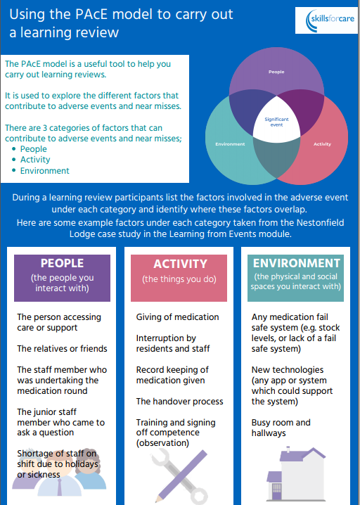
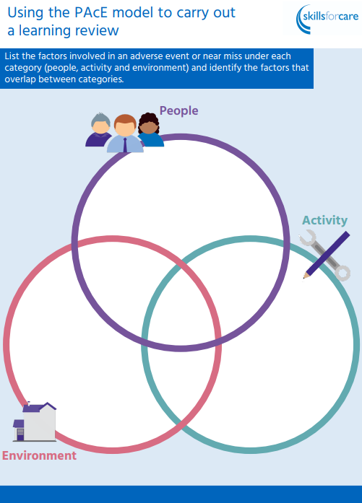
Learning from Events
You will get access to job aids that you can download and print to support you in conducting learning reviews.
Notes:
Learners will have access to 2 job aids to support them in completing learning reviews. These can be downloaded and printed at the end of the module.

Slide 6





Learning from Events
What’s next?
Course available from 26th October 2020
Sign up and complete the course!
Share your experiences #LearningFromEvents
Tell others about the course
Don’t forget to claim your £100 Workforce Development Funding
Notes:
External audiences:
Sign up and complete the course.
And try a learning review!
We’d love to hear how you’re getting on, so tell us! Use Twitter/etc
Don’t keep it to yourselves, please let others know about the course.
WDF is available as a contribution to the learners time committed to the learning – whilst completing the module and doing to follow-on reading.
WDF claims are subject to the usual eligibility criteria and claimed in the same way other courses are claimed.
Internal audiences:
Share the message far and wide! DHSC are keen for every RM to complete this course!!!
We have a communications plan running from October through to January.
Please use the text and key messages that are within the comms plan for consistency.
And please let us know who you’ll be sharing this with! We’d love to keep an eye on who’s hearing about it.
WDF is available as a contribution to the learners time committed to the learning – whilst completing the module and doing to follow-on reading.
WDF claims are subject to the usual eligibility criteria and claimed in the same way other courses are claimed.

